Slide 1
Scouting Family Forum Simon Kenton Council
Session 8 | December 13, 2022

Slide 2
Welcome & Introductions

Slide 3
Welcome and Introductions
Family Forum Purpose:
To keep SKC leaders well informed, engaged, and up-to-date on news across the Council while offering an open forum for discussion, feedback and questions

Slide 4
Meeting opening
Pledge of Allegiance
Scout Oath
On my honor I will do my best to do my duty to God and my country and to obey the Scout Law; to help other people at all times; to keep myself physically strong, mentally awake, and morally straight.
Scout Law
A Scout is:
Trustworthy, Loyal,
Helpful, Friendly,
Courteous, Kind,
Obedient, Cheerful,
Thrifty, Brave,
Clean, and Reverent.

Slide 5
Agenda
Council News and Highlights – Jay Jacobsmeyer
National Bankruptcy Update– Jay Jacobsmeyer
Properties Update – Todd Boyer
Day of Giving – Rich Maskiell
Membership Successes – Ken Heintz
Charter Renewal and UMC Updates – Chris Sherman
Scout Executive Update – Jeff Moe
Q&A – All

Slide 6
Council News and Highlights Jay Jacobsmeyer

Slide 7
Council News and Highlights
2022 was a year of both challenges and opportunities in Scouting.
Bankruptcy
Health and Safety
The Court of Public Opinion
Great momentum in many areas of the council, including membership, camps, events and training, and more
Greater growth month to month over 2021
Over 1,600 new Scouts
Grateful for leadership by so many to help our council succeed

Slide 8
National Bankruptcy Update Jay Jacobsmeyer

Slide 9
Properties Update Todd Boyer

Slide 10
Properties Update
Property Sale Update
CLR and Madison Lake are listed for sale.
The south 60-acre side of Camp Lazarus is still on hold until we move forward with the other properties.
Property Overview – CFR Improvements
Water supply on lower camp
Lower lake shelter to be replaced
Updated and improved amphitheater
35 New canvas tents
Communications infrastructure improvements
Six new, individual bathroom at the dining hall

Slide 11
Day of Giving Rich Maskiell

Slide 12
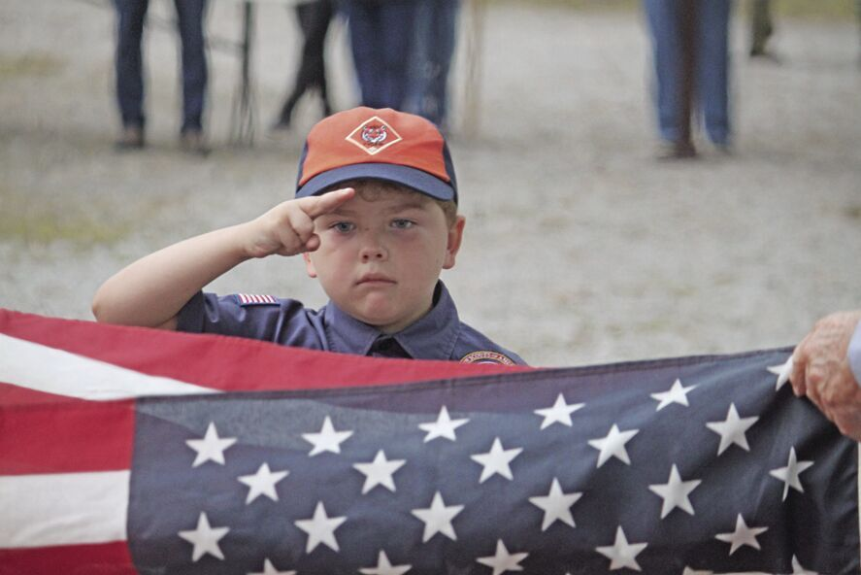
2023 Day of Giving
Save the Date – Day of Giving
Tuesday, March 7, 2023
Goal – Support 1,000 Scouts
Raise $175,000 for Scouting
Day of Giving – Unit Coordinator Training
January 18, 2023 at 7:00 p.m. (Zoom)
Unit Incentives:
Reach Assigned Unit Day of Giving Goal by March 31, 2023
Free Cloth Rank Advancement
Free Weekend of Tent Camping

Slide 13
Membership Successes Ken Heintz

Slide 14
2022 Membership Recruitment
Membership Kickoff & Training Conducted – July 25, 2022
Also, at August District Roundtables (200+ attended)
Council Membership Highlights
Over 1,600 Scouts registered this fall (200+ over 2021)
Exploring Program has grown by 63% in 2022
District Membership Highlights
Frontier achieved total membership growth of 2.3% and grew Cub Scouts by 6.6%
Daybreak achieved 4.7% growth in Cub Scouts and is only 10 youth away from year end growth
Gateway achieved 1.3% growth in Cub Scouts and is 80 youth away from year end growth
Polaris has recruited 476 new youth, the most of any district in the SKC

Slide 15
2022 Membership Recruitment

Slide 16
2023 Membership Recruitment
Year-Round Membership Recruiting
Every meeting is an opportunity for a youth to join Scouting!
Spring & Fall Campaigns
Membership Kickoff & Training
May 2023
Leadership
Council & District Membership Chair positions filled
Building Committees
Innovation
Share your recruiting ideas and success stories! We need them to grow in 2023!

Slide 17
Membership and Charter Renewal Chris Sherman

Slide 18
2023 Membership and Charter Renewal
Membership/Charter Renewal Progress
United Methodist Church-chartered Units
Progress update
Resources available for units needing assistance
Youth Protection Training Update
Concerns with expiring YPT during unit’s charter year
Puts units, youth, chartered orgs and BSA at risk
Changes coming regarding registration status leaders with expired YPT
Process and procedures to be finalized, change to take place sometime in 2023

Slide 19
Scout Executive Update Jeff Moe

Slide 20
Questions & Answers

