Slide 1
Simon Kenton Council Membership Kickoff and Training Adventure For All!
Notes:
MAKE A NOTE ABOUT – SCOUTS BSA UNITS RECRUIT IN THE SPRING
SCOUTS BSA HELP WITH CUB RECRUITMENT – THOSE CUB SCOUTS ARE YOUR FUTURE SCOUTS

Slide 2
2023 Fall Recruitment
The goal is to conduct a stand alone recruiment by prepared packs at every elementary school within the boundaries of the Simon Kenton Council.
*Give every youth the chance to experience Scouting*
Timeline = Now – Year End
Execute best practices
Learn the plan.
Get the word out.
Grow your unit and have fun!

Slide 3
Planning & Preparation
Recruit a Membership Coordinator & Committee
Update your Beascout.org pin
Set a Goal
School Scheduling
Set a date during the 2nd or 3rd week of the school year
Back to School Night
Have a table/display at back-to-school nights
Flyer Request
https://tinyurl.com/Flyer-Scout-Talk-Request-Form
School Talk
Set the talk a day or two before the sign up & coordinate with your DE

Slide 4
Promotion – Best Practices
Units should consider doing multiple methods, there isn’t one method that is a "silver bullet" way of recruiting.
We challenge you to do 7 or more methods of promotion.
Flyers
School Talks
School Announcements
Posters
Postcards
Yard Signs
Stickers
Uniform Days (align on A or B)
Service Projects
Community Events
Social Media
Door Hangers
Churches/Youth Centers
Billboards
Banners
Bookmarks
Peer to Peer
https://scoutingwire.org/marketing-and-membership-hub/

Slide 5
Glider Incentive
Each new Scout that signs up will receive a Glider
Gliders will be distributed based on paid membership
Packs are encouraged to distribute and utilize the gliders at their parent orientation meeting following their sign up
STEM - Cub Scout Activity & Awards
Purchasing additional Gliders:
Store Options: (pick up only)
Call the store 614-481-4270
Email the Store at: SimonKentonScoutShop@scouting.org
Online: www.scoutshop.org
Notes:
This will impact both Scouts BSA and Packs

Slide 7
Social Media
The Power of Personal testimonials & invitations

Slide 8
Geofencing
A personal invitation to parents directly through Facebook
WHAT IS GEOFENCING?
You can work with the SKC to set up a Facebook event & Geofence for your sign-up nights.
SKC supported Geofencing will be selected based on the recruitment’s adherence to the SKC plan and effectiveness.
Your unit can utilize geofencing for all of your recruitments and events. Vist the BSA Brand Center for a step by step guide.

Slide 9
Peer to Peer – Invite a Friend
Every Scout and their family is a recruitment tool to promote Scouting.
Challenge every family to think of at least one other family.
Parents should invite their child’s friend's parents to the sign-up night or to the next meeting.

Slide 10
Peer to Peer – Invite a Friend
Invite Cards
These cards can be created by the pack for parents to hand out to other families. Card templates can be found on the BSA Brand Center by visiting:
https://scoutingwire.org/marketing-and-membership-hub/
Include details like date and location of pack/den meetings and pack/den leadership contact information
Have each leader/family carry and hand out cards at school and community functions
Have each Scout share these cards with their friends.

Slide 11
Invite Cards

Slide 12
School Sign Up Night
They came to join – SIGN THEM UP!
Four Station Sign Up
Station 1 – Welcome/Sign In
Station 2 – What We Do (Calendar/Contacts/Books/Pictures)
Station 3 – SIGN UP utilizing electronic application (paper backup)
Station 4 – Check Out & Q&A with Leadership (sign off on apps)

Slide 13
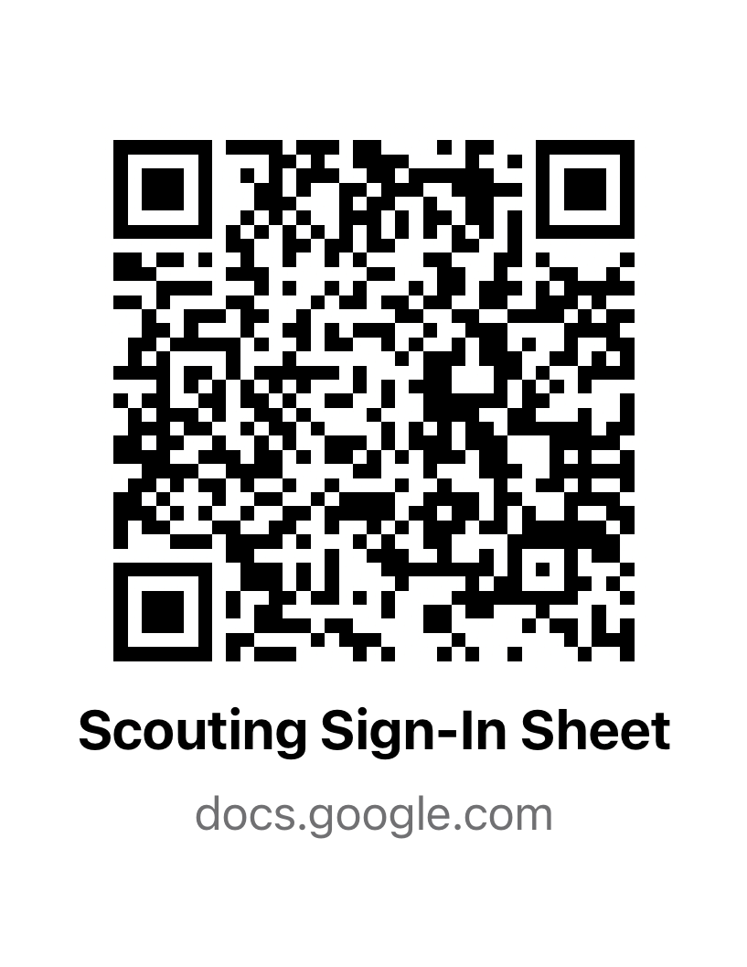
SIGN IN QR CODE

Slide 14
Following School Sign-Ups
Approve any online applications submitted (via my.scouting.org)
Make sure every family receives a welcome phone call
Review your performance vs. last year (DE will provide this data)
Identify if an additional sign-up night(s)
Set up sign up night(s), request flyers, and utilize promotional materials
Review sign in info and follow up with families that didn’t sign up
DE will provide excel sign in sheet data)
Ensure packs onboard families at Unit Orientation
Tell your DE the date of your orientation
Participate in Council Fall Activities
Conduct a new youth popcorn kick off and new families are participating in the popcorn sale

Slide 15
THE MAIN THINGS
Schedule your sign-up night and request flyers
Attend back to school night at your school(s)
PROMOTE YOUR SIGN-UP NIGHT
7 different ways (minimum)
Every youth that attends should be signed up (that’s why they came)
Approve all applications the night of the sign up
Ensure new families know when the next meeting occurs and have their leader's contact info
Have an Orientation Meeting
GROW YOUR UNIT & HAVE FUN!

Slide 16
Fall Membership Recruitment
Questions & Answers
Ben Mahlke
630-277-1322
ben.mahlke@scouting.org

Slide 17
Sign-Up Night – Walkthrough

