Slide 1
PECATONICA RIVER POPCORN
2023 KICKOFF

Slide 2
Unit and Council Impact
SCOUTING VALUES
Scouts learn to earn their own way
Scouts learn responsibility
Scouts learn perseverance
Salesmanship
Communication
Self Confidence
Enhance Scouting programs
Provide needed equipment
Reduce program costs

Slide 3
2023 Simon Kenton Council Popcorn Calendar
Order, Distribution and Return Information:
Pecatonica River Online Store is Open: Tuesday, August 1 – Monday, November 20
Show & Sell Orders Due: Friday, August 18
Show & Sell Distribution: Wednesday, September 6 – Saturday, September 9
*Specifics vary by District
Show & Sell Sale Starts: Saturday, September 9
1st Swap Day: Saturday, September 23
2nd Swap Day: Saturday, October 7
3rd Swap Day: Saturday, October 21
Final Swap Day/Super Saturday/Last Day of Show-n-Sell: Saturday, October 28
*Final opportunity to return popcorn **no returns on chocolate products
Take-Orders Due:
Monday, October 30
Take Order Distribution:
Wednesday, November 15 – Saturday, November 18
*Specifics vary by District
Last Day to Place Prize Orders & Invoices Paid in Full: Friday, December 8
**The Simon Kenton Council will not be accepting returns of Chocolate Products. The list of chocolate products for 2023 includes Sea Salt Splash, Peanut Butter Cup, Chocolate Pretzels, and the Chocolate Lover’s Collection.

Slide 4
TBC • 2020

Slide 5
SALES MATERIALS
SALES FLYERS
TAKE-TO-WORK TENTS
TOTES
DOOR HANGERS
TASTING KITS

Slide 6
HOW TO SELL
SALES FLYER
Scout takes the flyer door to door to collect orders. Form has spaces for up to 30 names.
TAKE TO WORK TENTS
Setup a display of your popcorn at a high traffic area, such as place of employment. Easy way to increase your sale!
DOOR HANGERS
Best utilized for those customers requesting social distance or as a way to allow more time to make a decision. Leave the door hanger with customer and return to collect the order at a later date. One customer per hanger
SALES BANNER
Use to draw attention to your display or location

Slide 7
FAMOUS PR POPCORN TASTING KIT
(It’s Free!)
The purpose of a tasting session is to have each Scout try 1-2 kernels of each flavor. Let the Scouts vote on their favorites - have fun with it!
Boost your sales with a tasting session. Foster familiarity and product knowledge. Encourage the Scouts to share their tasting experience with potential buyers.

Slide 8
WHERE TO SELL
Show & Sell
Set up in high traffic area
Popcorn is ordered in advance on consignment from Council
Show & Deliver
Combine Show & Sell and Take Order
Popcorn is taken door to door & sold on the spot
Take Order
Traditional way of going door to door
Popcorn is delivered after the sale
Online Store
Customers can support all across the country
Each Scout gets credit for sales

Slide 9
Show & Sell
Unit Kernels order popcorn in advance (S&S orders due XXXXXXXX) to set up in a high traffic area. Scouts sell popcorn and hand it to customer at time of purchase.
Sample Show-and-Sell Script
Hello sir/ma’am. My name is _______________. (first name only) I’m a Scout with Pack/Troop _________ here in _________ (city). We’re selling popcorn to raise money to _________. By buying popcorn today, you’ll help me earn my way and do fun things with my Pack/Troop all year-long. This product is my favorite (point to a product on the table) Can you help us today?

Slide 10
Show & Deliver “Wagon Sales”
One of the most effective sales methods! In this case, a unit signs out popcorn to a Scout who takes it throughout their neighborhood, selling as he/she goes.
Product is brought along (in wagon or vehicle), making it a quick and easy process for the customer. So, it is like a mobile show & sell booth.
Units should order for this as part of their show & sell order or use product left over from your Show & Sell locations.
A large percentage of homeowners say that no Scout has ever come to their door, missing this great opportunity. If the desired product is not on hand, an order can be taken, and product delivered later.

Slide 11
Take Order
This method is where Scouts go to friends, family, and neighbors door-to-door to sell popcorn using an order sheet.
Parents can also help by taking the “take to work” order forms to work.
Later, at the end of the sale, the Scouts deliver the ordered products to the customers who ordered them.
TIP: Use leftover inventory from your Show & Sell to fill these orders.
Sample Take Order Script
Hi. My name is _______________. (first name only) I’m a Cub/Boy Scout with Pack/Troop ______. We’re raising money to. (trip, event, purchase, etc.) You can support us by buying some of our delicious popcorn. (hand customer Take Order form and a pen) Will you help me?

Slide 12
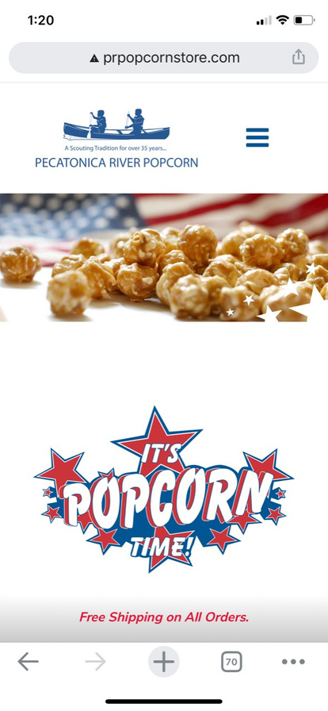
ONLINE STOREFRONT
PRPOPCORNSTORE.COM
60% of every purchase goes to the Scout's unit and Council in their name
FREE SHIPPING
No deliveries to worry about - all ships from PRP
ALL SALES COUNT TOWARDS PRIZE LEVELS
Personable email can be sent to family & friends with customized video message

Slide 13
Opens: August 1st
Closes: November 20th

Slide 14
TECHNICAL SUPPORT & SERVICES
KERNEL TRACKER TOOL
SCOUT BOSS
WEB BASED (NO APP STORE)
LINK AVAILABLE ON UNIT DASHBOARD
LIST SHOW-N-SELL LOCATIONS SHIFTS
MANAGE SIGN UPS FOR S&S SHIFTS
LIMIT SCOUTS
REMOVE SCOUTS
CLOSE LOCATION
VIEW HISTORICAL SALES
SIGN UP SCOUTS FOR ONILNE SALES
VIEW ONLINE SALES
ENTER SCOUTS INTO WINNERS CIRCLE
MYPRPOPCORN TOOL
SQUARE
ONLINE SELLING APP FOR SCOUT
SHARE VIA SOCIAL PLATFORMS
TRACK SALES PROGRESS
SIGN UP FOR SHOW-N-SELL SHIFTS
INCREASE SALES
ACCEPT CREDIT CARDS ANYWHERE
UPLOAD PRODUCT MIX FROM PR WEBSITE

Slide 15
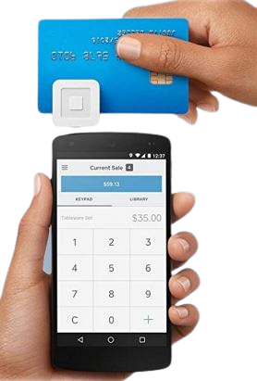
CARD READER
SQUARE
Accept credit cards anywhere! Square readers works with the free Square Point of Sale app to allow everyone to take payments on their smartphone or tablet. Increase your popcorn sales with the latest technology.
FREE
squareup.com/i/prpopcorn5
2.6% + $0.10 per swipe applies

Slide 16
CARD READER
SQUARE
Save time by uploading a file containing all products and pricing to your Square library. Images also available for upload.
Both files can be found by clicking the files link once logged into your unit’s account at www.prpopcorn.com.

Slide 17
CARD READER
SQUARE ACCOUNT SETUP
Just head to squareup.com to sign up for Square for FREE.
Type of merchant – Business
Business information - When applying for a merchant processing account you should use your Chartering Organizations (TIN).
Type of business – Charitable Organization
Enter personal information (including SSN) to verify that you are a real person, does not perform a credit check.

Slide 18
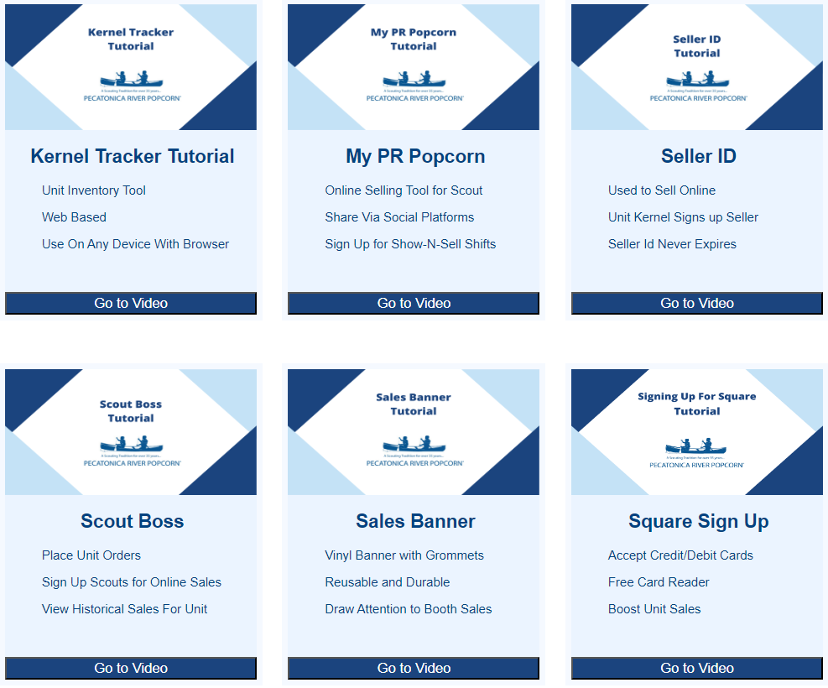
TUTORIALS
SALES TUTORIALS www.pecatonicariverpopcorn.com/Tutorials.html
Kernel Tracker
My PR Popcorn
Seller ID
Scout Boss (unit)
Sales Banner
Envelopes
Tote Bag
Tasting Kit
Sales Flyer
Take to Work Tent
Door Hanger

Slide 19
1099-K
“As of January 1, 2022, the IRS introduced new reporting requirements for payments received for goods and services, lowering the threshold to $600. Third party settlement organizations, such as PayPal and Venmo, will be required to provide customers with a 1099-K form if they receive $600 or more in goods and services transactions during the 2022 tax year. Charter Organization Units and Council Registered Units utilizing PayPal or Venmo should ensure they are using appropriate EINs and following all policies and procedures. Parents of/Groups of Citizens Units should consult their own tax advisors.”
BSA Unit Guide for Fiscal Policies & Procedures
“Under the new rules set forth by the IRS, if you got paid more than $600 for the transaction of goods and services through third-party payment platforms, you will receive a 1099-K for reporting the income. This rule is aimed at individuals who run a side hustle, small business or do part-time work and receive payments through a business account on third-party payment platforms. So, if you don’t have a business account and you’re just sending money to friends for a restaurant bill or a vacation, this won’t apply to you and your transactions won’t trigger a 1099-K form.”
WWW.IRS.GOV

Slide 20
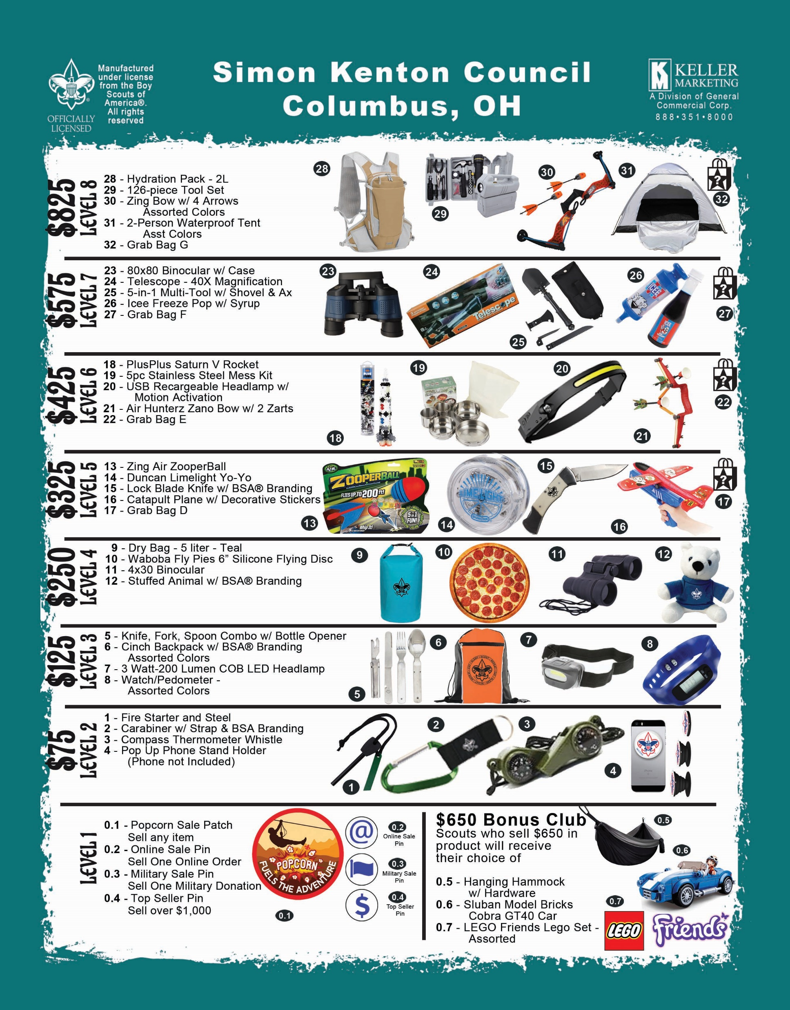
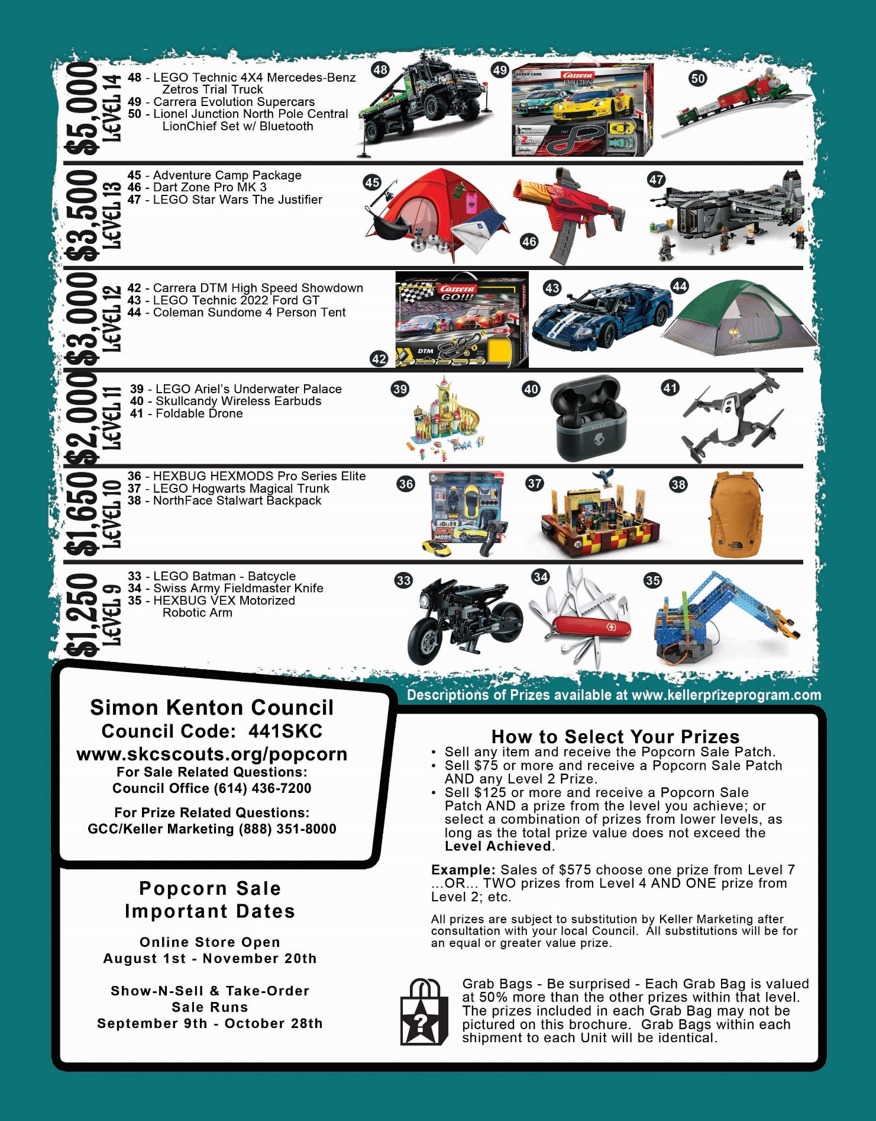
GCC/BSA PRIZE PROGRAM

Slide 21
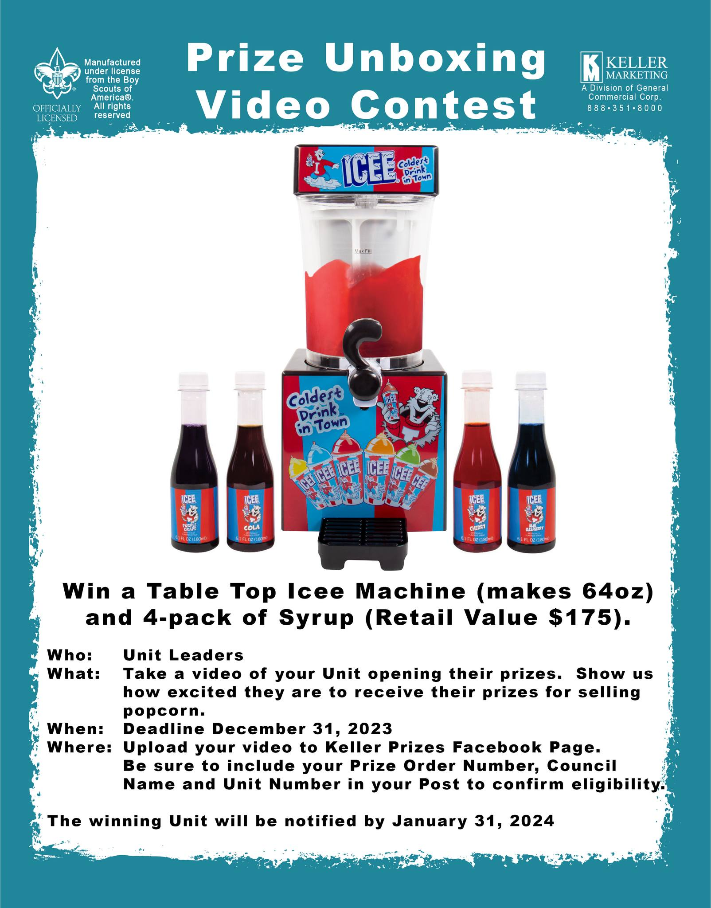

Slide 22
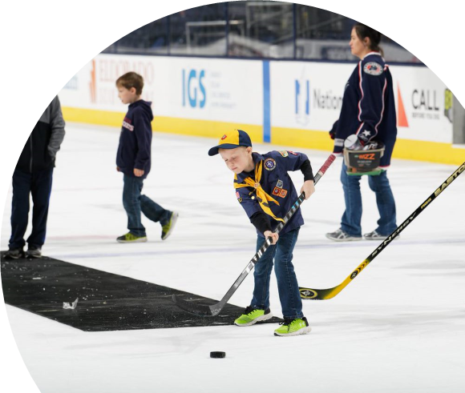
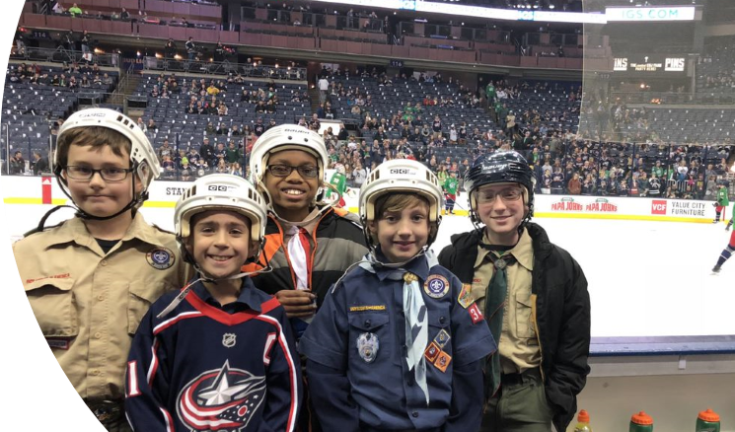
$2,000 Sellers Bonus Prize!
Free CBJ Game Tickets
Saturday, March 9th @ 12:30PM
Exclusive Experiences
Free Scout-Themed CBJ Gift
Top 10 Sellers Get Bonus Experiences

Slide 23
PR POPCORN
WINNER'S CIRCLE
ONLINE SALES INCLUDED!
For every $3,000 sold a Scout will have their choice of prize from Pecatonica River's "Winner Circle". Unit leader will enter their Scout's into the Winner Circle.

Slide 24
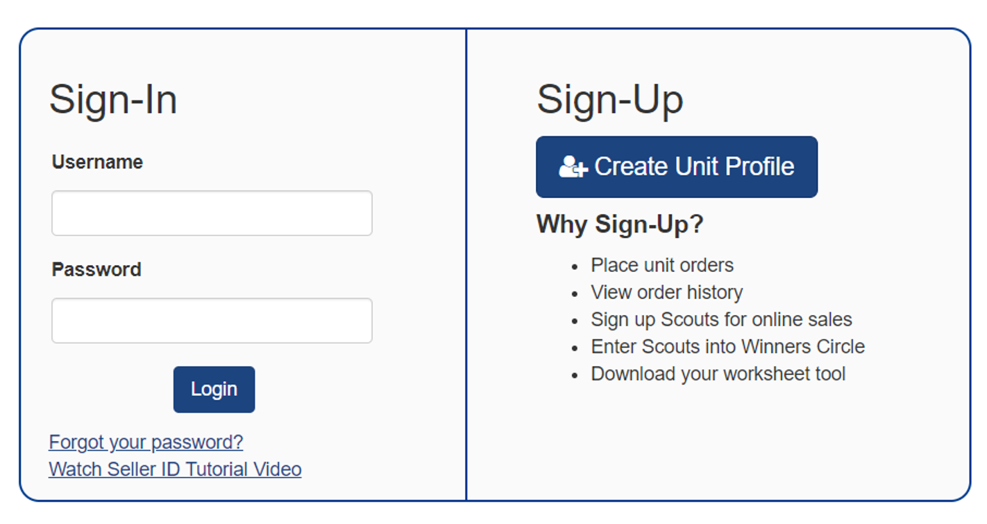
Getting Started
Go to PRPopcorn.com
Click “My Account”
Click “Create Unit Profile”
Council Key = 441SKC

Slide 25
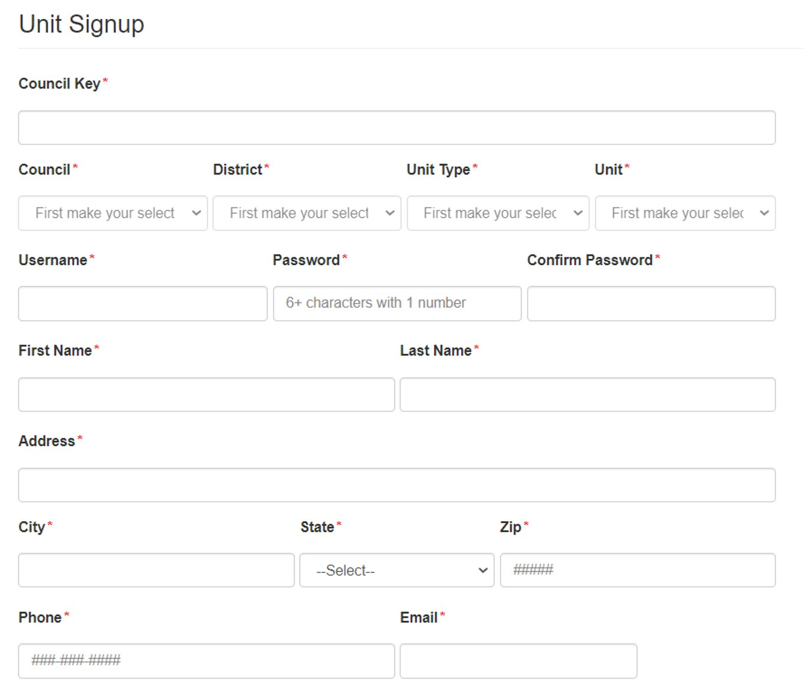
Getting Started
Council Key = 441SKC​
Choose District, Unit type and number from drop downs​
Username must be unique​
Can use same email if managing multiple units​
Click “Next” to commit to the sale.

Slide 26
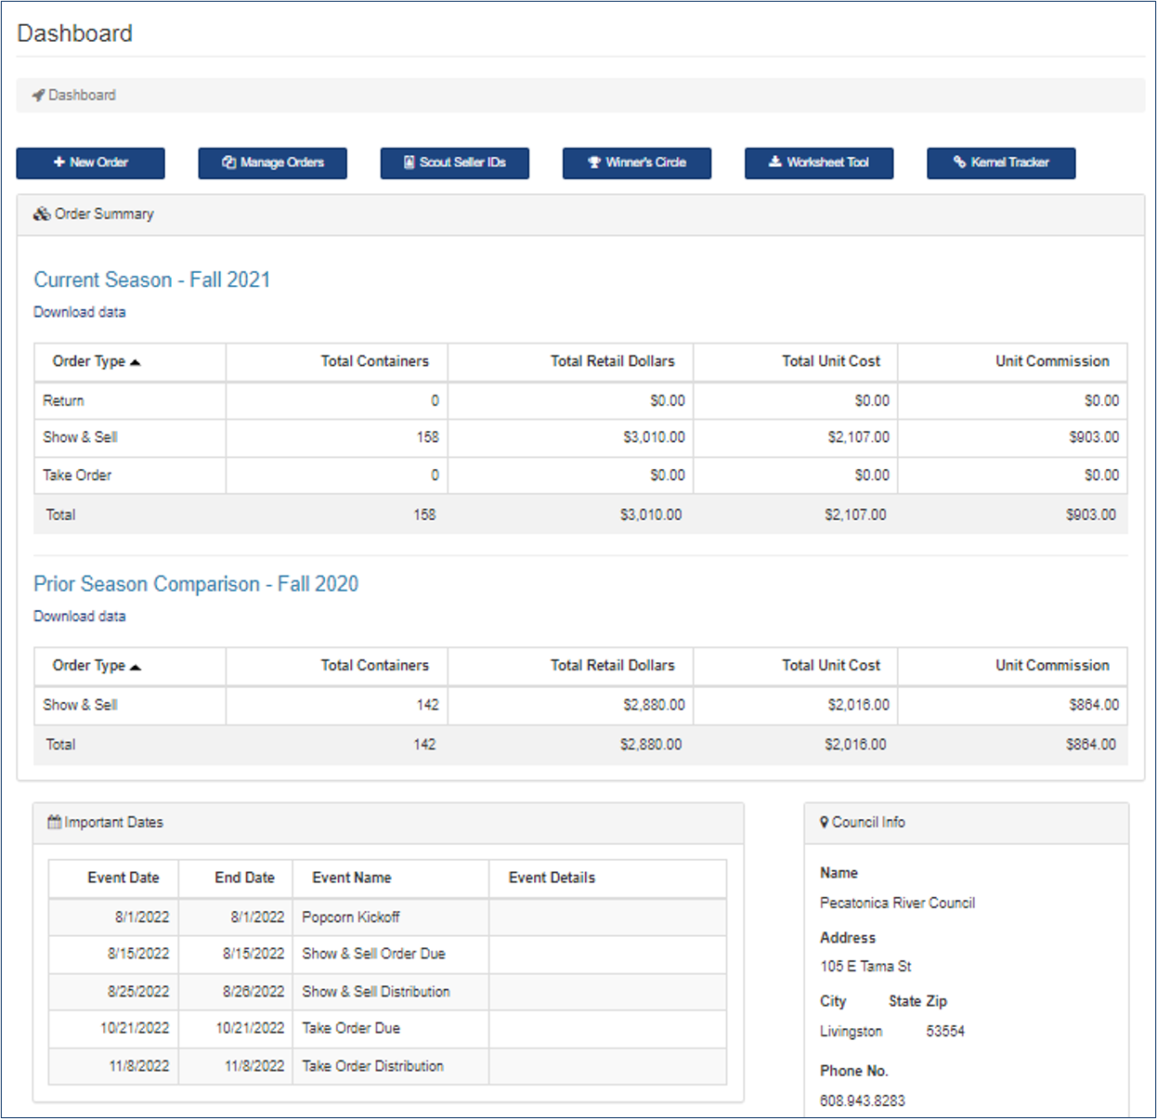
Dashboard
New order
Manage Orders
Prior Year’s Sales
Scout Seller IDs
Winners Circle
Worksheet Tool
Kernel Tracker

Slide 27
Effective Kick-offs and Sale Resources
Explain how the popcorn sale benefits...
...your Unit: Funds our Ideal Year of Scouting—pays for special activities, awards, equipment, and Camp.
...your Scouts: Builds a personal sense of responsibility, sales, and leadership skills, and supports the program.
...your Council: Raises money for improving activities and camping programs.
Review the prizes and incentives:
Review sales goals and techniques:
Go over delivery and money collection process:
Review safety rules for youth and adults:
Youth should be selling with a buddy or accompanied by a chaperone.
Emphasize that youth do not enter homes.
Unit Commissions
Popcorn
32% Base Commission
35% online sales

Slide 28
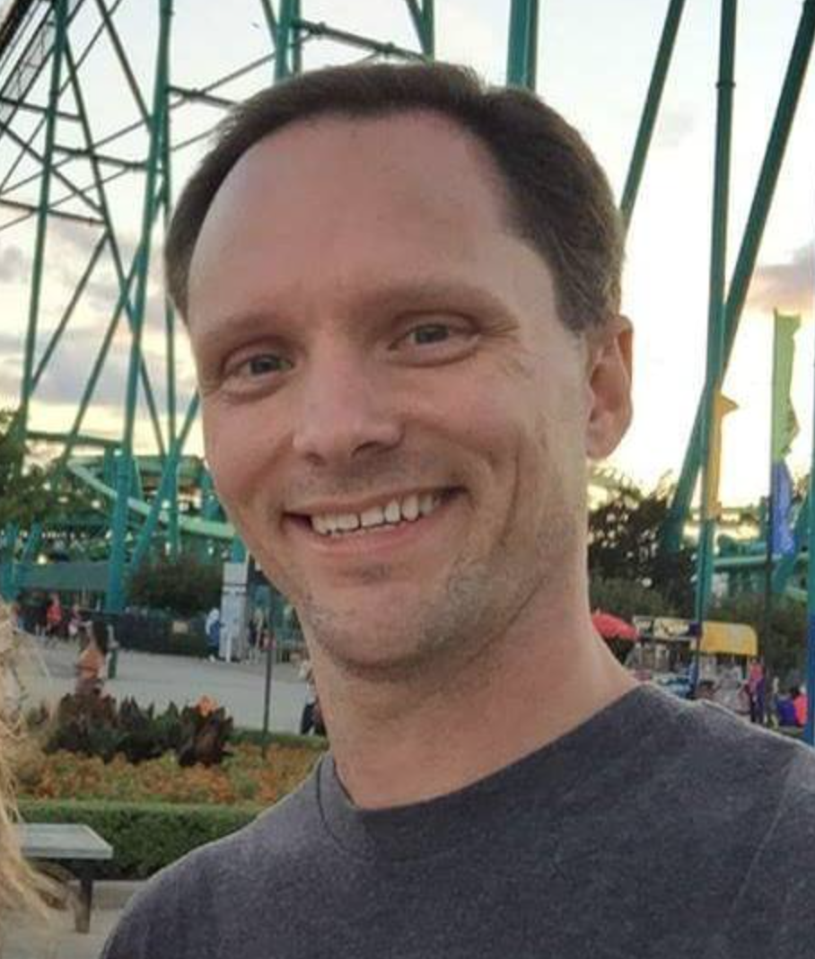
Information/Communication
Council Kernel
Rob Recker -recker0824@gmail.com
District Kernels
Polaris – Nataria Scales natljones_20@yahoo.com
Gateway – Roger Bauer rxbauer@netscape.net
Frontier – Natalie Knore faerychick27@yahoo.com
Daybreak –
James.Dockter@Scouting.org
614.310.1327

Slide 29
THANK YOU

