Slide 1
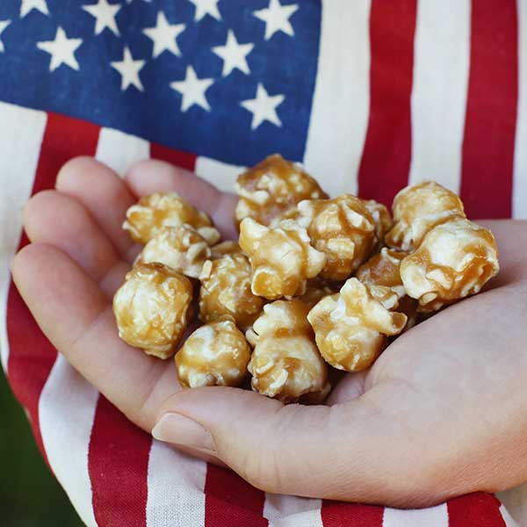

SIMON
KENTON
COUNCIL 2024
PRPOPCORN.COM

Slide 2
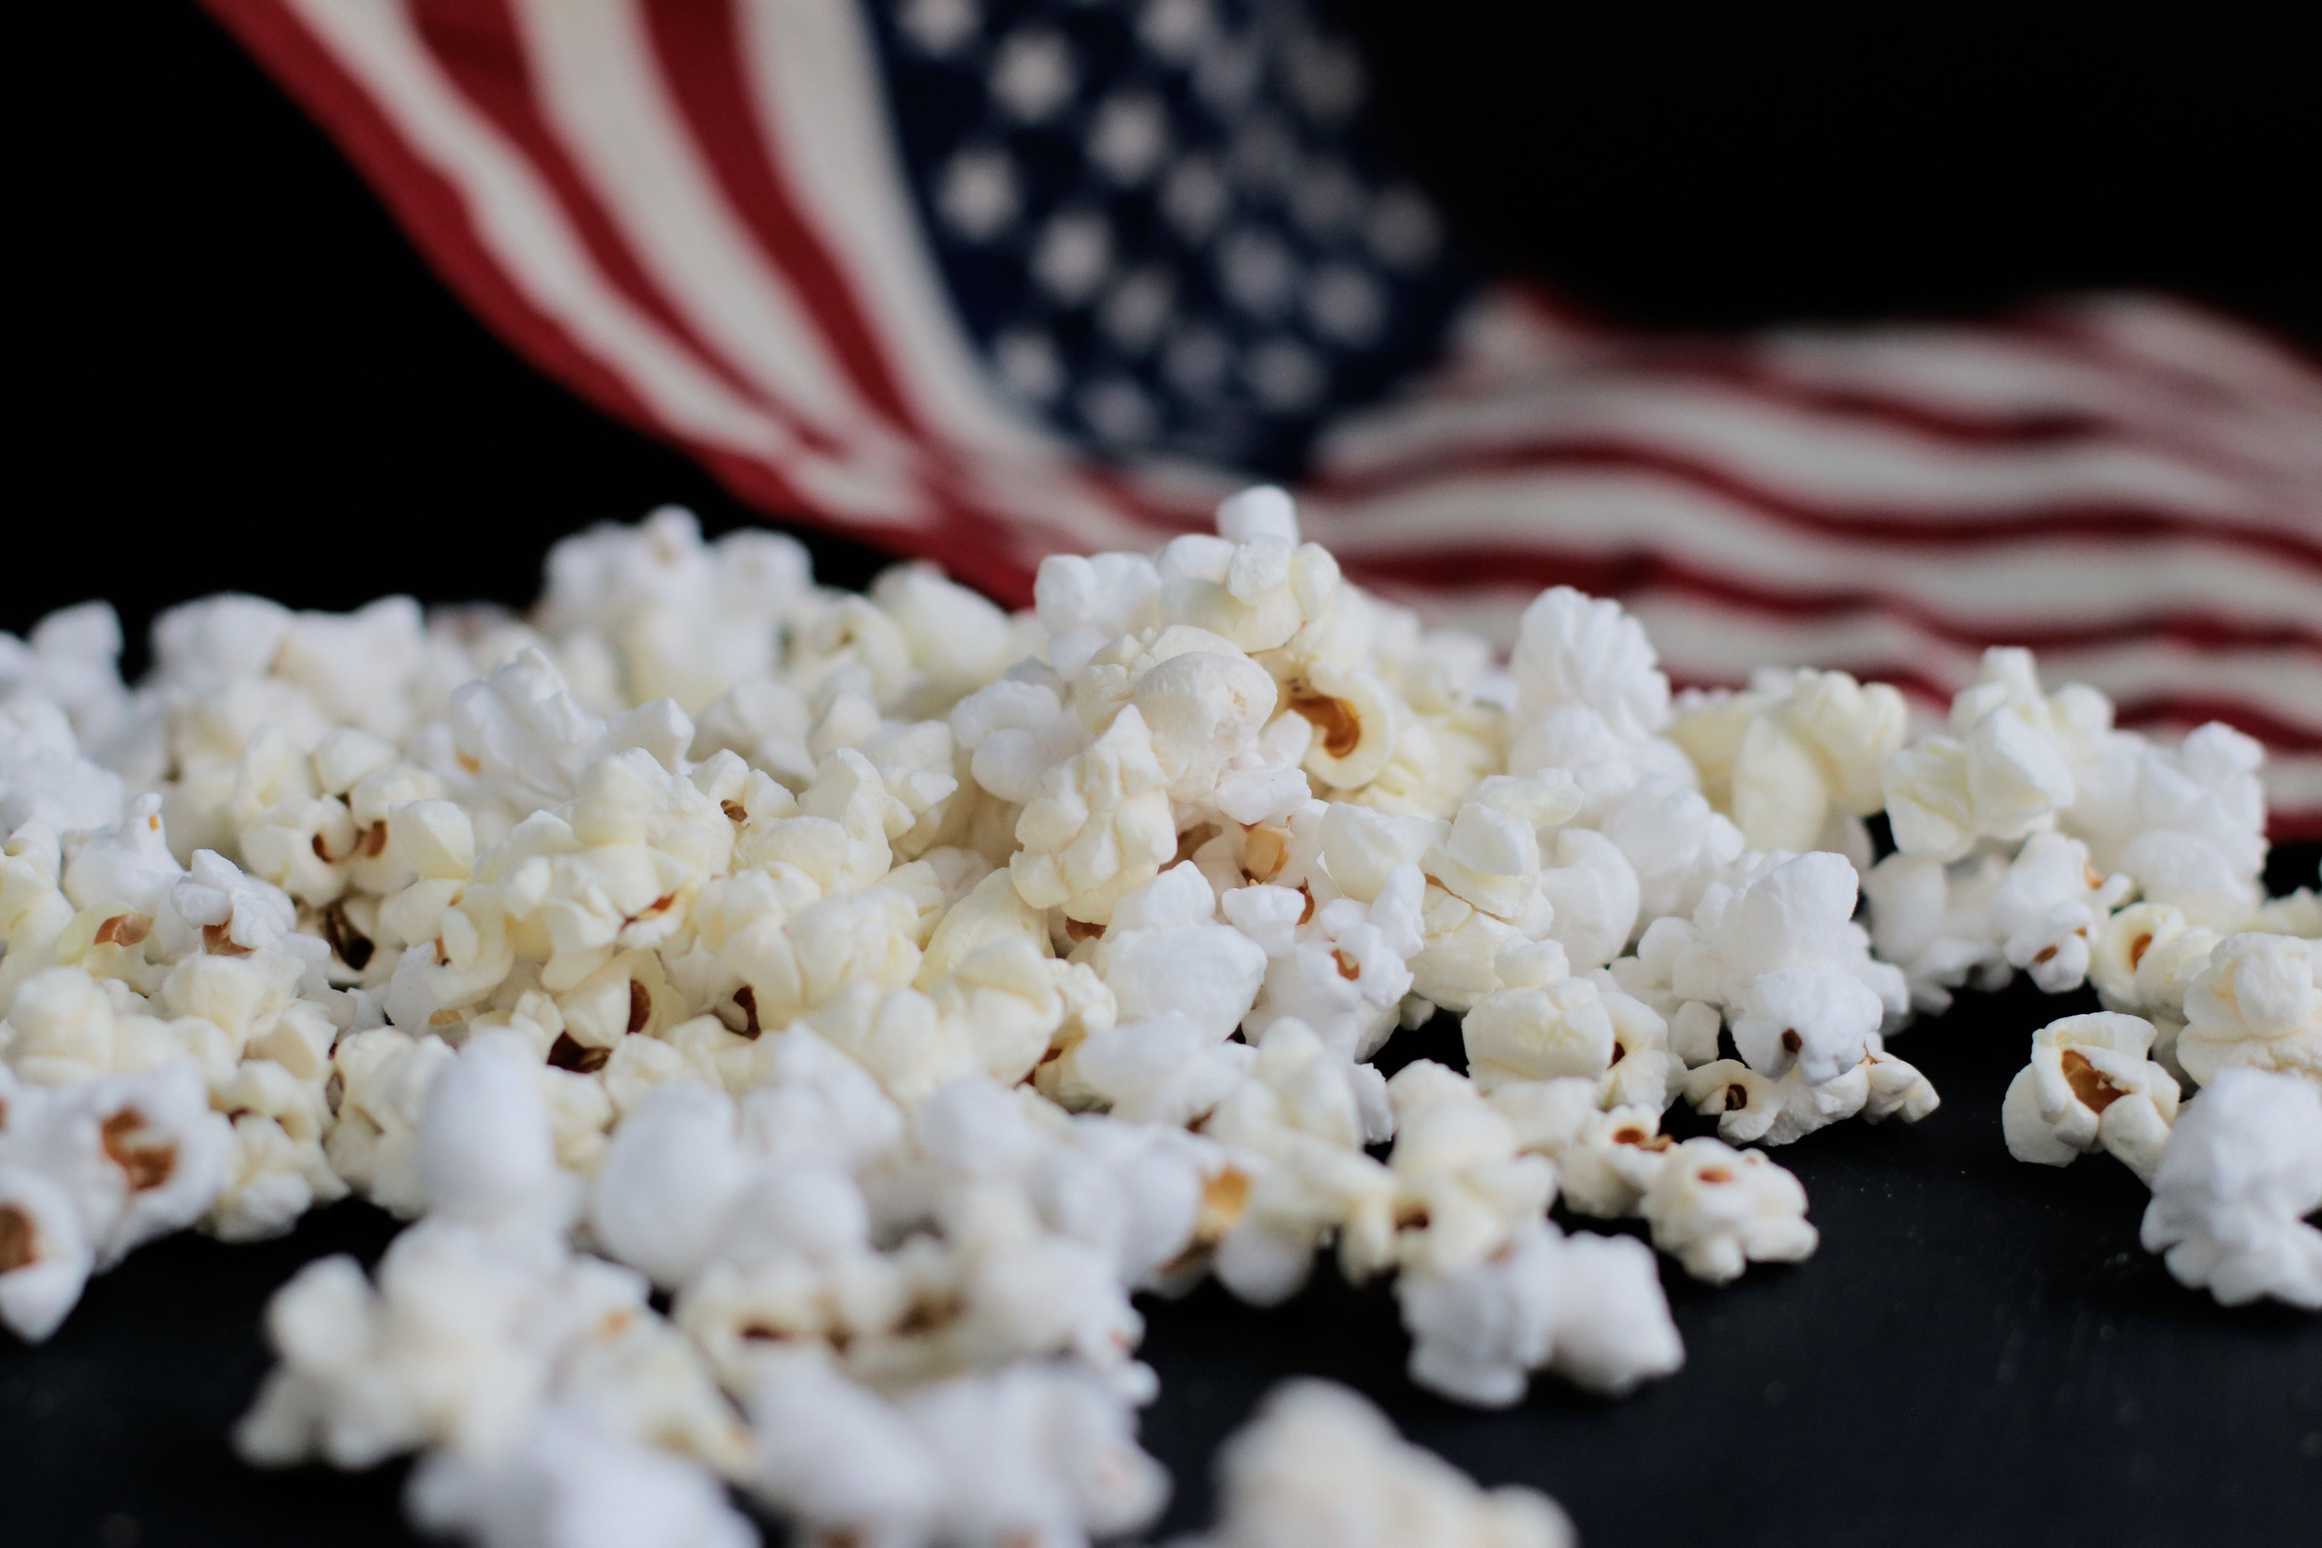












EDUCATION AT POPCORN UNIVERSITY
POPCORN PAYS FOR...
SCOUTS CAN LEARN...
Outdoor activities, camp maintenence & adventures
Responsibility
Yearly fees & renewals
Follow-Through
Uniforms, patches & awards
Customer Service
Unit gear & supplies
Goal Setting
High adventures
Perseverance
Celebrations, traditions & advancement

Slide 3
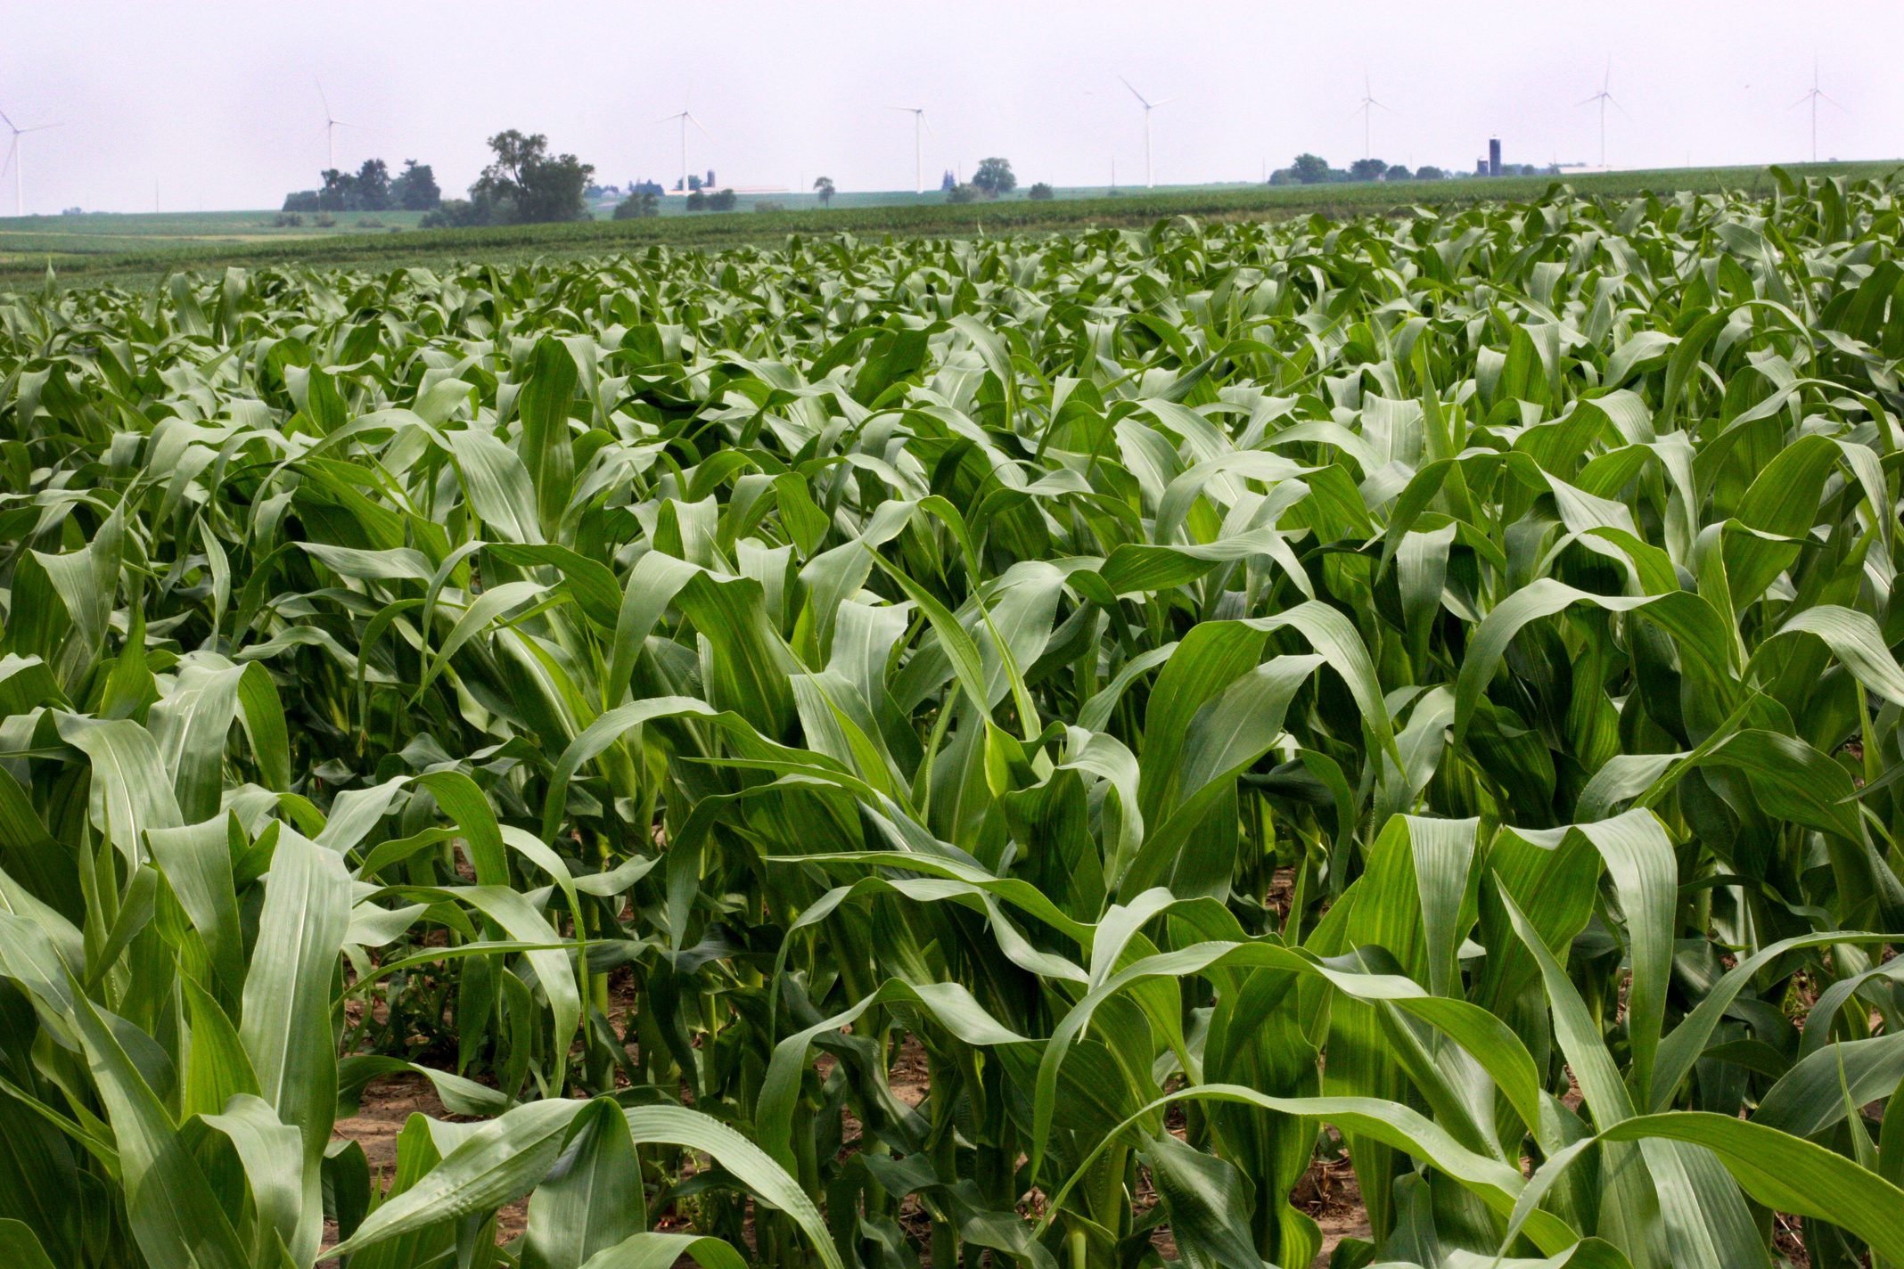
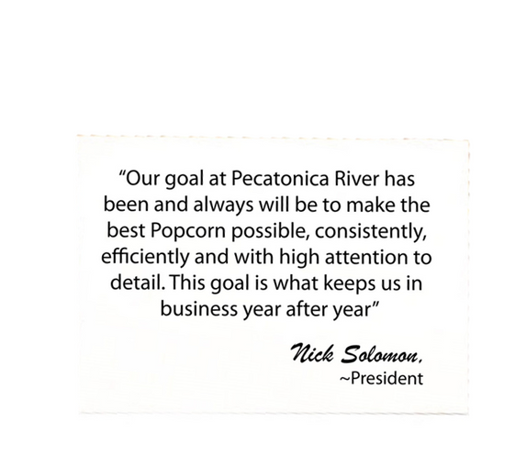
WHO WE ARE
Attention to detail is paramount. Since 1983, we have been creating high-quality popcorn. Over the last 41 years, we have partnered with different Boy Scout councils, tailoring each sale to maximize the unique strengths and resources of each council. This customization includes designing containers, offering exclusive products, and creating personalized promotions.

Slide 4
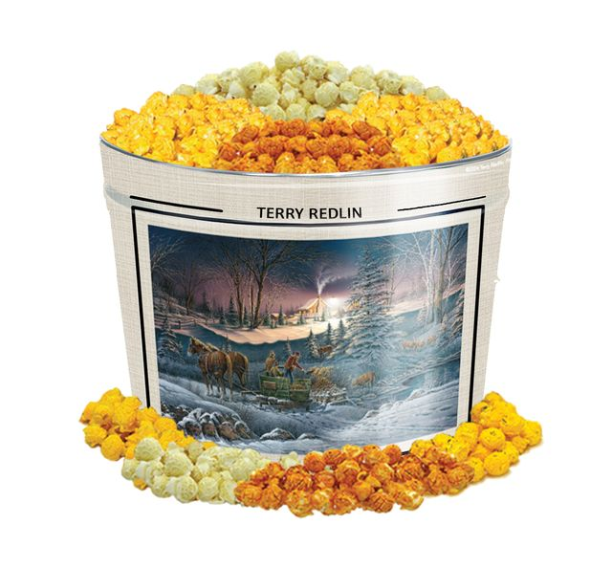

2024 Simon Kenton Council Popcorn Calendar
Order, Distribution and Return Information:
Pecatonica River Online Store is Open:
Thursday, August 1st – Sunday, November 24th
Show & Sell Orders Due:
Friday, August 16th
Show & Sell Distribution:
Wednesday, September 4th – Saturday, September 7th
*Specifics vary by District
Show & Sell Sale Starts:
Saturday, September 7th
1st Swap Day: Saturday, September 21st
2nd Swap Day: Saturday, October 12th
3rd Swap Day: Saturday, October 19th
Final Swap Day/Super Saturday/Last Day of Show-n-Sell:
Saturday, November 2nd
*Final opportunity to return popcorn **no returns on chocolate products
Take-Orders Due:
Monday, November 4th
Take Order Distribution:
Wednesday, November 14th – Saturday, November 16th
*Specifics vary by District
Last Day to Place Prize Orders & Invoices Paid in Full:
Friday, December 6th
**The Simon Kenton Council will not be accepting returns of Chocolate Products. The list of chocolate products for 2024 includes Sea Salt Splash, Peanut Butter Cup, Chocolate Pretzels, and the Chocolate Lover’s Collection.

Slide 5
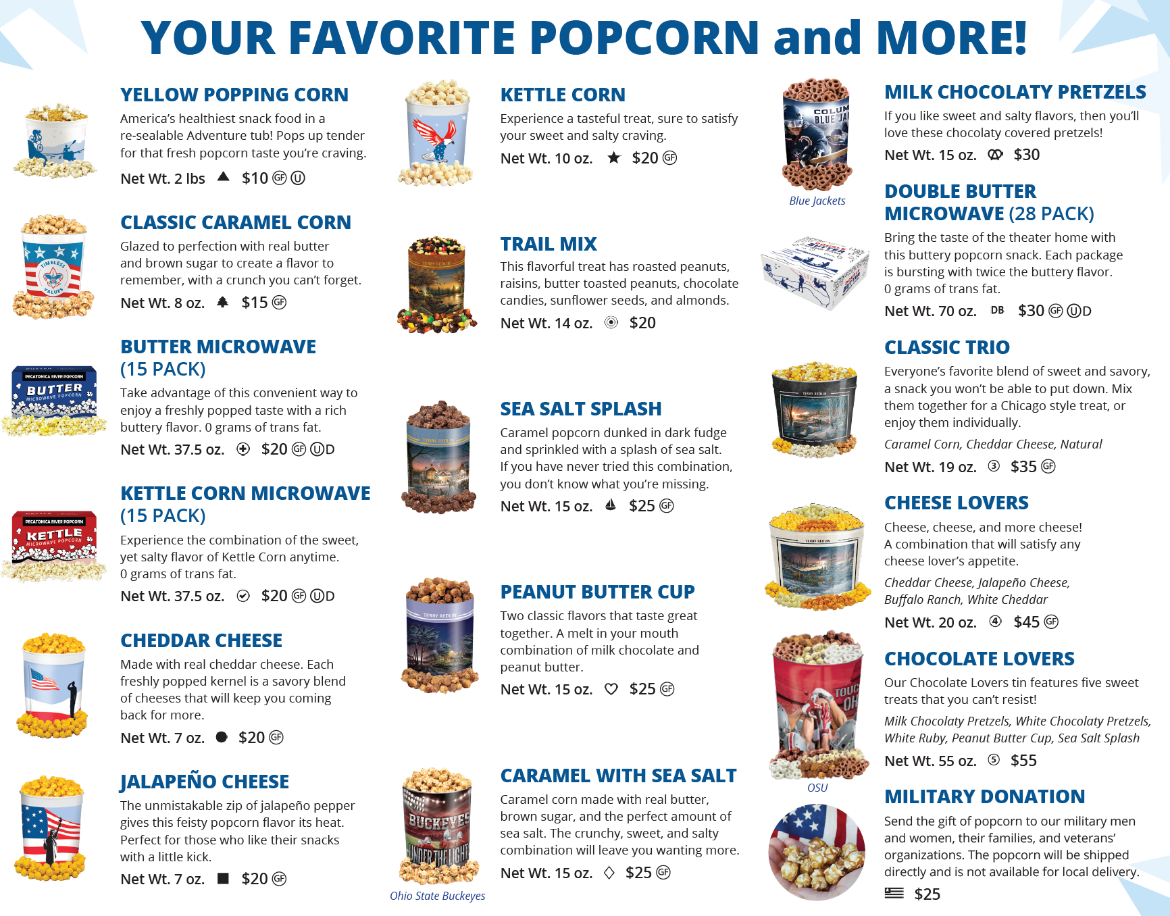
2024 PRODUCT MIX
~

Slide 6


MILITARY
DONATIONS
A military donation allows customers to purchase popcorn for the military men & women serving our country and supporting Scouting at the same time.

Slide 7
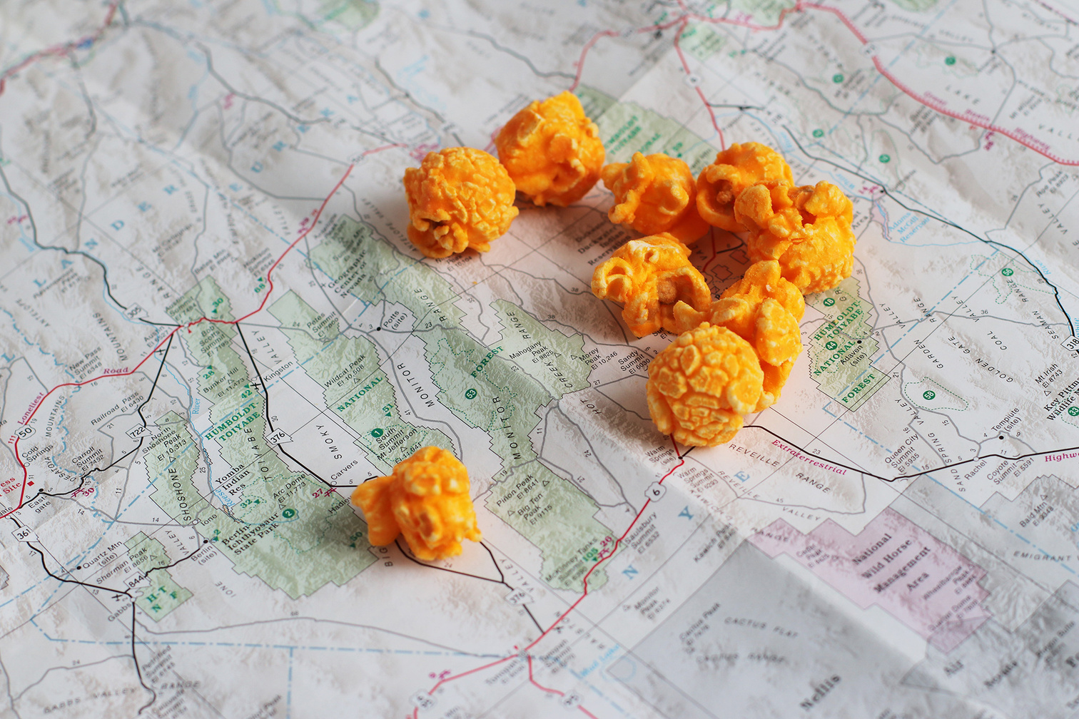




TOOLS TO BOOST SALES
SALES FLYERS
Scout takes the flyer door to door to collect orders.
Form has spaces for up to 30 names.
TAKE-TO-WORK TENTS
Display your popcorn at a high-traffic area like your workplace to boost sales easily!
TASTING KITS
Scouts taste product and share their experience with customers.
PROMOTIONAL
EXTRAS
Organize, promote, and draw attention to your sale.

Slide 8

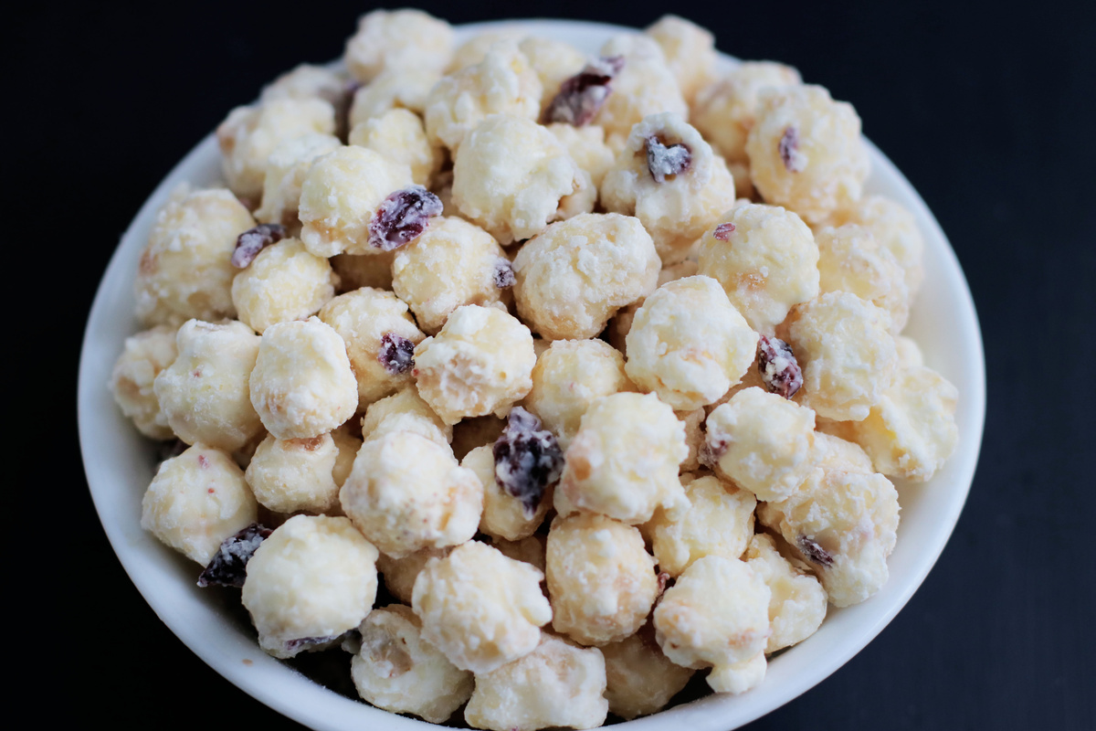

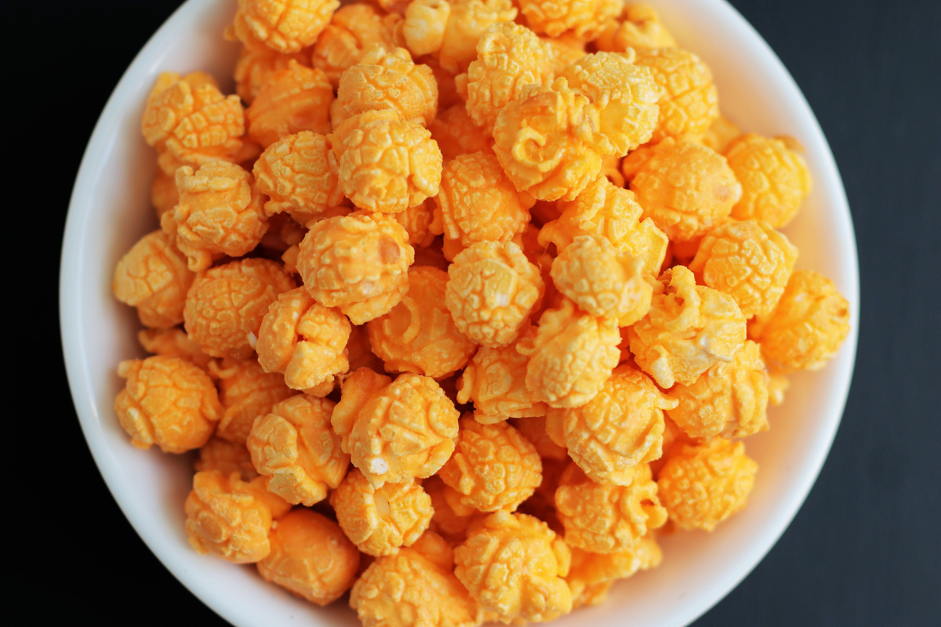
TASTING KIT
FAMOUS PR POPCORN
TASTING KIT
The purpose of a tasting session is to have each Scout try 1-2 kernels of each flavor. Let the Scouts vote on their favorites - have fun with it!
Boost your sales with a tasting session. Foster familiarity and product knowledge. Encourage the Scouts to share their tasting experience with potential buyers.

Slide 9






Show & Sell
Set up in high traffic area
Popcorn is ordered in advance on consignment from Council
Show & Deliver
Combine Show & Sell and Take Order
Popcorn is taken door to door & sold on the spot
01
WHERE TO SELL
02
Take Order
Traditional way of going door to door
Popcorn is delivered after the sale
03
Online Store
Customers can support all across the country
Each Scout gets credit for sales

Slide 10
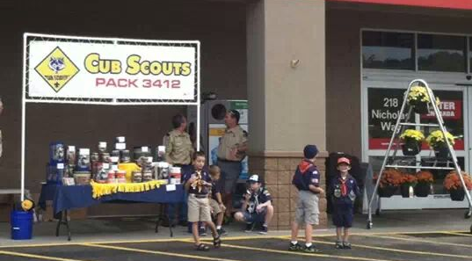
Show & Sell
Unit Kernels order popcorn in advance (S&S orders due Friday, August 16th) to set up in a high traffic area. Scouts sell popcorn and hand it to customer at time of purchase.

Slide 11
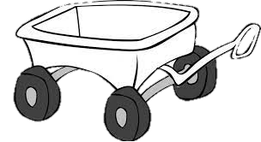
Show & Deliver “Wagon Sales”
One of the most effective sales methods! In this case, a unit signs out popcorn to a Scout who takes it throughout their neighborhood, selling as he/she goes.
Product is brought along (in wagon or vehicle), making it a quick and easy process for the customer. So, it is like a mobile show & sell booth.
Units should order for this as part of their show & sell order or use product left over from your Show & Sell locations.
A large percentage of homeowners say that no Scout has ever come to their door, missing this great opportunity. If the desired product is not on hand, an order can be taken, and product delivered later.

Slide 12
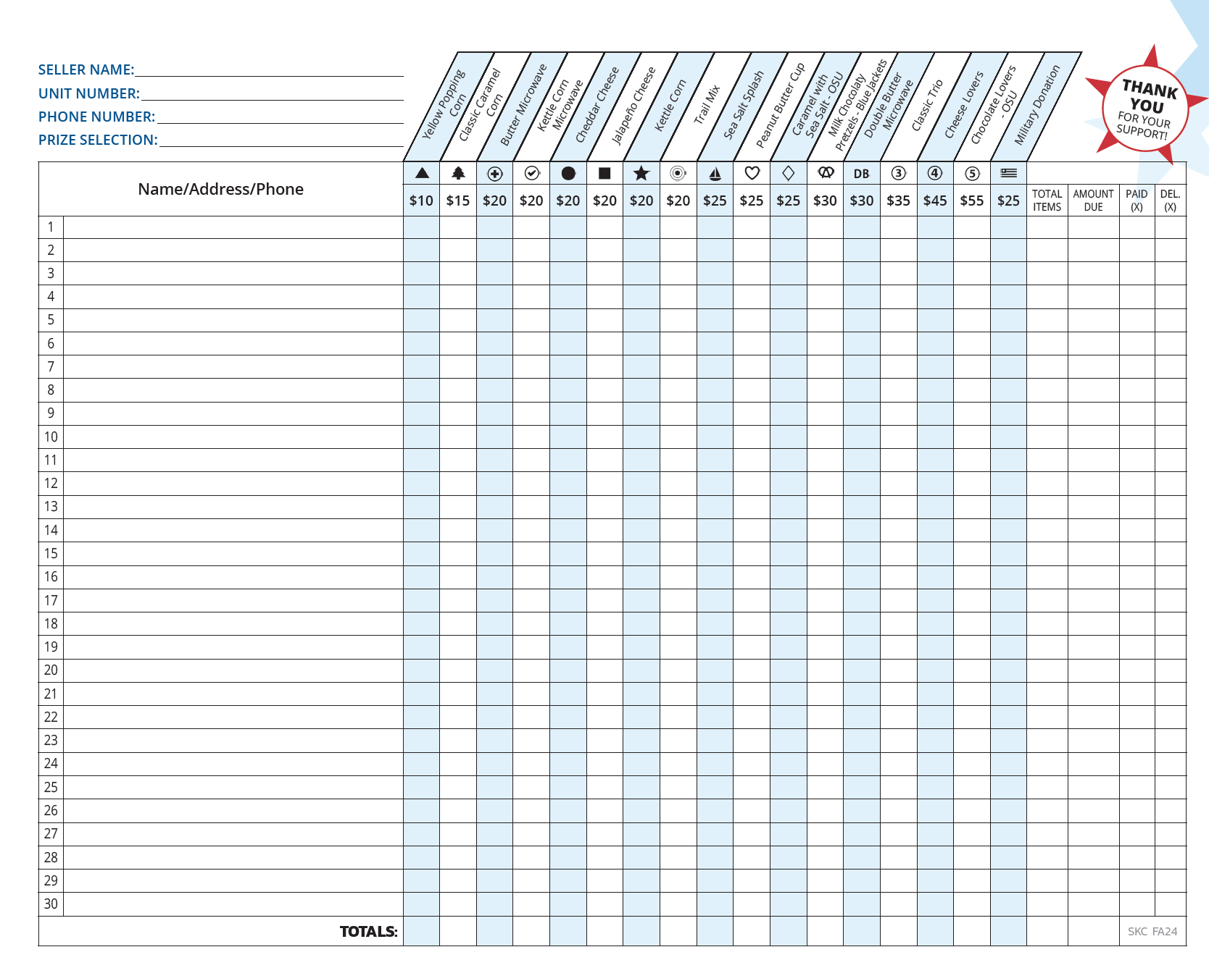
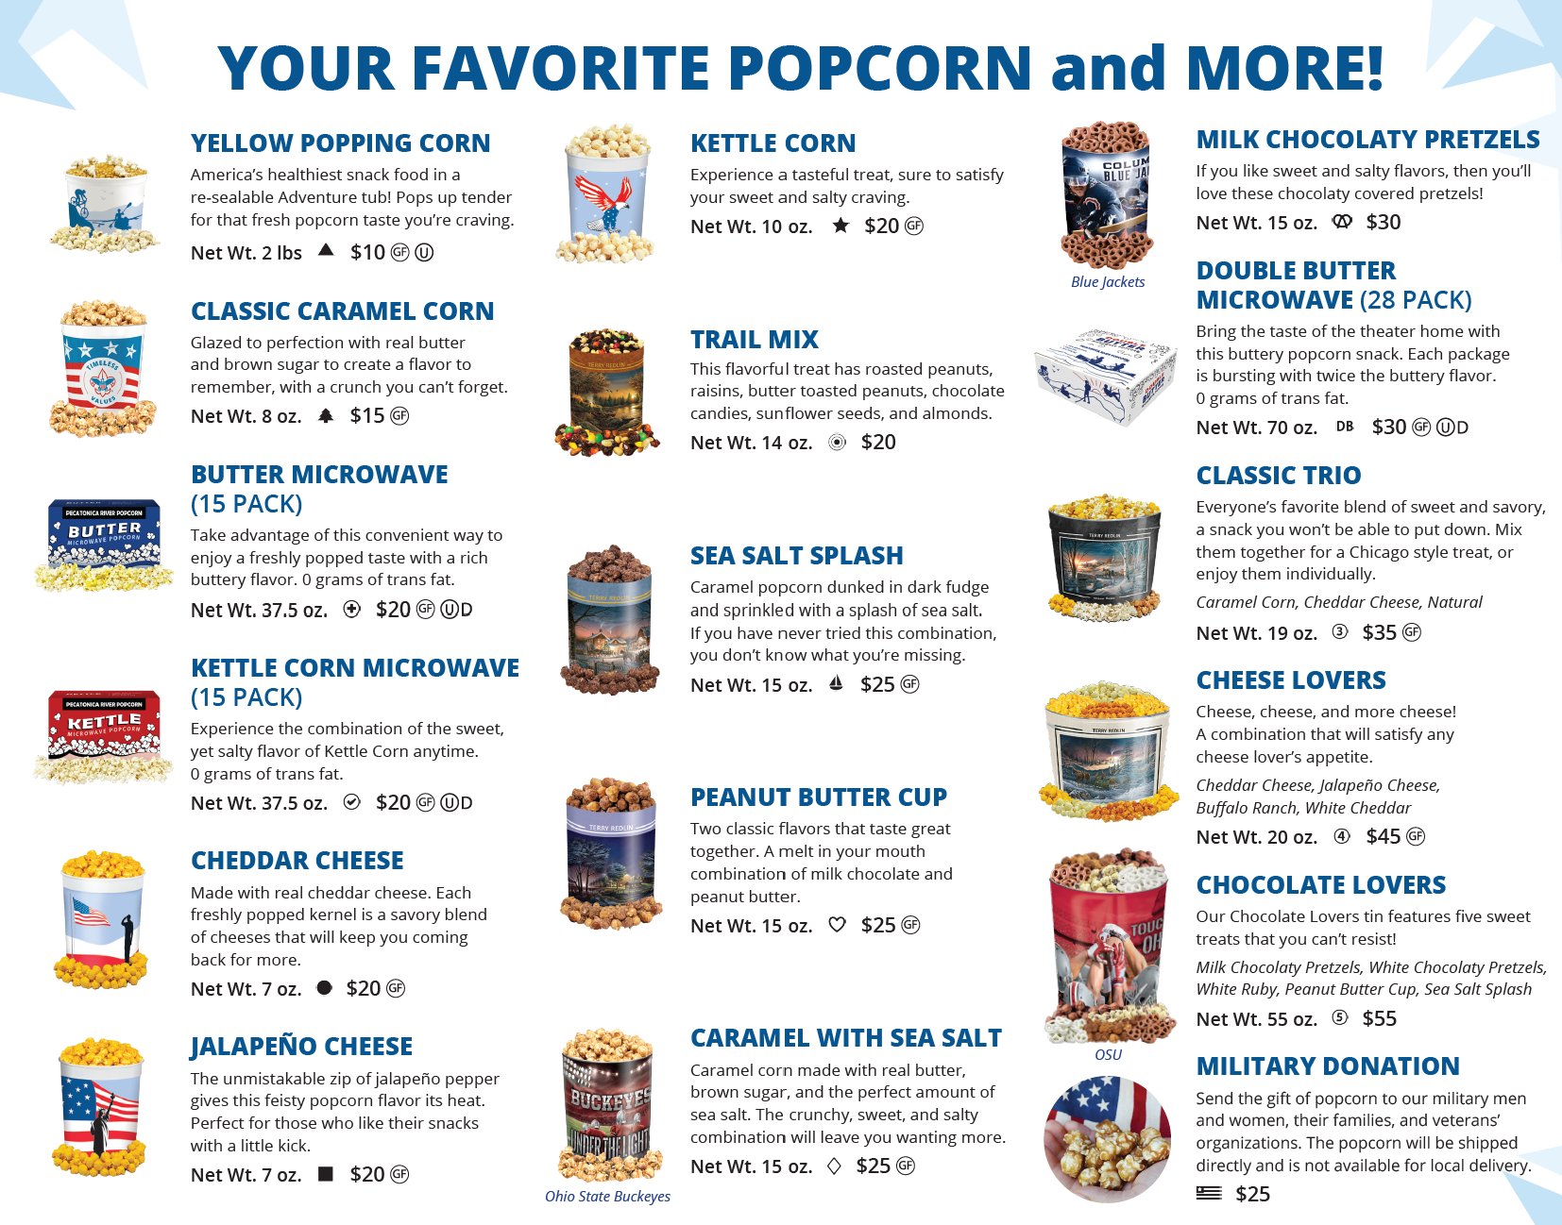
Take Order
This method is where Scouts go door-to-door selling popcorn to friends, family, and neighbors, using an order sheet.
Parents can also help by taking the “take to work” order forms to work.
At the end of the sale, the Scouts deliver the ordered products to the customers who ordered them.
TIP: Use leftover inventory from your Show & Sell to fill these orders.

Slide 13
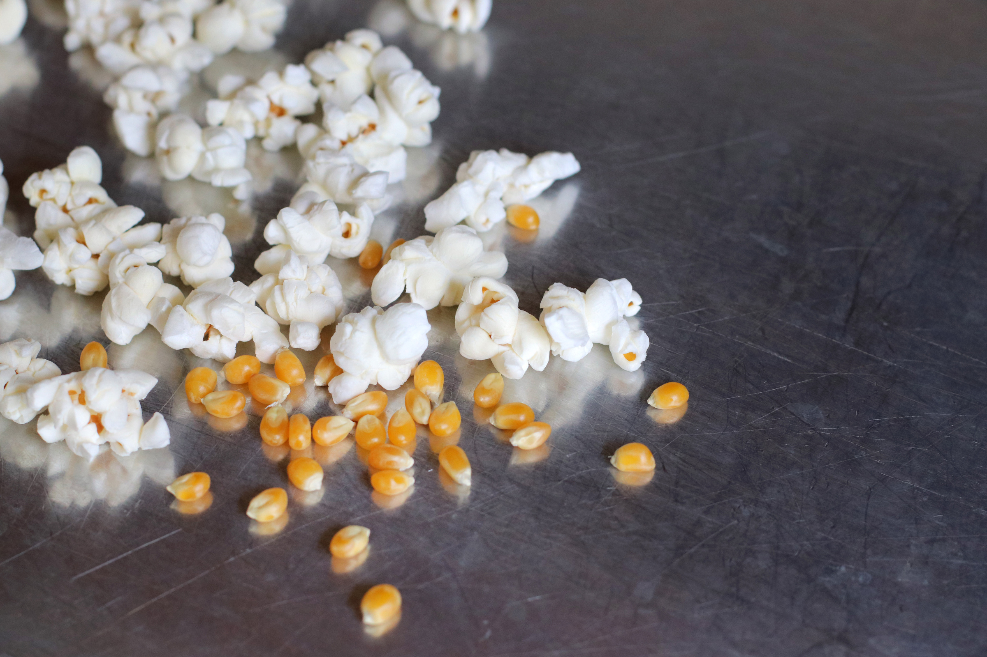

SCOUT SCRIPT & BEST PRACTICES
SCOUT SCRIPT
“Hello! My name is _________________ and I am with pack/troop _______. I am selling popcorn to earn my way to ________ and support our camp outings. I have some great popcorn flavors available for sale. My favorite flavor is ___________ and I know you will love our popcorn assortment. Would you consider supporting me?
***Always thank your customer, even if they do not purchase. Be cordial & kind.
SELLING TIPS
  Be in Uniform - always wear your clean uniform.
  Know Your Products - know the names & types of popcorn you are selling.
  Be Prepared - practice your sales script and pitch. Have confidence and smile!
  Always Thank your Customers - even if they do not purchase.
  Follow Scout Safety Tips - buddy system, road-rules, money management and curfew.

Slide 14


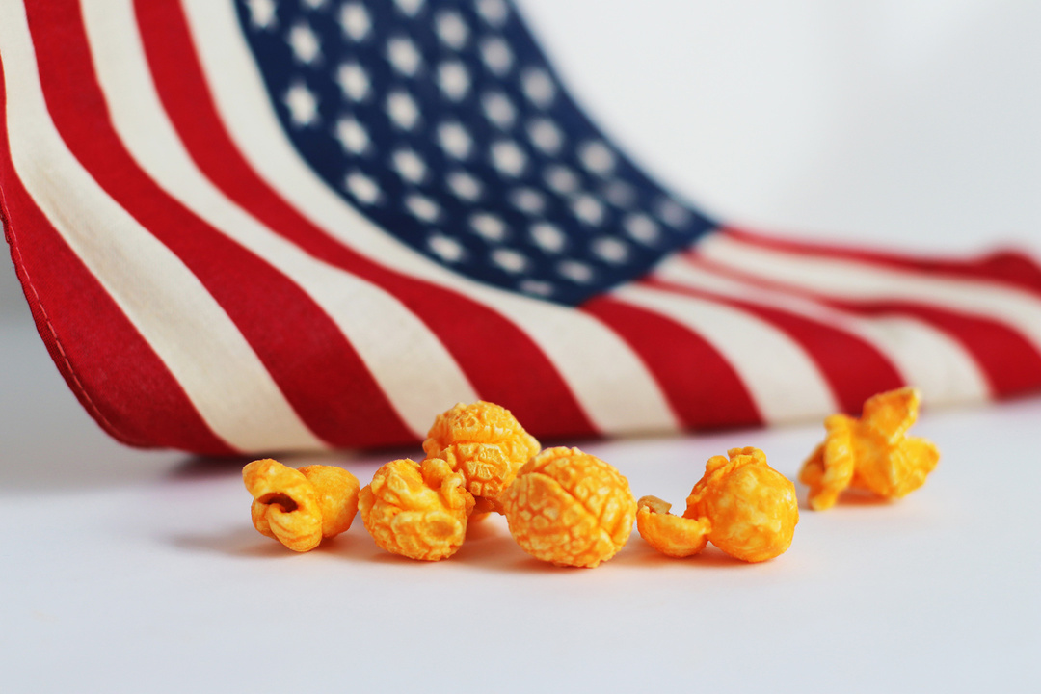
ONLINE STOREFRONT
SHOP ONLINE!
PRPOPCORNSTORE.COM
60% of every purchase goes to the Scout's unit and Council in their name
FREE SHIPPING
No deliveries to worry about - all ships from PRP
ALL SALES COUNT!
All sales qualify for Winner’s Circle! Personable email can be sent to family & friends with customized video message

Slide 15


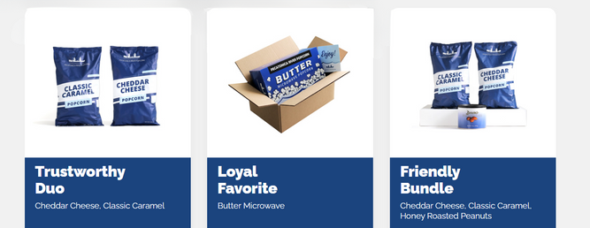
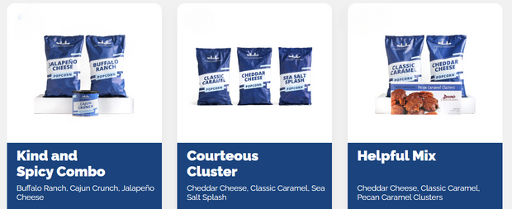
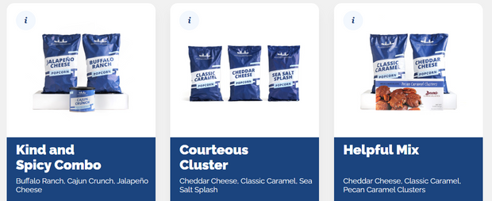
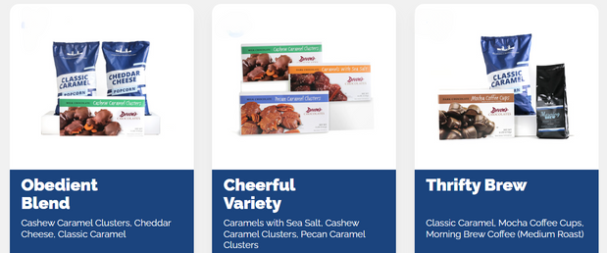
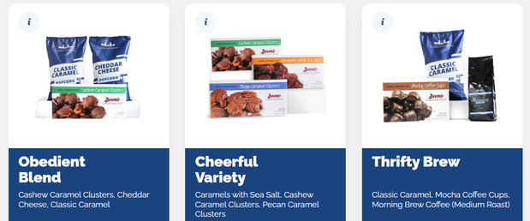
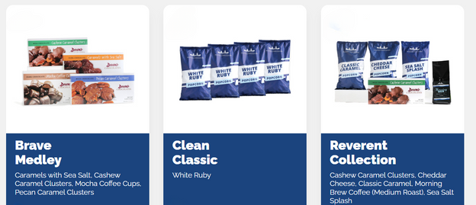

2024 ONLINE SALE
Shop our product mixes today - or support the military with our
MILITARY DONATION
$30.00
$30.00
$35.00
$35.00
$40.00
$40.00
$40.00
$45.00
$45.00
$50.00
$50.00
$60.00
WWW.PRPOPCORNSTORE.COM

Slide 16



ONLINE RESOURCES
WWW.PRPOPCORN.COM
TRAINING VIDEOS
SALES TOOLS
WATCH & LEARN OUR 12 VIDEOS TO HELP YOU MAKE THIS SEASON A SUCCESS!
NUTRITION INFORMATION, PRODUCT WEIGHTS & DIMENSIONS AND MORE!
PRINTABLE RESOURCES
PAYMENT INFO
RECEIPTS, LEAVE BEHINDS & MORE!
LEARN ABOUT SUGGESTED PAYMENT OPTIONS!

Slide 17
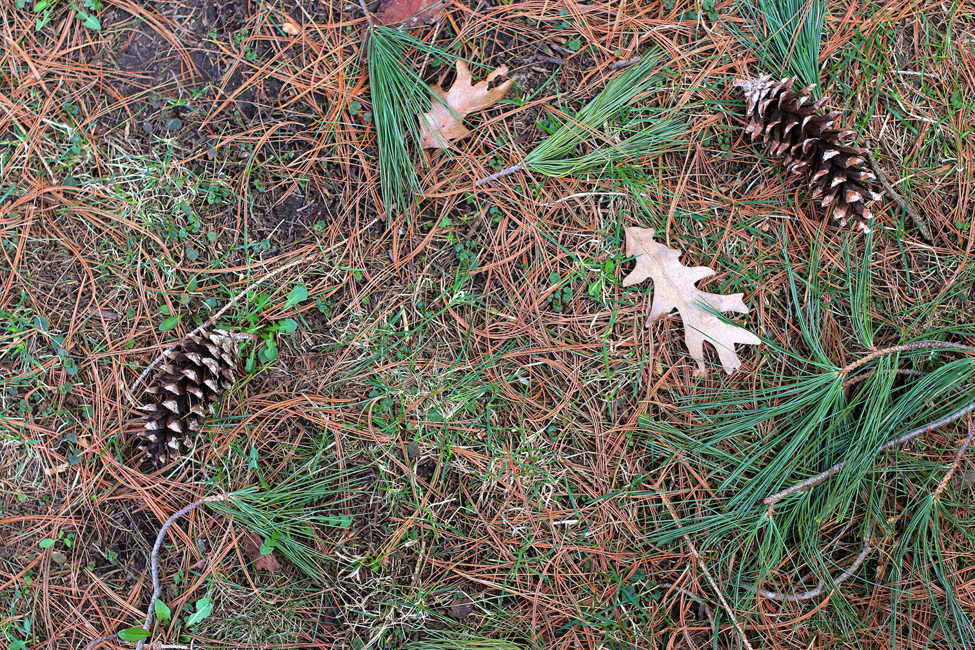


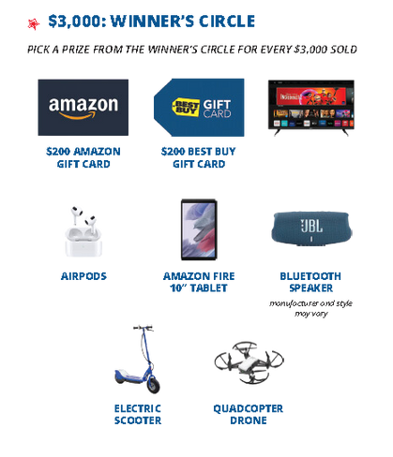

UNIT POPCORN KICKOFF
The Unit Popcorn kickoff offers a fantastic chance to captivate and inspire your Scouts while also providing an ideal platform to enlighten parents about the importance of selling popcorn to sustain your Scouting program.
BEST PRACTICES
Promote the Popcorn! The best way to sell Pecatonica River Popcorn is by tasting! Have the Scout try all the flavors and pick their favorite. In addition, practice their sales pitch & review all safety tips.
Discuss the Winner’s Circle Prizes! All Scout sales, including Online Sales, qualify the Scouts for our Winner Circle prizes. Highlight previous sales’ winners or prizes.
Make it fun! Consider banners, posters, balloons and music to help create a fun & exciting environment. This is your opportunity to really excite the Scouts!

Slide 18
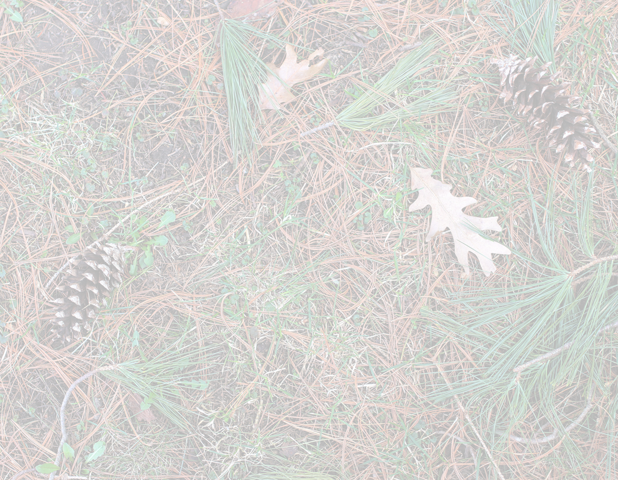
Effective Kick-offs and Sale Resources
Explain how the popcorn sale benefits...
...your Unit: Funds our Ideal Year of Scouting—pays for special activities, awards, equipment, and Camp.
...your Scouts: Builds a personal sense of responsibility, sales, and leadership skills, and supports the program.
...your Council: Raises money for improving activities and camping programs.
Review the prizes and incentives:
Review sales goals and techniques:
Go over delivery and money collection process:
Review safety rules for youth and adults:
Youth should be selling with a buddy or accompanied by a chaperone.
Emphasize that youth do not enter homes.

Slide 19
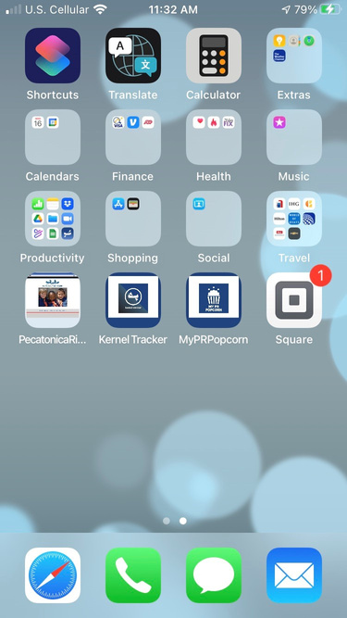






3 APPS TO MANAGE
YOUR SALE
MY PRPOPCORN
App used to promote online sales at the Scout level through social media.
MY PR POPCORN
KERNEL TRACKER
App designed to manage unit level inventory down to the Scout level.
SQUARE READER
Money collection app to allow for the collection of credit cards.

Slide 20




USING MY PRPOPCORN
Quick & Easy Guide
MY PR POPCORN
UNIT KERNEL SIGNS YOU UP FOR SELLER ID
Watch for your registration email from “Pecatonica River Popcorn” (pops@prpopcorn.com) with the subject “Scouting America Online Popcorn Sale”
CREATE YOUR PROFILE
Click : “Register Now” in the email from step one to get to the MYPRP platform to create a profile. Include a picture & video! Drive your success with a complete profile!
SHARE YOUR LINK!
Share to Facebook, X, Email and/or Text by clicking the share buttons at the top of your profile page.!

Slide 21




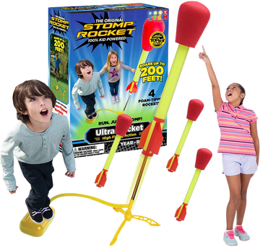

My PRPopcorn Incentive
Set Yourself Up for Success & LAUNCH your sales!
 | Create a MyPRPopcorn profile and earn a stomp rocket! Your profile needs to be completed BY August 16th, 2024! Your profile must include a profile picture and video explaining why you are selling.
 | To access My PRPopcorn tool you must be first signed up for a Seller ID by your unit Kernel. Product Knowledge If you have a seller ID, click If you do not have a seller ID contact your unit kernel
 | Online Sale Opens August 1, 2024 Closes November 24, 2024
MY PR POPCORN
This could be you!

Slide 22
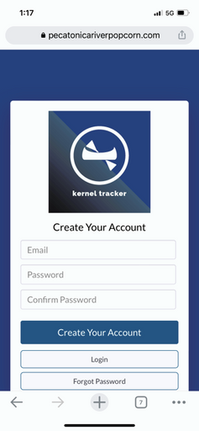
KERNEL TRACKER
Quick & Easy Guide
MANAGE INVENTORY
By Scout
Container
Retail Value!
VIEW DISTRIBUTED STOCK
By Scout
Container
Retail Value
MANAGE SITE LOCATIONS
Create location opportunities
Limit number of Scouts
Assign Scouts to Shifts

Slide 23

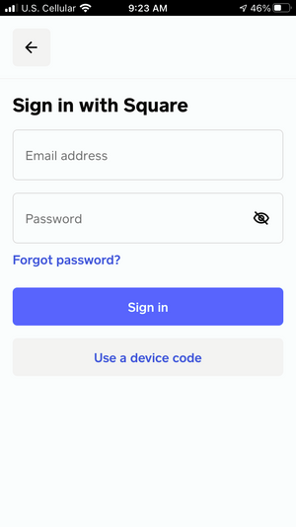

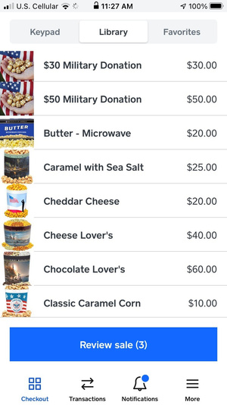
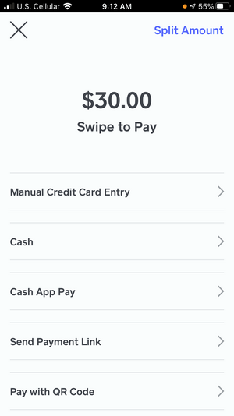
SQUARE READER
Capture Funds
PAYMENT TYPES
Cash
Check
Credit Cards
EASY DEPOSITS
All money collected is deposited into the unit account for payment to the Council
SIMPLE PROCESS
Sign In
Upload mix from www.prpopcorn.com
Swipe & Go!

Slide 24
What's New in 2024
Classic Caramel Corn is $15 not $10
Chocolate Pretzels are $30 not $25
Units can, and should, complete their trades from their unit dashboard at www.prpopcorn.com
Some of the nutritional and allergy information has been updated. Please check www. https://pecatonicariverpopcorn.com/nutrition.html for the most accurate information

Slide 25
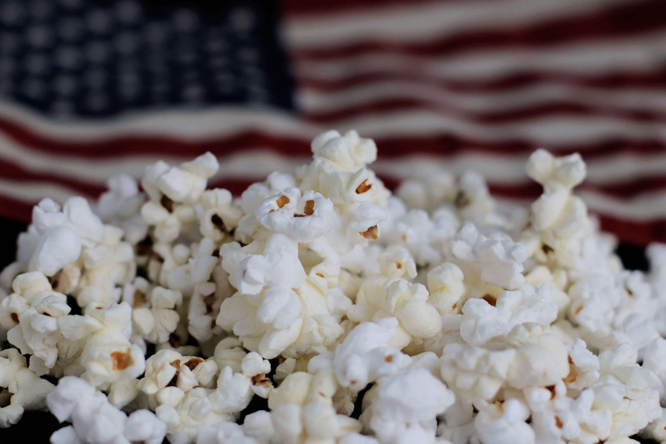
GCC/BSA PRIZE PROGRAM

Slide 27
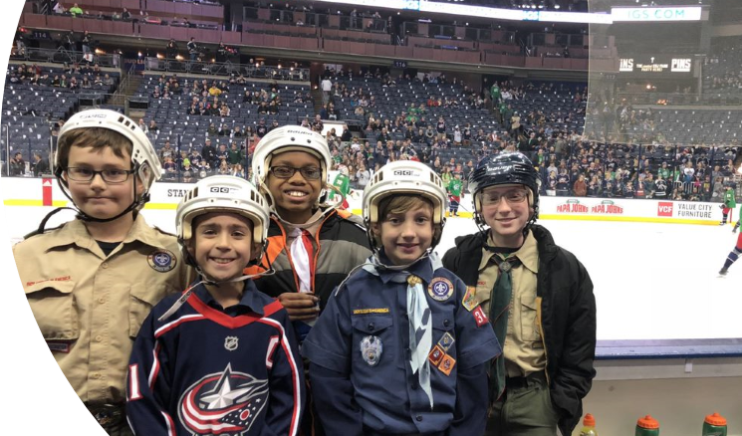
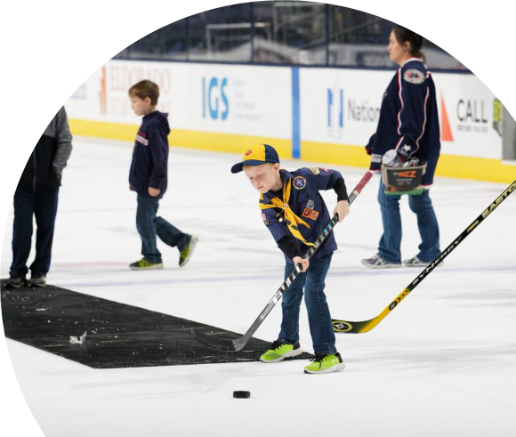

$2,000 Sellers Bonus Prize!
Free CBJ Game Tickets
  Friday, March 28th @ 7:00PM
  Columbus Blue Jackets vs Vancouver Canucks
Exclusive Experiences
Free Scout-Themed CBJ Gift
Top 10 Sellers Get Bonus Experiences

Slide 28

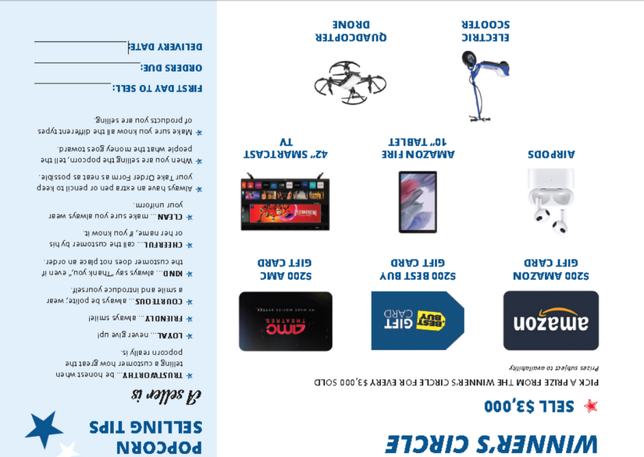
PR POPCORN
WINNER'S CIRCLE
ONLINE SALES INCLUDED!
$3,000 Winner's Circle Scout can select their prize
  All popcorn sales count (S&S, TO, Online)
  Prize choice for every $3,000 sold
  Kernel enters qualifying Scouts
  PRP fulfills and communicates with family

Slide 29
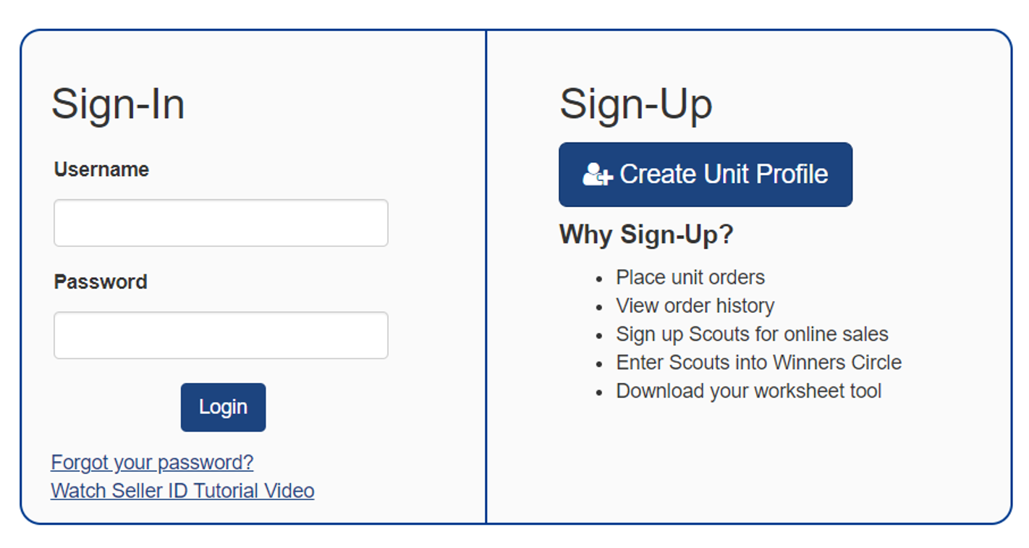
Getting Started
Go to PRPopcorn.com
Click “My Account”
Click “Create Unit Profile”
Council Key = 441SKC

Slide 30
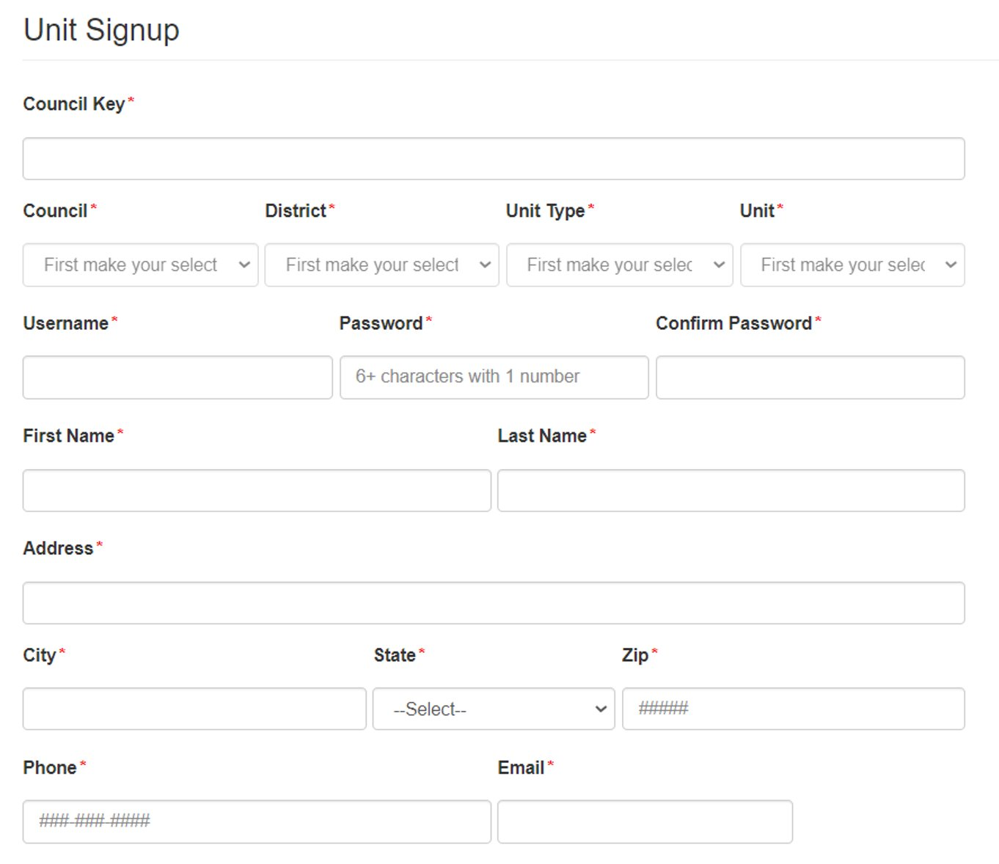
Getting Started
Council Key = 441SKC​
Choose District, Unit type and number from drop downs​
Username must be unique​
Can use same email if managing multiple units​
Click “Next” to commit to the sale.

Slide 31
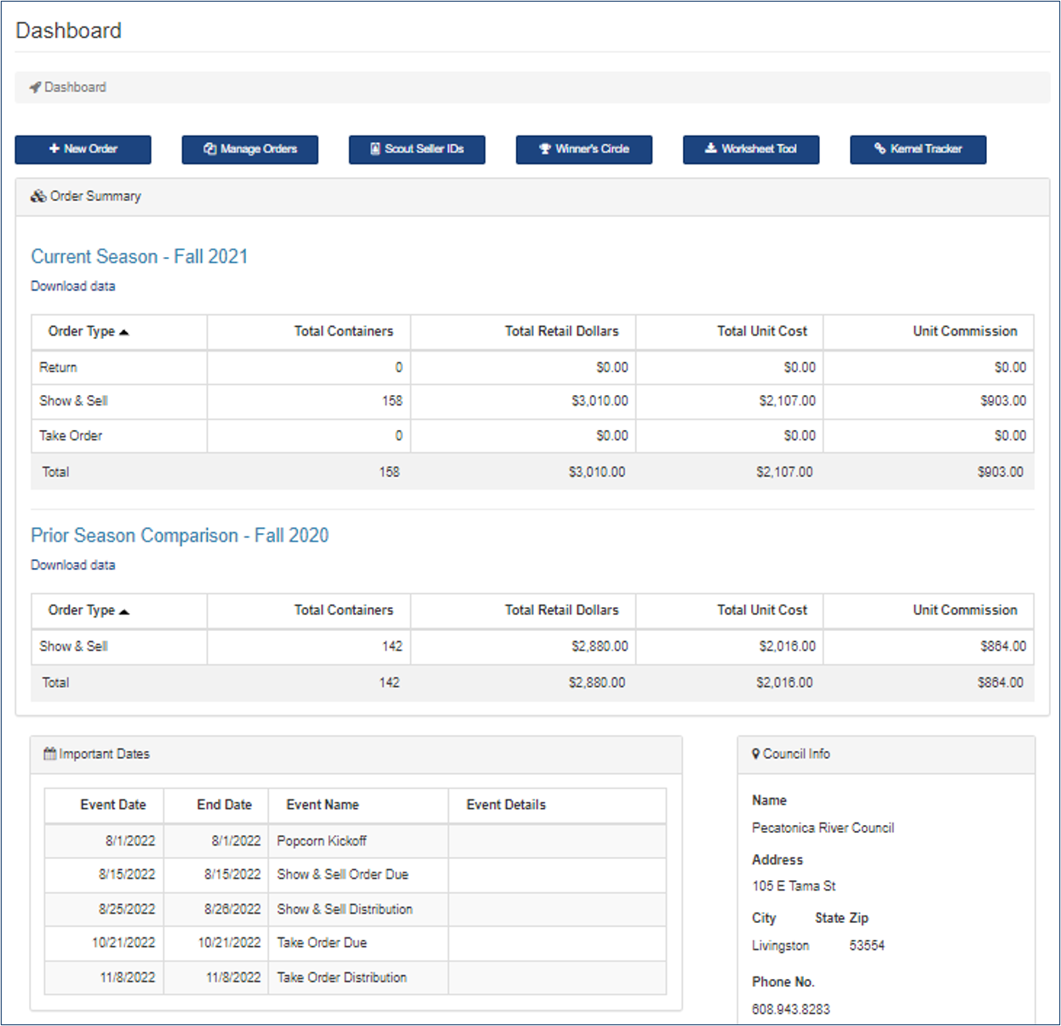
Dashboard
New order
Manage Orders
Prior Year’s Sales
Scout Seller IDs
Winners Circle
Worksheet Tool
Kernel Tracker

Slide 32
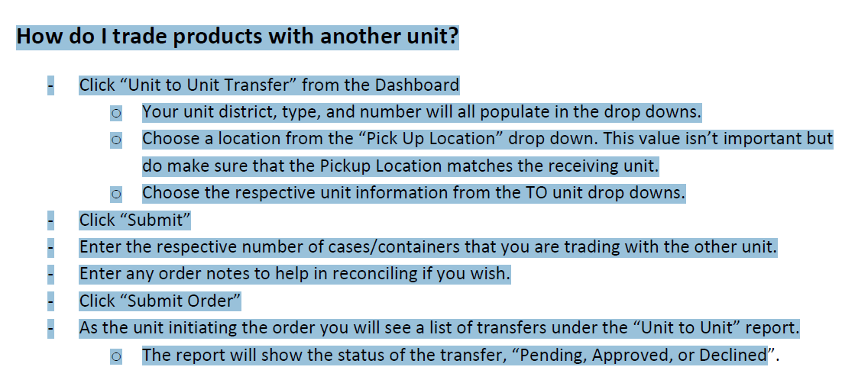
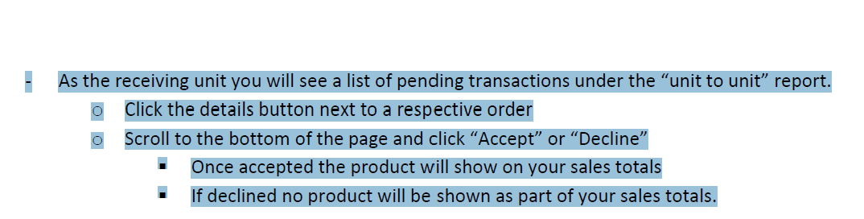

Slide 33



Information/Communication
District Kernels
Polaris – Nataria Scales natljones_20@yahoo.com
Gateway – Roger Bauer rxbauer@netscape.net
Frontier – Natalie Knore faerychick27@yahoo.com
Daybreak – Jeremy Boggs jeremy.boggs@hapcap.org
James.Dockter@Scouting.org
614.310.1327

Slide 34
THANK
YOU
FOR SUPPORTING SCOUTING

