Slide 1


SIMON
KENTON
COUNCIL 2025
PRPOPCORN.COM

Slide 2













WHY SELL POPCORN?
POPCORN PAYS FOR...
SCOUTS CAN LEARN...
Outdoor activities, camp maintenence & adventures
Responsibility
Yearly fees & renewals
Follow-Through
Uniforms, patches & awards
Customer Service
Unit gear & supplies
Goal Setting
High adventures
Perseverance
Celebrations, traditions & advancement

Slide 3

POPCORN PAYS FOR SCOUTING ADVENTURES
POPCORN = PROGRAM!
Fund all your program related expenses and activities that you want your Scouts to enjoy this year, through Propcorn.
  Yearly Membership Dues
  Scout’s Life Magazine
  Uniforms, Patches, and Awards
  Camping Trips
  Hikes
  Celebrations
  Blue & Gold Banquet
  Court of Honor
  Pinewood Derby
  Meeting Supplies & Equipment
  and more...

Slide 4
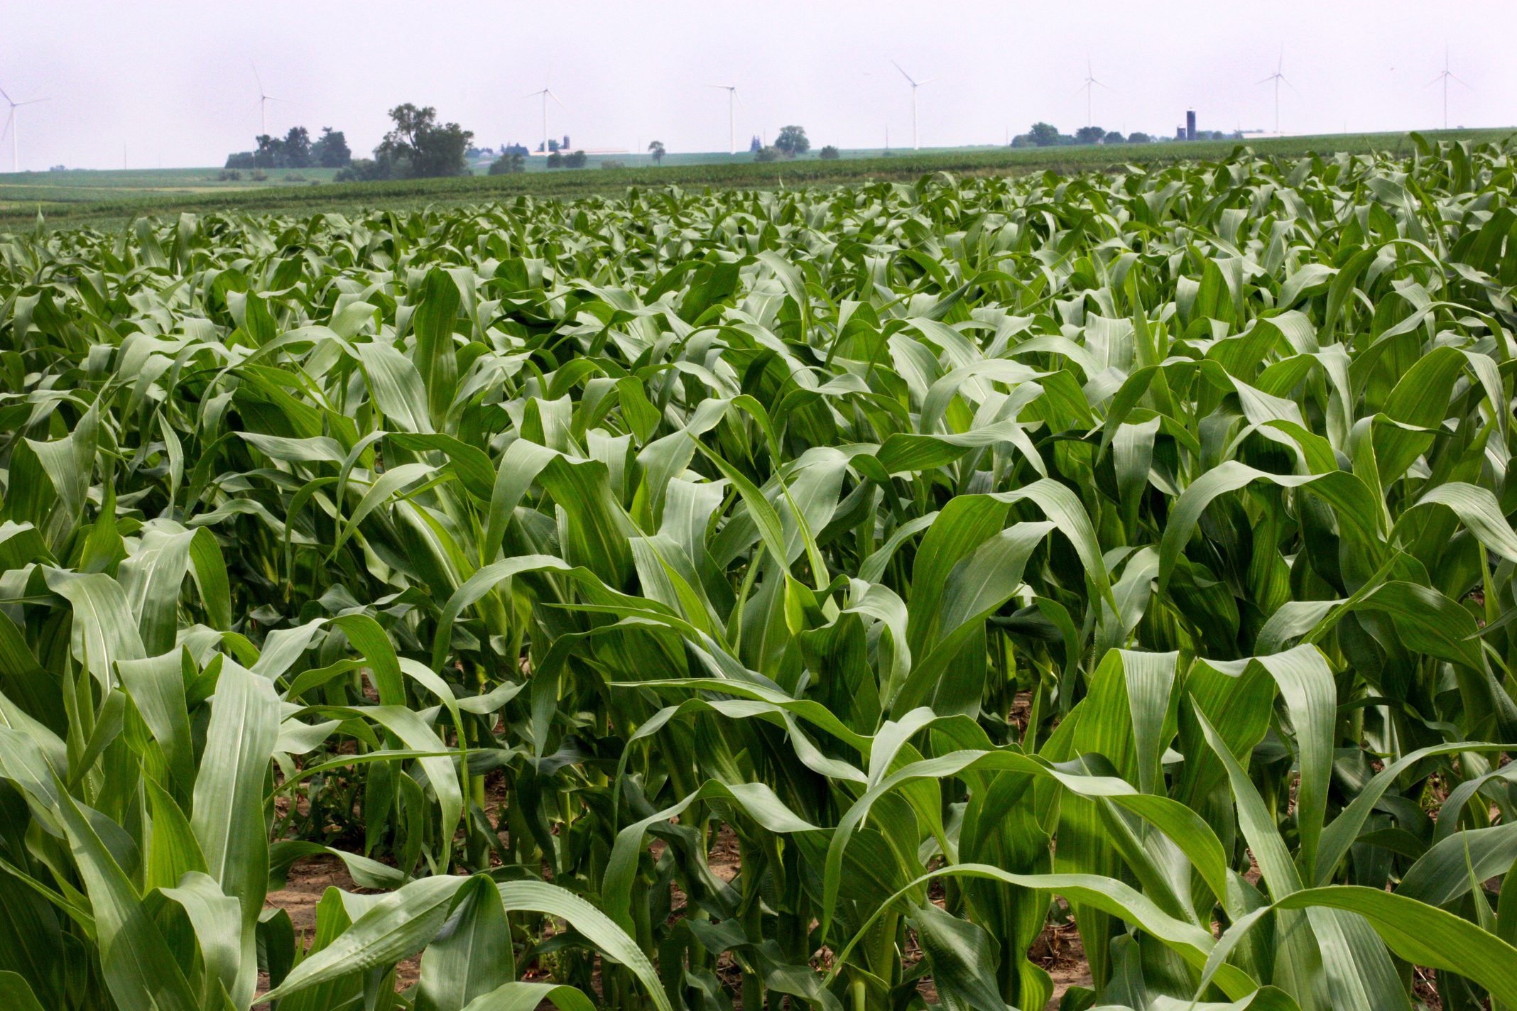
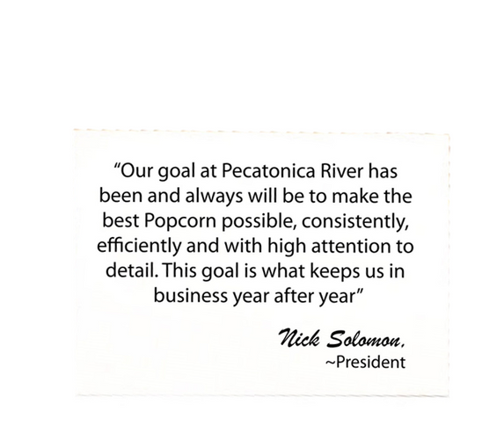
WHO WE ARE
Attention to detail is paramount. Since 1983, we have been creating high-quality popcorn. Over the last 42 years, we have partnered with different Boy Scout councils, tailoring each sale to maximize the unique strengths and resources of each council. This customization includes designing containers, offering exclusive products, and creating personalized promotions.

Slide 5
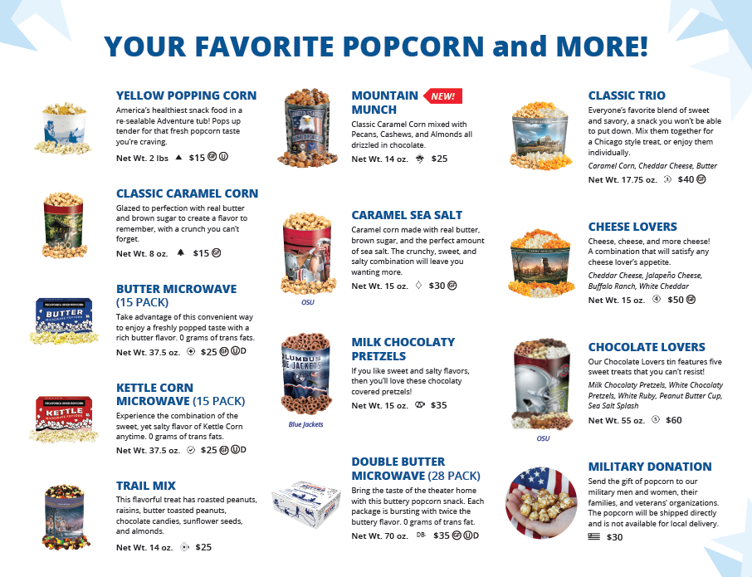
2025 PRODUCT MIX

Slide 6
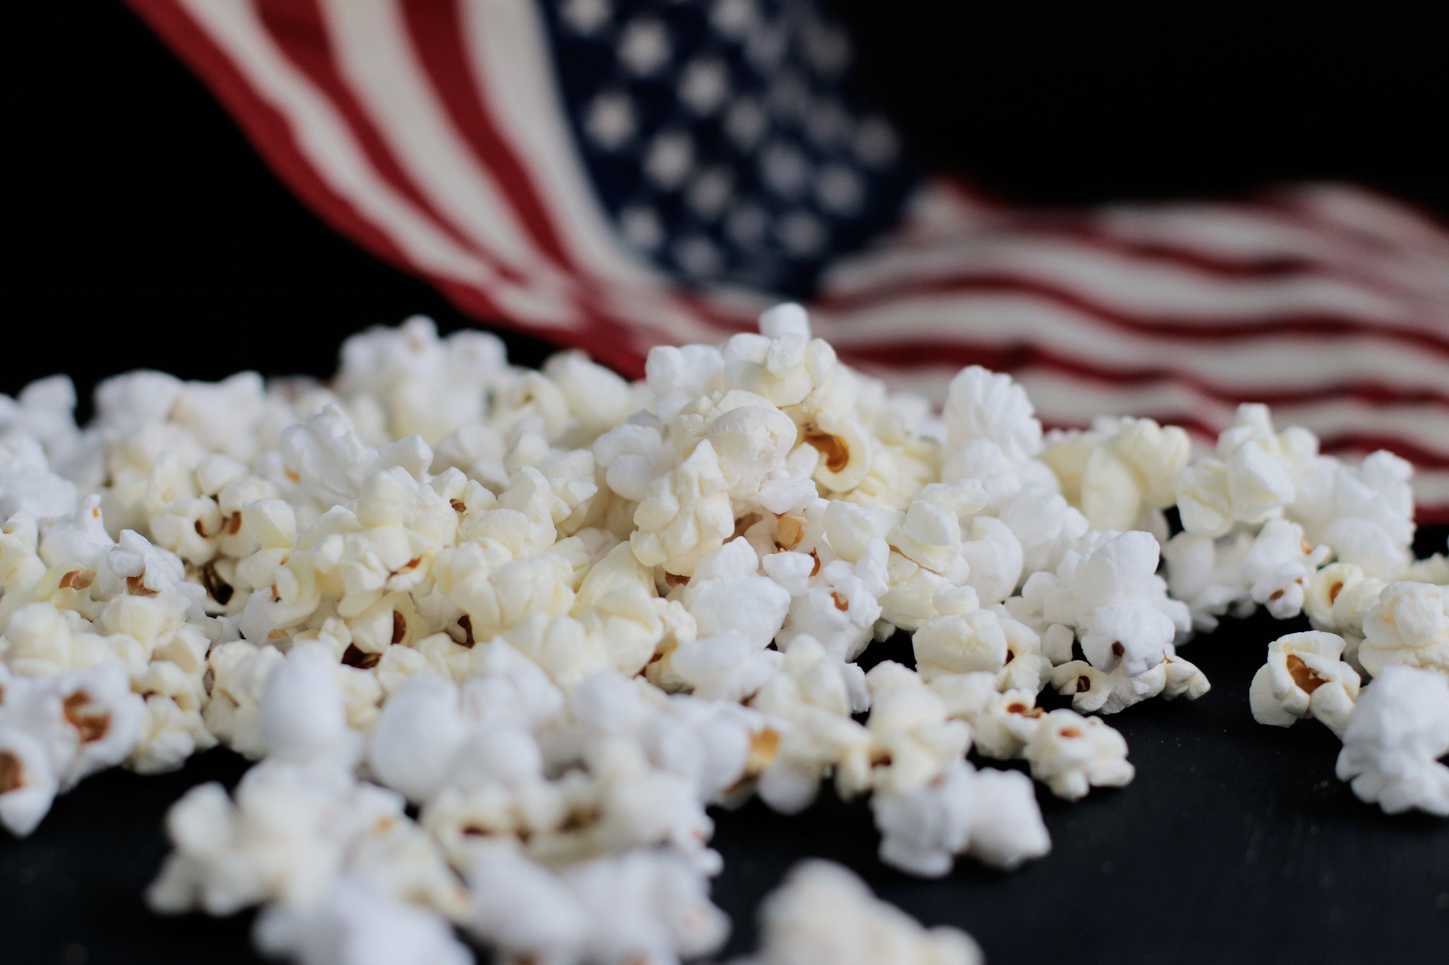


MILITARY
DONATIONS
A military donation allows customers to purchase popcorn for the military men & women serving our country, while supporting Scouting at the same time.

Slide 7





TOOLS TO BOOST SALES
SALES FLYERS
Scout takes the flyer door to door to collect orders.
Form has spaces for up to 30 names.
DOOR HANGERS
Lists online store product mix for customer to purchase using Scout seller id with no delivery by Scout.
TAKE-TO-WORK TENTS
Display your popcorn at a high-traffic area like your workplace to boost sales easily!
TASTING KITS
Scouts taste product and share their experience with customers.
BULLET BOARDS
& TOTES
Draw attention to your sale.

Slide 8
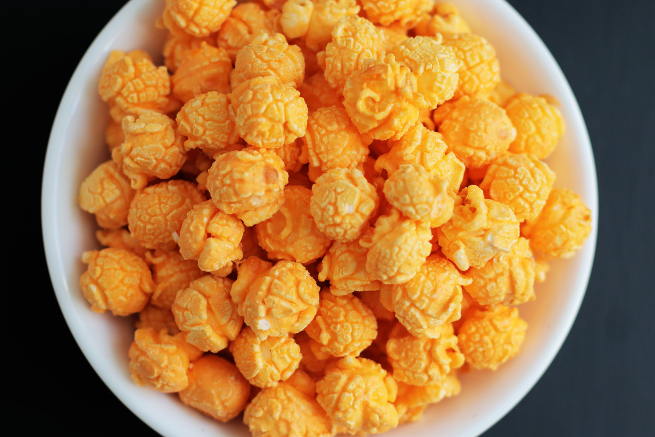
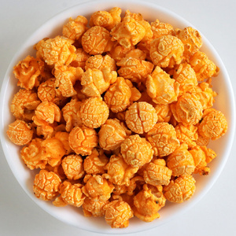

TASTING KIT
FAMOUS PR POPCORN TASTING KIT
The purpose of a tasting session is to have each Scout try 1-2 kernels of each flavor. Let the Scouts vote on their favorites - have fun with it!
Boost your sales with a tasting session. Foster familiarity and product knowledge. Encourage the Scouts to share their tasting experience with potential buyers.

Slide 9






Show & Sell
Set up in high traffic area
Popcorn is ordered in advance on consignment from Council
Show & Deliver
Combine Show & Sell and Take Order
Popcorn is taken door to door & sold on the spot
01
WHERE TO SELL
02
Take Order
Traditional way of going door to door
Popcorn is delivered after the sale
03
Online Store
Customers can support all across the country
Each Scout gets credit for sales

Slide 10
SCOUT SCRIPT & BEST PRACTICES
SCOUT SCRIPT
“Hello! My name is _________________ and I am with pack/troop _______. I am selling popcorn to earn my way to ________ and support our camp outings. I have some great popcorn flavors available for sale. My favorite flavor is ___________ and I know you will love our popcorn assortment. Would you consider supporting me?
***Always thank your customer, even if they do not purchase. Be cordial & kind.
SELLING TIPS
  Be in Uniform - always wear your clean uniform.
  Know Your Products - know the names & types of popcorn you are selling.
  Be Prepared - practice your sales script and pitch. Have confidence and smile!
  Always Thank your Customers - even if they do not purchase.
  Follow Scout Safety Tips - buddy system, road-rules, money management and curfew.

Slide 11


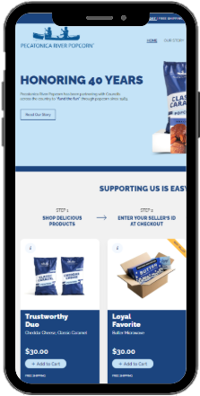
ONLINE STOREFRONT
SHOP ONLINE!
PRPOPCORNSTORE.COM
Every purchase goes to the Scout's unit and Council in their name
FREE SHIPPING
No deliveries to worry about - all ships from PRP
ALL SALES COUNT!
All sales qualify for Winner’s Circle! Personable email can be sent to family & friends with customized video message

Slide 12


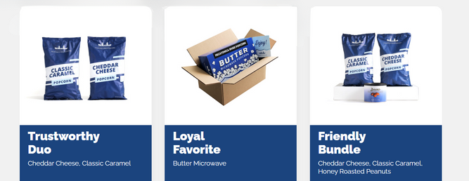
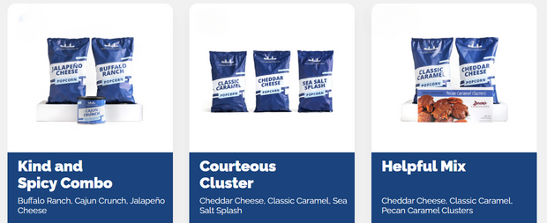
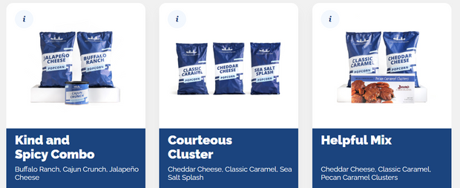
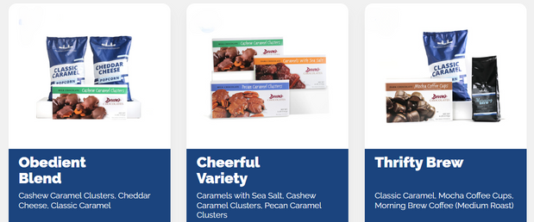
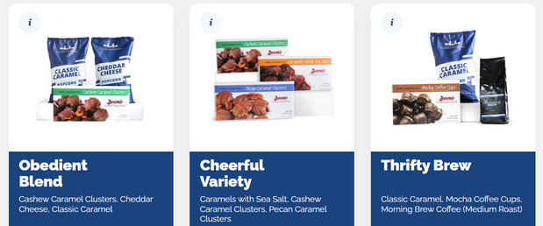
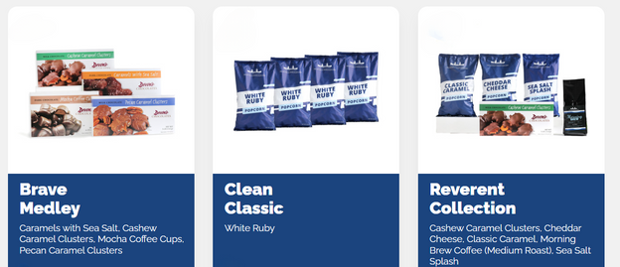

2025 ONLINE SALE
Shop our product mixes today - or support the military with our
MILITARY DONATION
$30.00
$30.00
$35.00
$35.00
$40.00
$40.00
$45.00
$45.00
$45.00
$50.00
$55.00
$60.00
WWW.PRPOPCORNSTORE.COM

Slide 13


ONLINE RESOURCES
WWW.PRPOPCORN.COM
TRAINING VIDEOS
SALES TOOLS
WATCH & LEARN OUR 12 VIDEOS TO HELP YOU MAKE THIS SEASON A SUCCESS!
NUTRITION INFORMATION, PRODUCT WEIGHTS & DIMENSIONS AND MORE!
PRINTABLE RESOURCES
PAYMENT INFO
RECEIPTS, LEAVE BEHINDS & MORE!
LEARN ABOUT SUGGESTED PAYMENT OPTIONS!

Slide 14
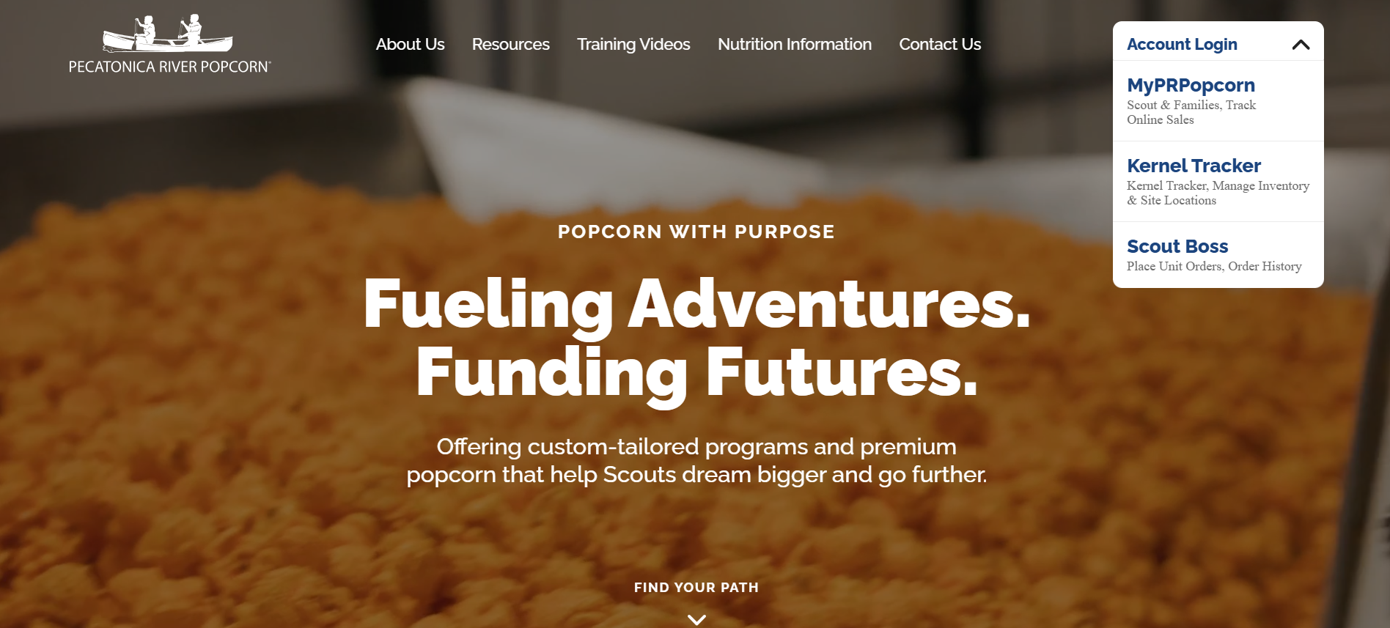
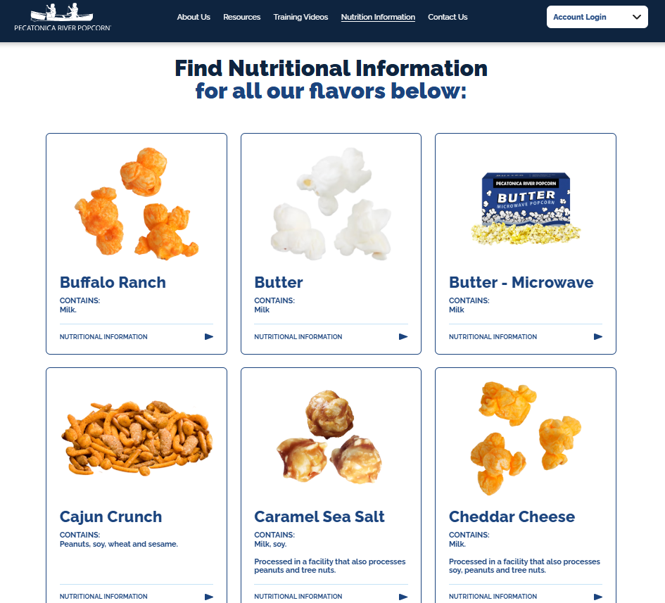
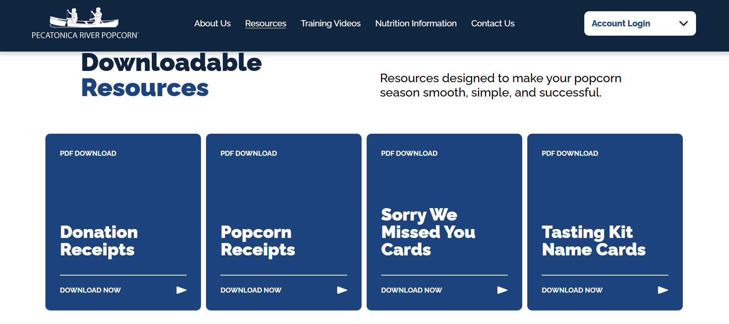
Updated Website (www.prpopcorn.com)

Slide 15
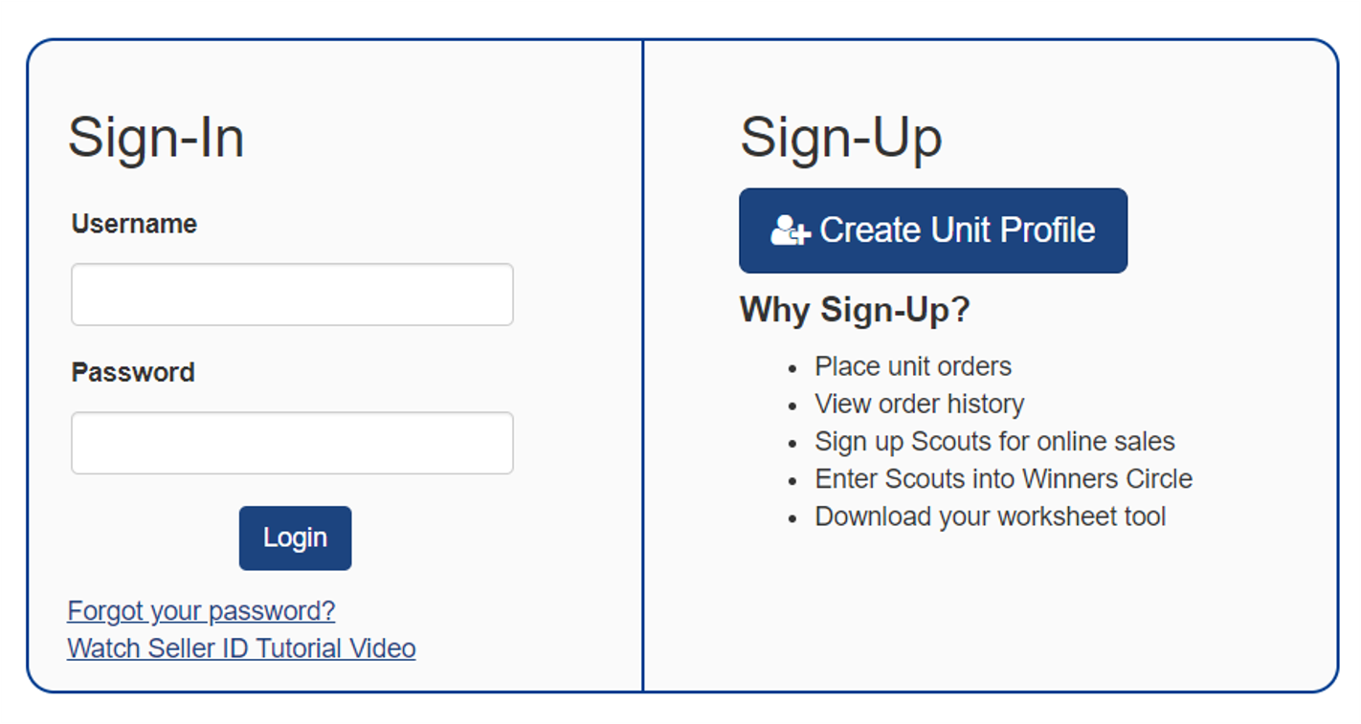
Getting Started
Go to PRPopcorn.com
Click “My Account”
Click “Create Unit Profile”
Council Key = 441SKC

Slide 16
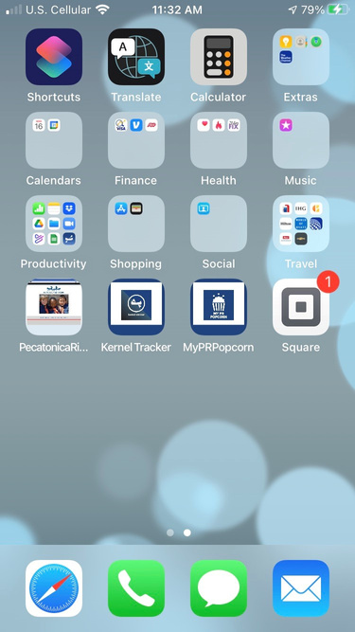






3 APPS TO MANAGE
YOUR SALE
MY PRPOPCORN
App used to promote online sales at the Scout level through social media. *2025 ENHANCEMENTS*
MY PR POPCORN
KERNEL TRACKER
App designed to manage unit level inventory down to the Scout level. *2025 ENHANCEMENTS*
SQUARE READER
Money collection app to allow for the collection of credit cards.

Slide 17




USING MY PRPOPCORN
Quick & Easy Guide
MY PR POPCORN
UNIT KERNEL SIGNS YOU UP FOR SELLER ID
Watch for your registration email from “Pecatonica River Popcorn” (pops@prpopcorn.com) with the subject “Scouting America Online Popcorn Sale”
CREATE YOUR PROFILE
Click : “Register Now” in the email from step one to get to the MYPRP platform to create a profile. Include a picture & video! Drive your success with a complete profile!
SHARE YOUR LINK!
Share to Facebook, X, Email and/or Text by clicking the share buttons at the top of your profile page.!

Slide 18
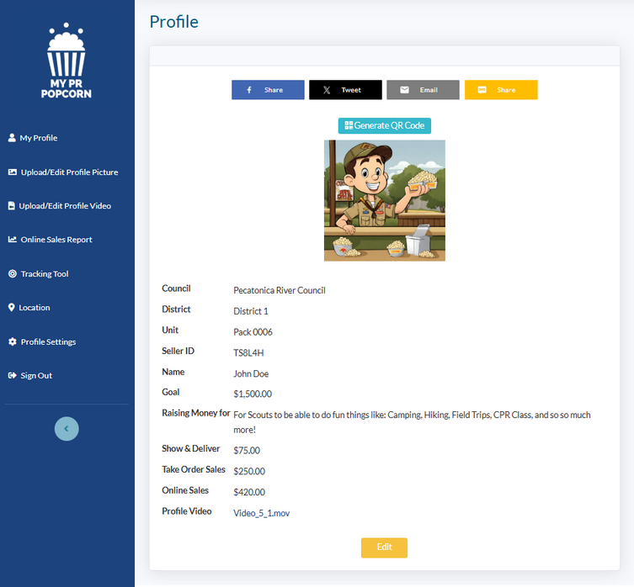
USING MY PRPOPCORN
Quick & Easy Guide
MY PR POPCORN
MY PRPOPCORN DASHBOARD
3
  1 Record your sales
  2 Sign up for Show N Sell shifts
  3 Share with those not on Social Media
2
1

Slide 19
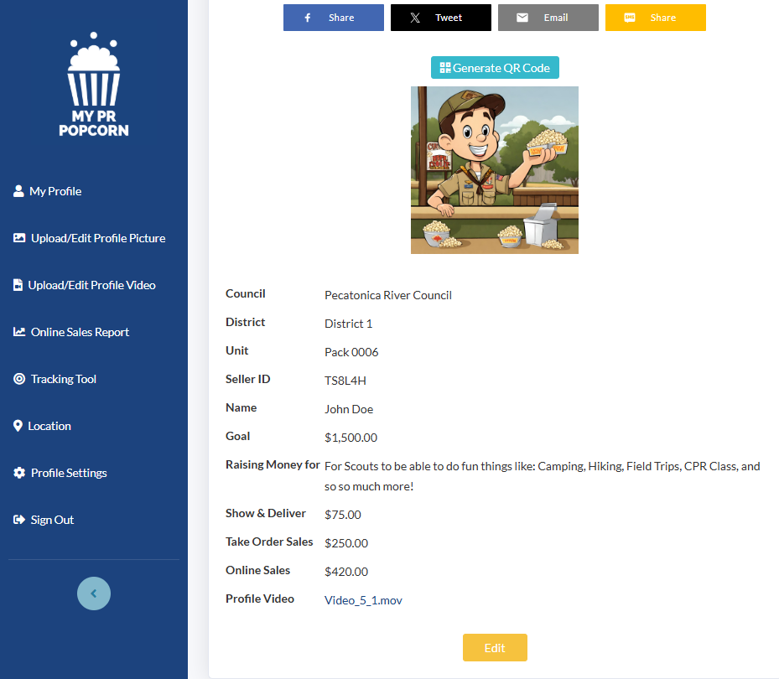
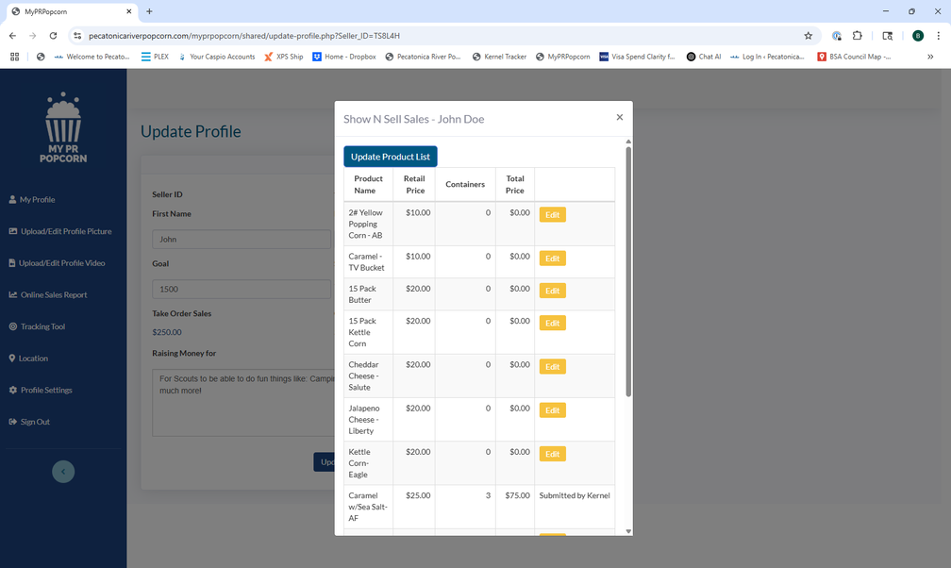
USING MY PRPOPCORN
Quick & Easy Guide
New Feature
MY PR POPCORN
RECORD SALES
Click the “Edit” button from your dashboard to enter in your Show & Deliver and/or Take Order Sales by clicking on the retail value for the respective order type.
Your unit kernel can update values from their app as well. If they do so, you will be only able to view the values for that product and no longer update.

Slide 20
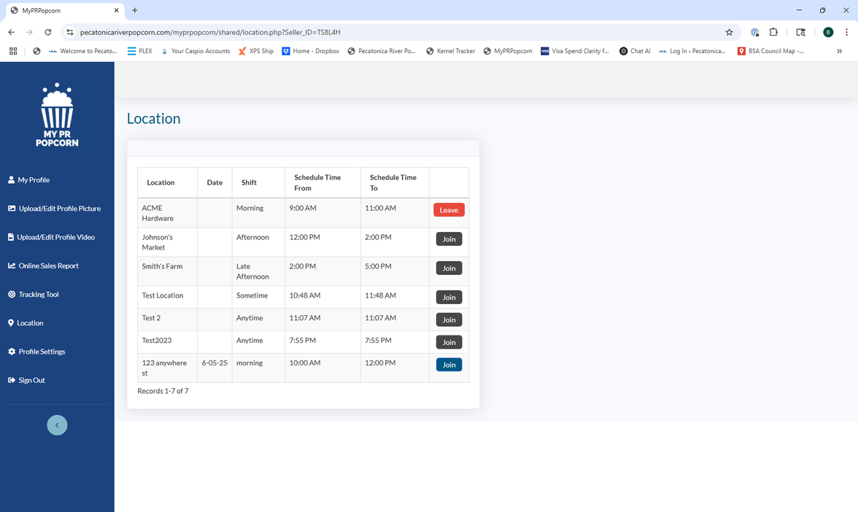
USING MY PRPOPCORN
Quick & Easy Guide
MY PR POPCORN
SIGN UP FOR
SHOW N SELL SHIFTS
Click the “Location” link from the left side navigation menu.
  Click “Join” next to the shift of the location you wish to sign up for.
    If the button is blue the shift if open
    If the button is black the shift is closed or full
  Click “Leave” to remove yourself from the shift

Slide 21
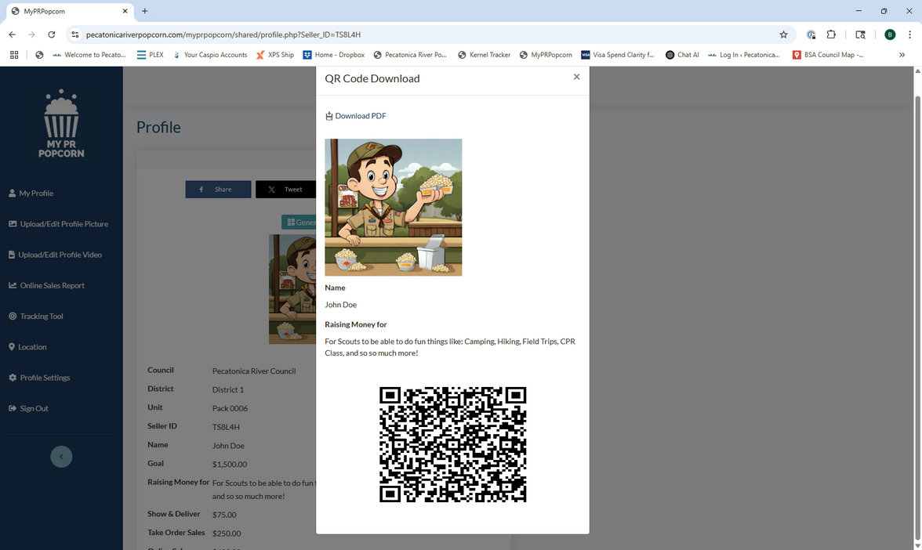
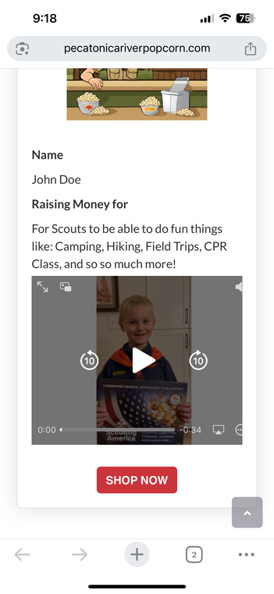
USING MY PRPOPCORN
Quick & Easy Guide
MY PR POPCORN
SHARE WITH THOSE NOT ON SOCIAL MEDIA
Click the “Generate QR Code” button from your dashboard..
  The QR code will take the consumer to your online profile for them to scan and view your video and why you are selling.
  At the bottom of their
screen they can click
“shop now” to go to the
online store to support you.

Slide 22
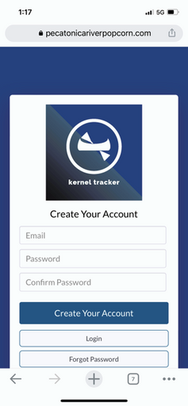
KERNEL TRACKER
Quick & Easy Guide
MANAGE INVENTORY
By Scout
Container
Retail Value!
VIEW DISTRIBUTED STOCK
By Scout
Container
Retail Value
MANAGE SITE LOCATIONS
Create location opportunities
Limit number of Scouts
Assign Scouts to Shifts

Slide 23
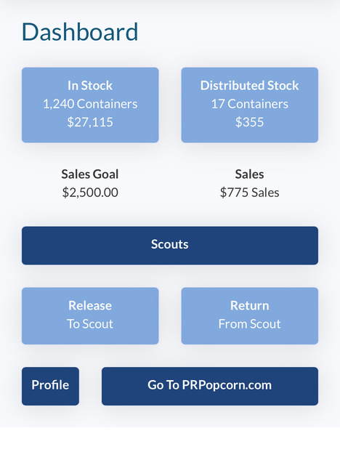
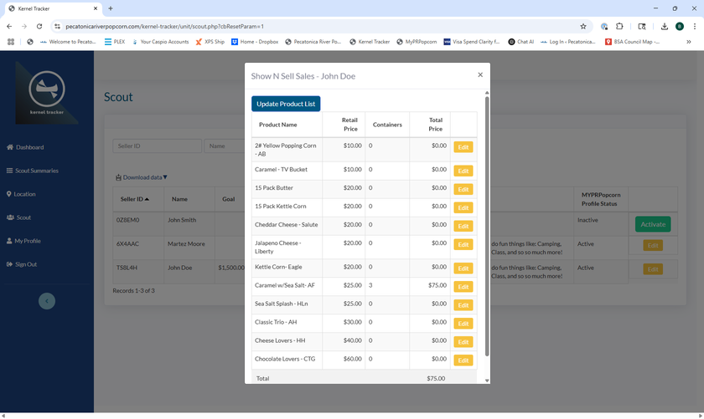
KERNEL TRACKER
Quick & Easy Guide
New Feature
MANAGE INVENTORY
  By Scout
    click “Release to Scout” or “Return to Scout” to allocate inventory.
  Container
    click “Scout” from left side navigation to see what families have entered in their app for Show N Sell and/or Take Order
    sales. Edit values as
    needed.

Slide 24
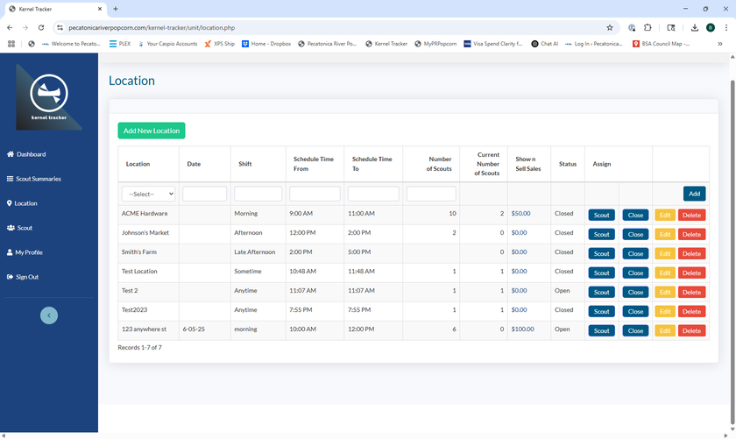
KERNEL TRACKER
Quick & Easy Guide
New Feature
MANAGE SITE LOCATIONS
  Click “Location” from the left side navigation.
    click “Scout” to assign Scouts or see who is signed up.
    Click “Close” to close the shift and the system will distribute sales equally (you can edit this if desired).
    Click the retail value in the Show n Sell Sales column to allocate unit inventory to the location.

Slide 25

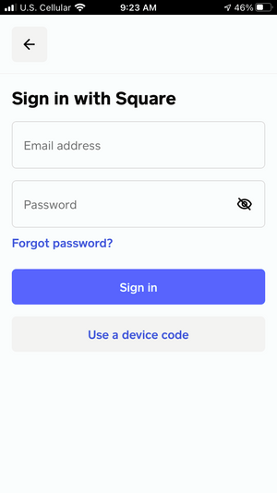

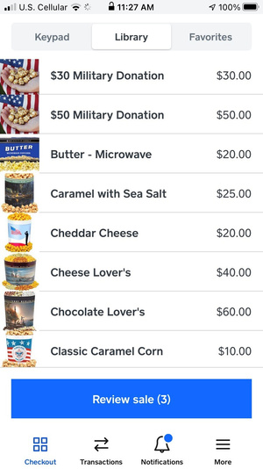
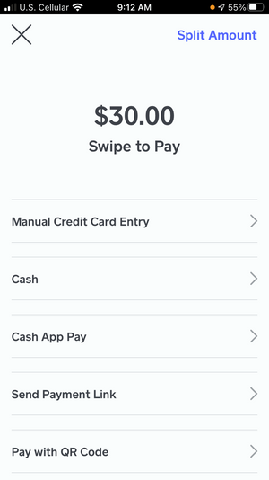
SQUARE READER
Capture Funds
PAYMENT TYPES
Cash
Check
Credit Cards
EASY DEPOSITS
All money collected is deposited into the unit account for payment to the Council

Slide 26



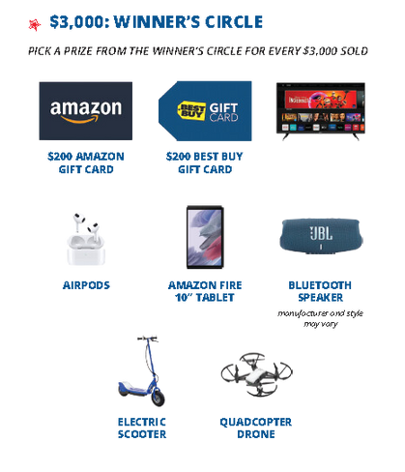

UNIT POPCORN KICKOFF
The Unit Popcorn kickoff offers a fantastic chance to captivate and inspire your Scouts while also providing an ideal platform to enlighten parents about the importance of selling popcorn to sustain your Scouting program.
BEST PRACTICES
Promote the Popcorn! The best way to sell Pecatonica River Popcorn is by tasting! Have the Scout try all the flavors and pick their favorite. In addition, practice their sales pitch & review all safety tips.
Discuss the Winner’s Circle Prizes! All Scout sales, including Online Sales, qualify the Scouts for our Winner Circle prizes. Highlight previous sales’ winners or prizes.
Make it fun! Consider banners, posters, balloons and music to help create a fun & exciting environment. This is your opportunity to really excite the Scouts!

Slide 27
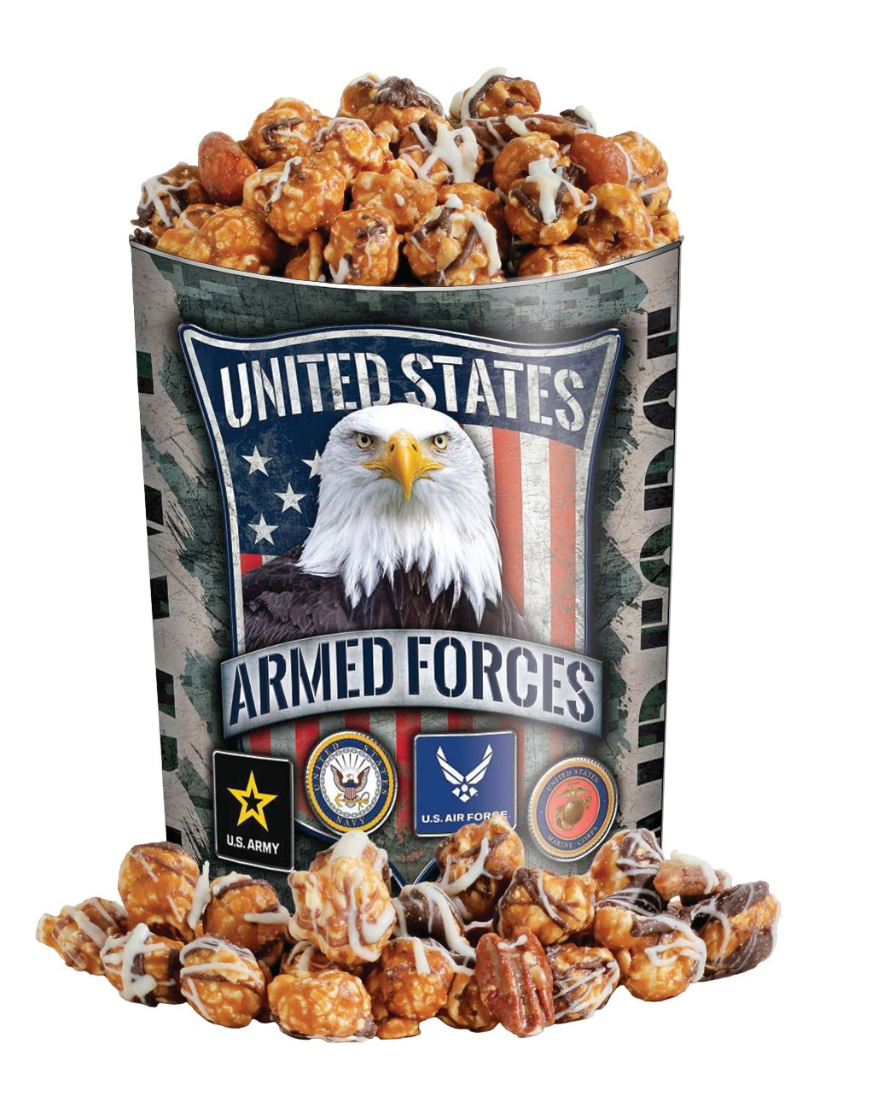
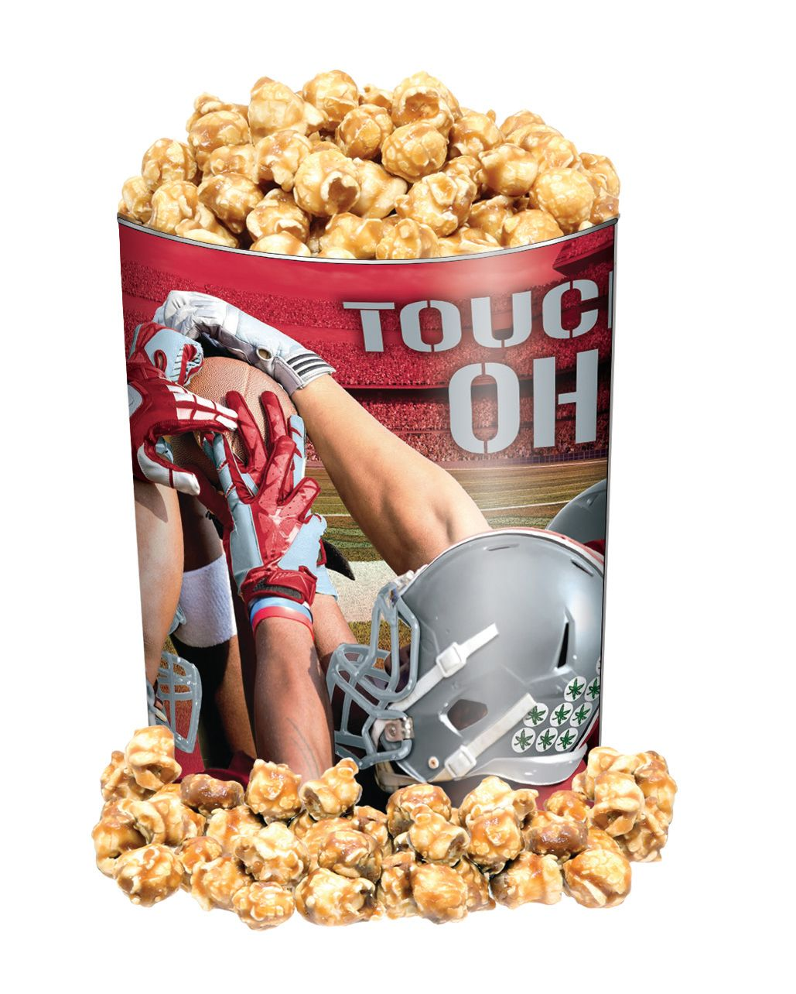
2025 Simon Kenton Council Popcorn Calendar
Order, Distribution and Return Information:
Pecatonica River Online Store is Open:
Friday, August 1st – Sunday, November 23rd
Show & Sell Orders Due:
Sunday, August 10th
Show & Sell Distribution:
Thursday, August 21st – Saturday, August 23rd
*Specifics vary by District
1st Swap Day: Saturday, September 6th
2nd Swap Day: Saturday, September 20th
3rd Swap Day: Saturday, October 11th
Final Swap Day/Super Saturday/Last Day of Show-n-Sell:
Saturday, November 1st
*Final opportunity to return popcorn **no returns on chocolate products
Show-n-Sell Payment Due:
Monday, November 3rd
Take-Orders Due:
Friday, November 7th
Take Order Distribution:
Thursday, November 20th – Saturday, November 22nd
*Specifics vary by District
Last Day to Place Prize Orders & Invoices Paid in Full:
Friday, December 5th
**The Simon Kenton Council will not be accepting returns of Chocolate Products. The list of chocolate products for 2025 includes Mountain Munch, Chocolate Pretzels, and the Chocolate Lover’s Collection.

Slide 28
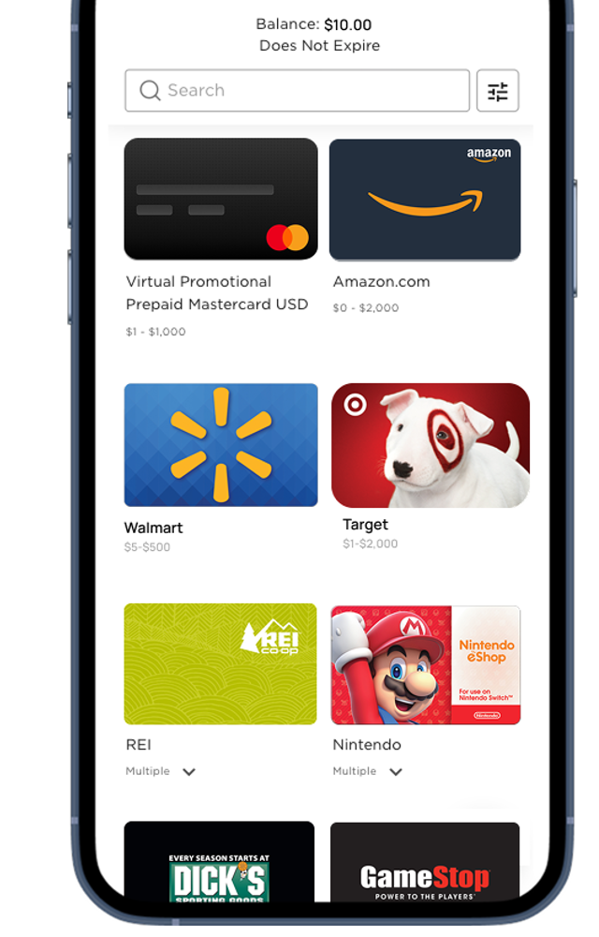
Our new prize program!
Details are being finalized, we apologize that we don’t have everything in place just yet.
The new program will utilize a points system that translates the popcorn sold by each Scout into gift cards in $10 increments.
Scouts will have the opportunity to receive gift cards from roughly 15 different vendors, delivered electronically to the family email address for immediate use.

Slide 29
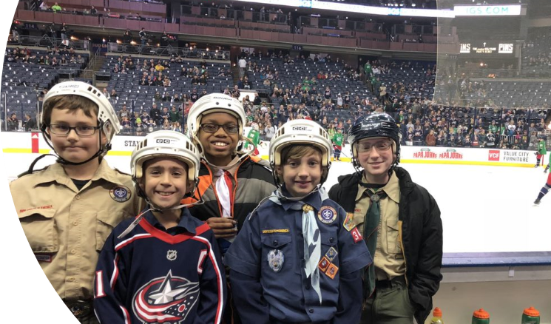
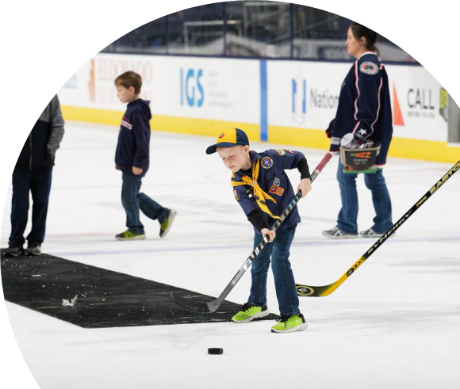

$2,000 Sellers Bonus Prize!
Free CBJ Game Tickets
  6:00 PM; Saturday, February 28th
  Columbus Blue Jackets vs New York Islanders
Exclusive Experiences
Free Scout-Themed CBJ Gift
Top 10 Sellers Get Bonus Experiences

Slide 30


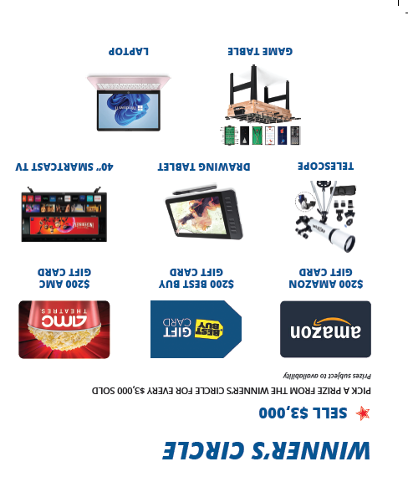
PR POPCORN
WINNER'S CIRCLE
ONLINE SALES INCLUDED!
$3,000 Winner's Circle Scout can select their prize
  All popcorn sales count (S&S, TO, Online)
  Prize choice for every $3,000 sold
  Kernel enters qualifying Scouts
  PRP fulfills and communicates with family
    Use Kernel Tracker to enter sales by Scout for validation

Slide 31

THANK
YOU
FOR SUPPORTING SCOUTING

