Slide 1

2023
Simon Kenton Council
2026 Popcorn Sale Kick-Off

Slide 2
Why is Simon Kenton Changing Vendors?
Technology
Scout App
Unit Leader Portal
Free Credit Card Processing
Storefront Scheduling
Reward Platform
Logistics
Fully staffed warehouse w/ weekly pickups
Ample product to pick up
Faster Shipping Online and for your Storefronts
More $ Back to Units
2% = Sell $5k to $20k
3% = Sell $20k to $30k
4% = sell $30k+
Scout avgs. grew 11.5%
  Over $860 a Scout!
Unit avgs. Grew 14%
  Over $10.5k Unit Avg.
Simplification
Simple Product Lineup
Streamlined tech
New Online Platform
Sell more in less time and less effort

Slide 3


TOP SELLING UNITS
Rank | Unit | Council | Total $'s
1 | Pack 313 | Greater Tampa Bay Area Council | $400,621
2 | Pack 7721 | Garden State Council | $194,274
3 | Pack 0273 | Middle Tennessee Council | $177,574
4 | Pack 365 | Greater Yosemite Council | $146,174
5 | Pack 3303 | Lake Erie Council | $145,653
6 | Troop 282 | Chief Seattle Council | $139,636
7 | Pack 0583 | Mid-Iowa Council | $138,848
8 | Troop 3714 | Northern Star Council | $125,184
9 | Pack 62 | Northeast Georgia Council | $119,871
10 | Pack 3396 | Last Frontier Council | $119,356
11 | Pack 1857 | Circle Ten Council | $112,766
12 | Pack 0264 | Crossroads of America Council | $109,310
13 | Pack 189 | Northeast Illinois Council | $108,445
14 | Pack 0081 | East Carolina Council | $108,093
15 | Pack 77 | Las Vegas Area Council | $108,013
16 | Troop 311 | Greater Colorado Council | $106,764
17 | Troop 64 | High Desert Council | $104,854
18 | Pack 107 | Three Fires Council | $104,155
19 | Pack 0112 | Crossroads of America Council | $103,399
20 | Troop 0384 | California Inland Empire Council | $101,259
NEW ALL TIME RECORD!
$400,621
Pack 313
21 Units
Sold >$100K
194 Units
Sold >$50K
2,678 Units
Sold >10K
Represents 78% of the Sale

Slide 4
TOP SELLING SCOUTS
$70,595
#1 Seller
Layton S., Troop 282,
Chief Seattle Council
Rank | Scout | Unit | Council | Total $'s
1 | Layton S | Troop 282 | Chief Seattle Council | $70,595
2 | Jonathan W | Troop 3714 | Northern Star Council | $69,453
3 | Blake R | Troop 25 | Jersey Shore Council | $60,457
4 | Jacob G | Pack 675 | Atlanta Area Council | $51,200
5 | David J | Pack 314 | Las Vegas Area Council | $34,336
6 | Grayson V | Pack 313 | Greater Tampa Bay Area Council | $34,002
7 | MA J | Troop 282 | Chief Seattle Council | $33,670
8 | Maximus J | Pack 3547 | Northern Star Council | $32,335
9 | Alana B | Pack 234 | Baltimore Area Council | $31,437
10 | Jude L | Troop 279 | Northern Lights Council | $30,804
11 | Ezra M | Pack 0202 | Pacific Harbors Council | $30,328
12 | Zoey K | Pack 62 | Northeast Georgia Council | $30,305
13 | Christian O | Pack 3303 (W2) | Lake Erie Council | $28,826
14 | Jayden C | Troop 194 | Northeast Illinois Council | $28,424
15 | Preston E | Pack 7721 | Garden State Council | $28,107
16 | Gavin B | Pack 862 | Greater Los Angeles Area Council | $27,170
17 | Trevor N | Troop 1180 | Sam Houston Area Council | $27,012
18 | Nathan R | Troop 3506 | Northern Star Council | $26,399
19 | Brody G | Troop 0384 | California Inland Empire Council | $26,381
20 | Lexi H | Pack 88 | Nevada Area Council | $25,175
4 Scouts
Sold >$40K
Layton S., Jonathan W.,
Blake R., Jacob G.
51 Scouts
Sold >$20K
384 Scouts
Sold >10K
Represents 6.7% of the Sale

Slide 5
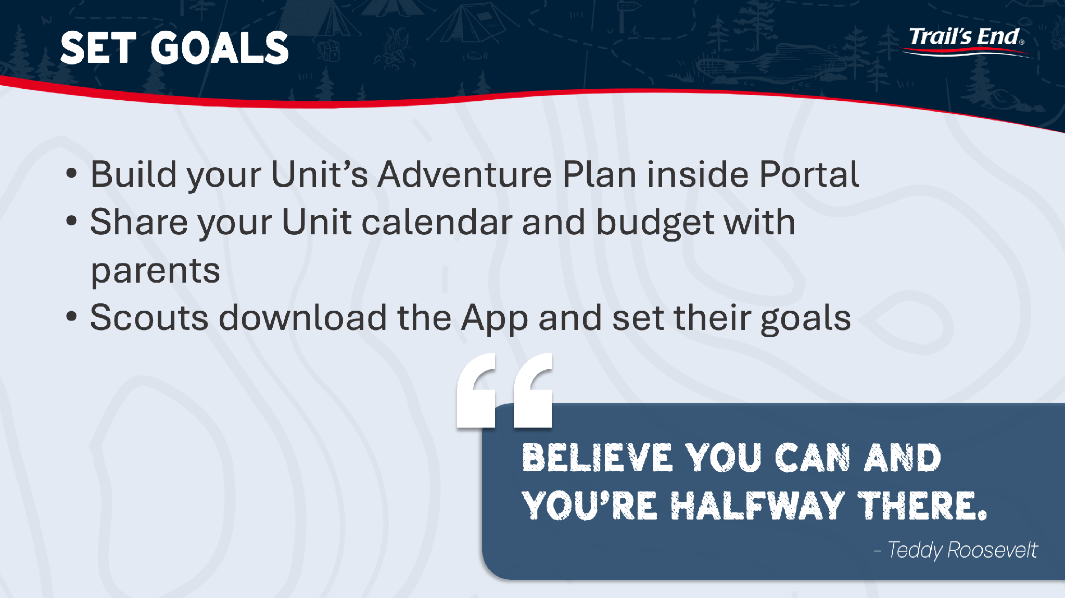

Slide 6

VALUE OF SELLING *SCOUTING*

Slide 7
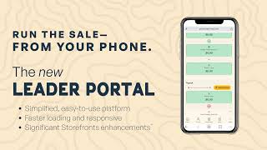
WHAT’S NEW 2026

Slide 8
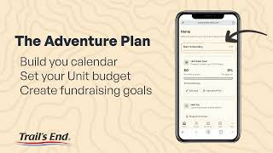
2026 ADVENTURE PLAN

Slide 9
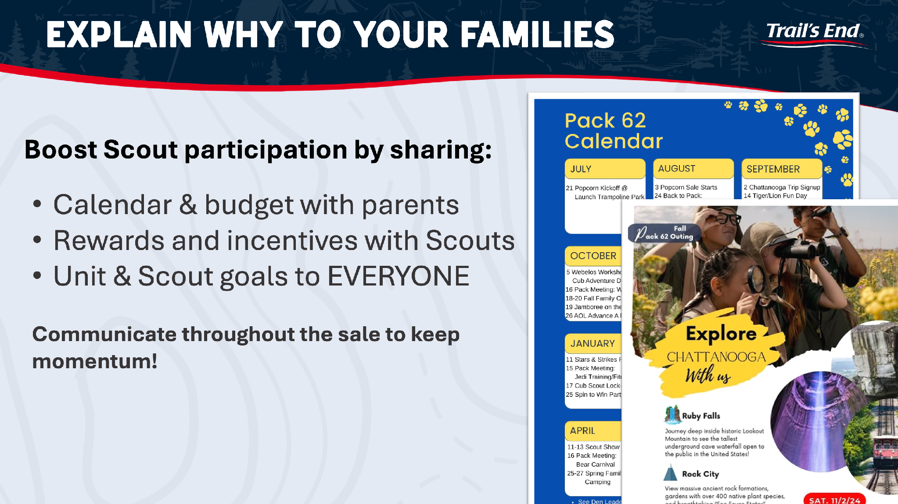

Slide 10
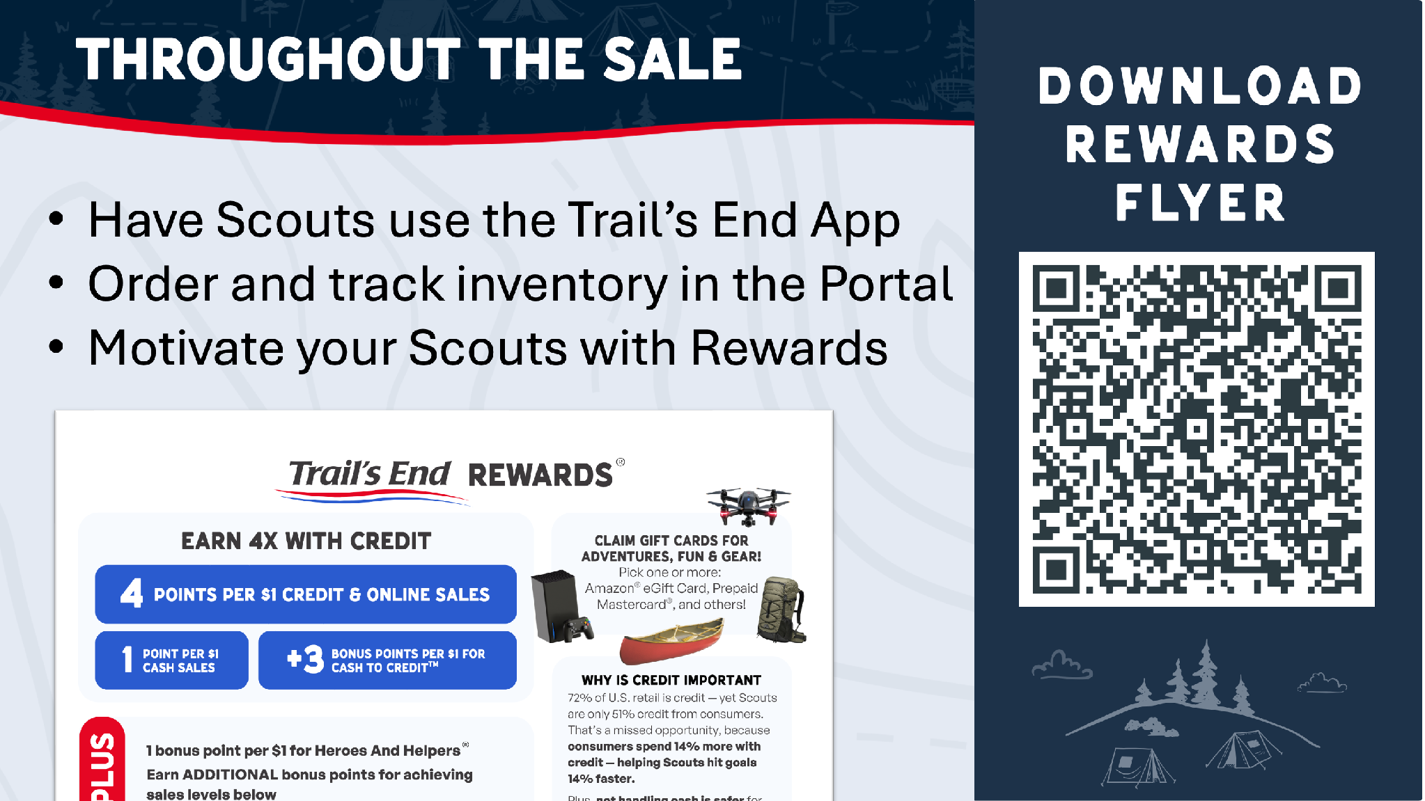

Slide 11
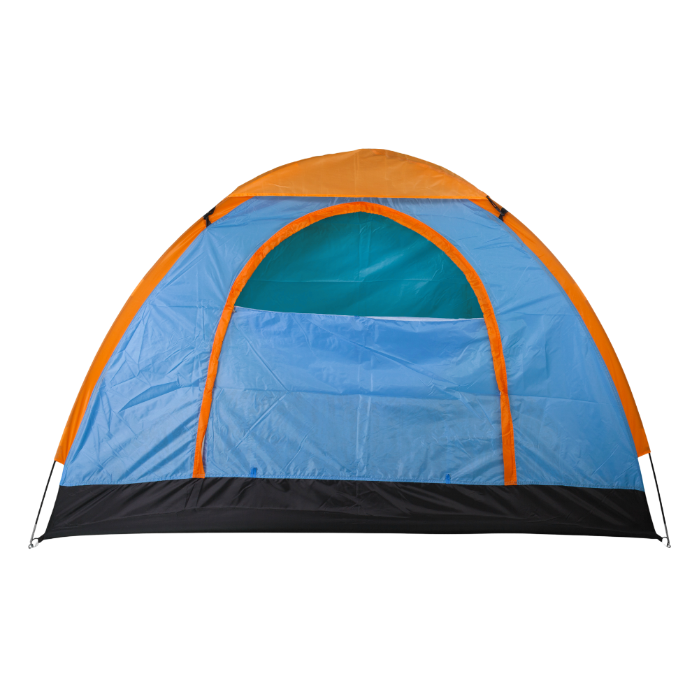

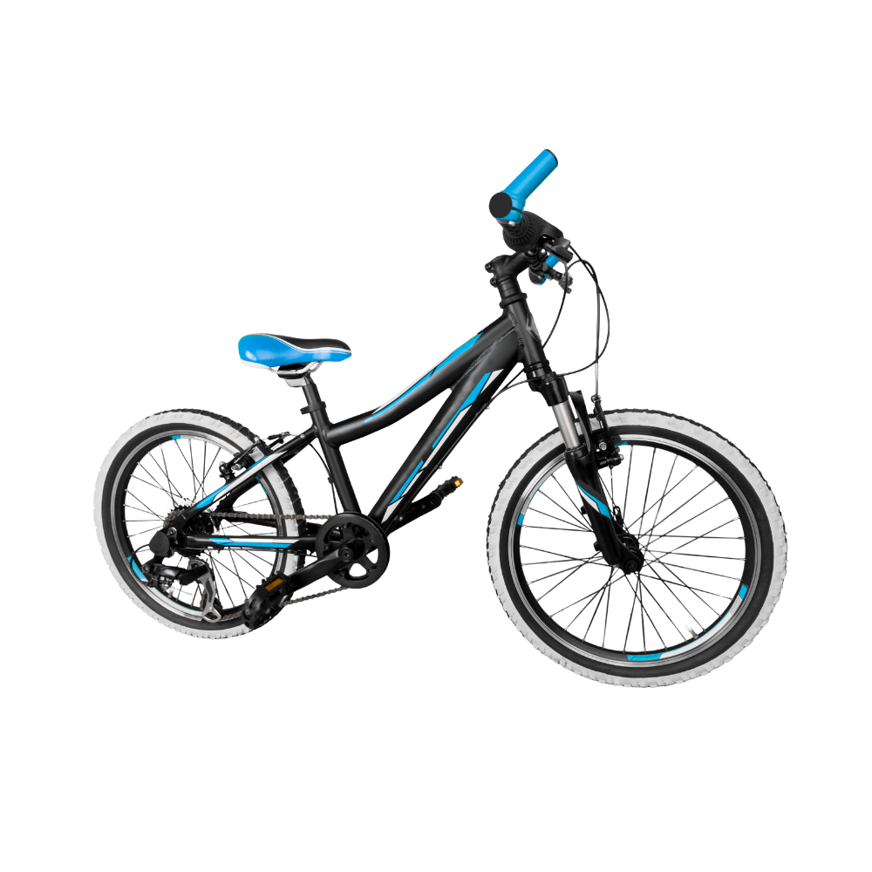

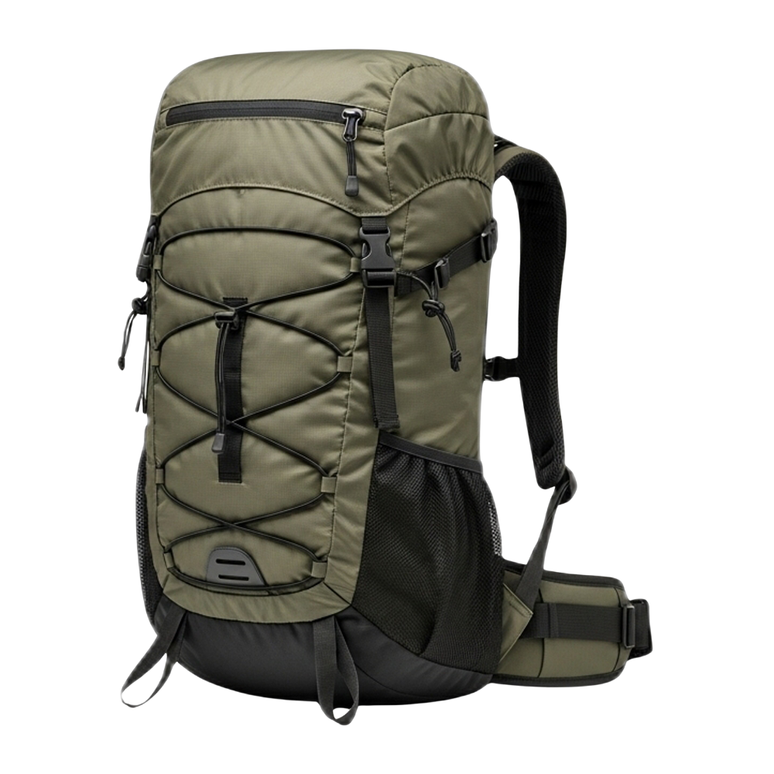
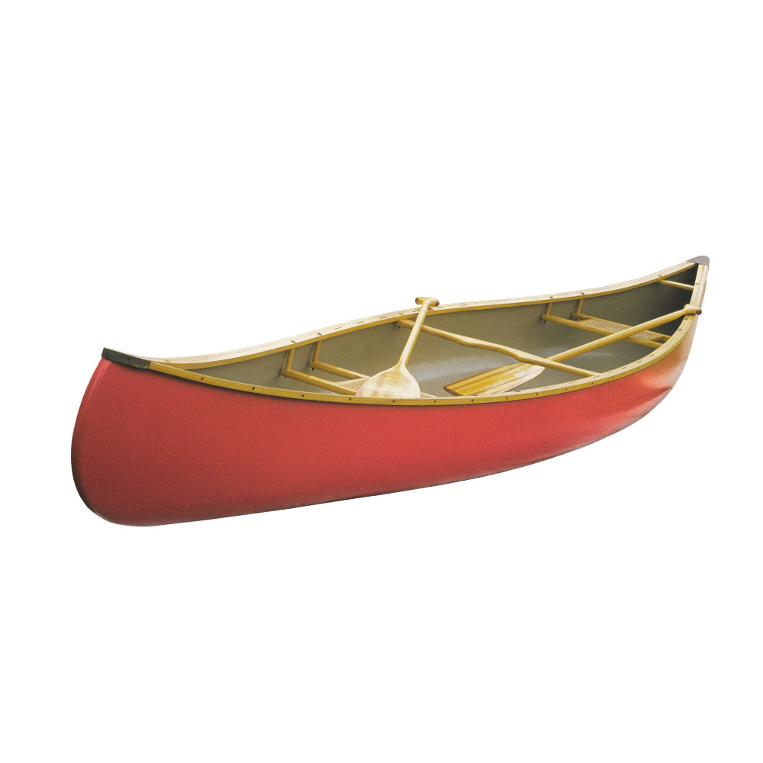


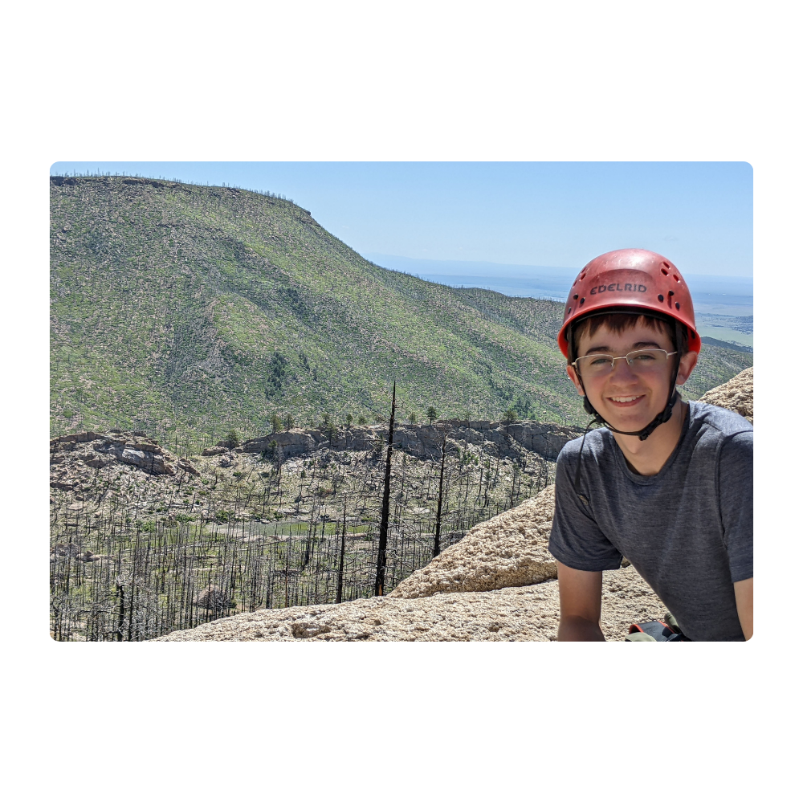
TRAIL’S END REWARDS HIGHLIGHTS
Rewards & Life Skills
For Your Scouts
Earn points and claim e-Gift Cards for adventures, fun, and gear!
  Credit earns 4x​ more than Cash
  +1 bonus point for Heroes and Helpers
  Scouts earn $0.01 per point—easy to track and calculate
  Every sale builds confidence, communication, and teamwork!

Slide 12

TRAIL’S END REWARDS HIGHLIGHTS

Slide 13

TRAIL’S END REWARDS HIGHLIGHTS

Slide 14
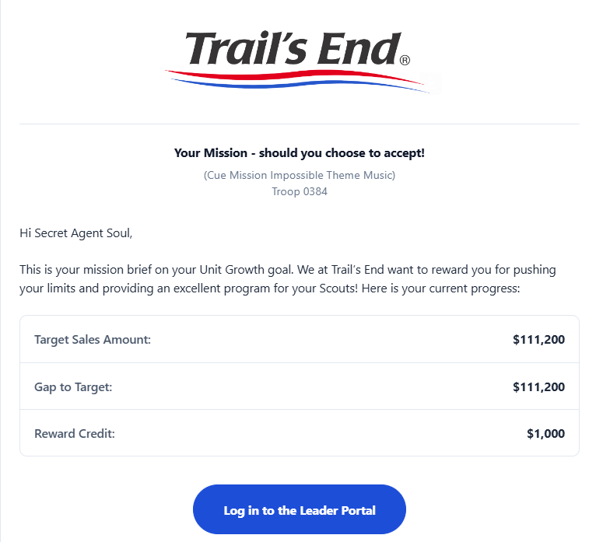
TRAIL’S END REWARDS HIGHLIGHTS

Slide 15
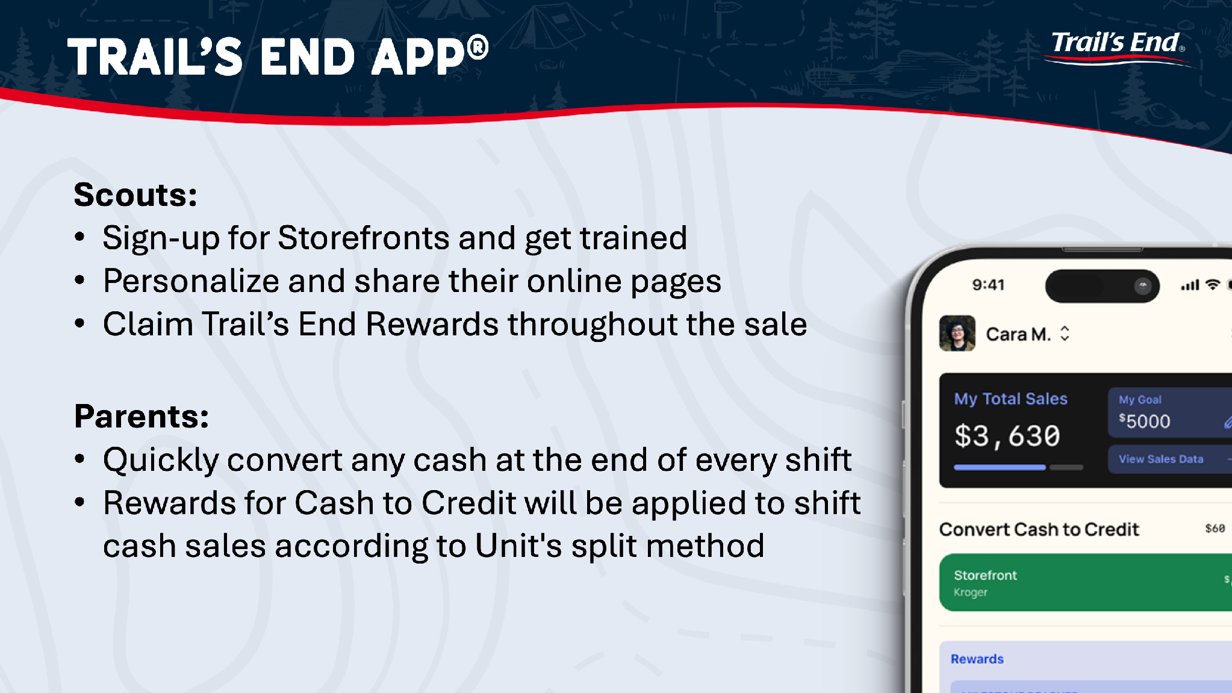

Slide 16
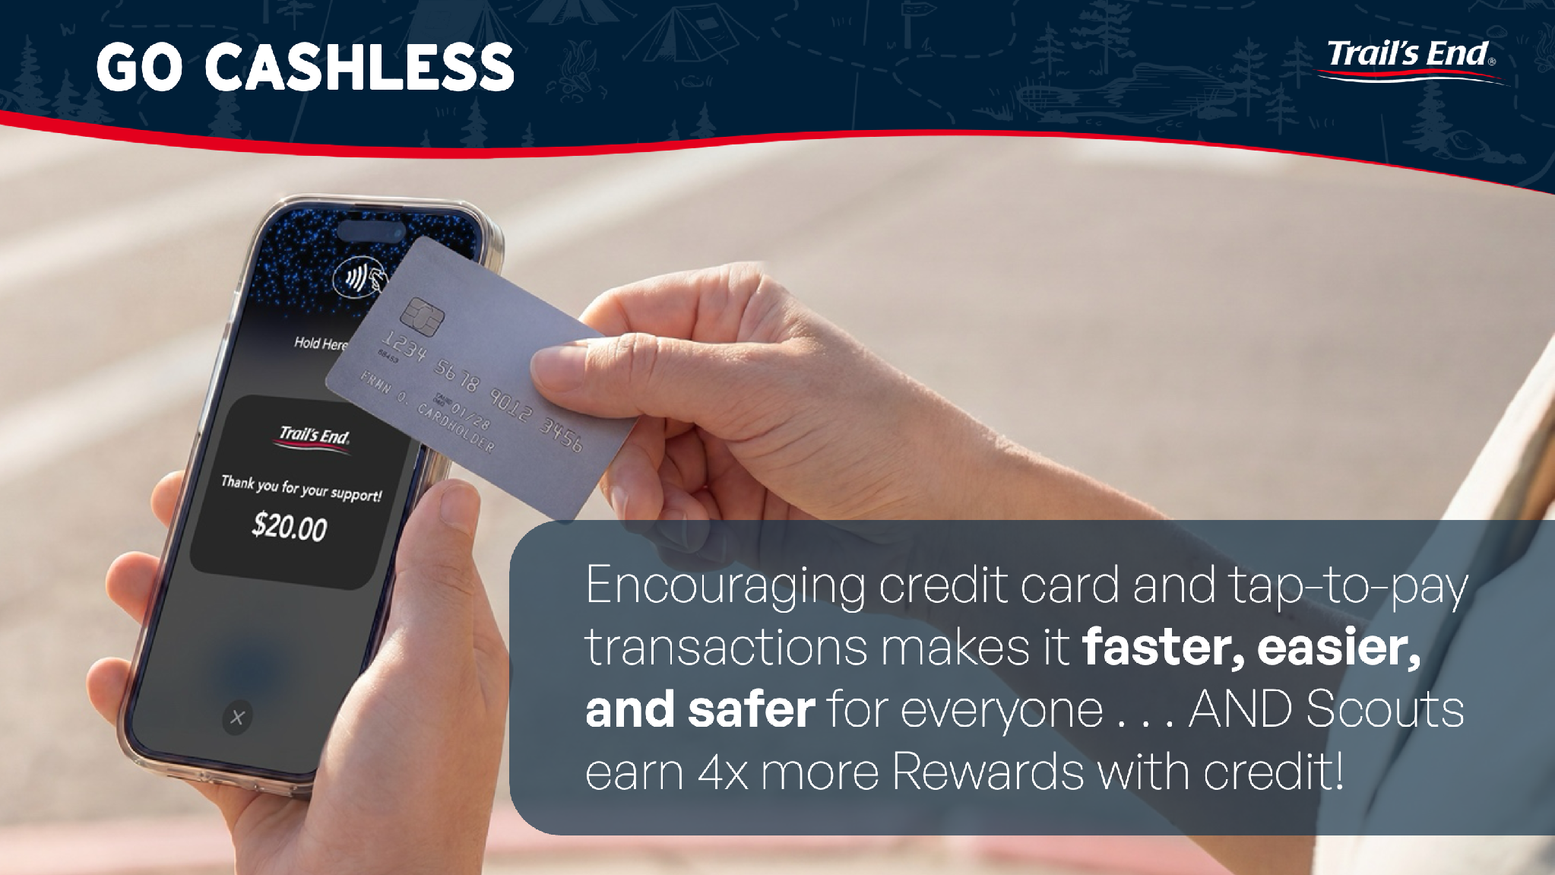

Slide 17


TRAIL’S END PROGRAM​ - ONLINE
Units avg 12-15% in Online sales​
Orders are fulfilled and delivered in *2-5 business days​
Share your custom Scout link on social media or text/email to family and friends
​

Slide 18

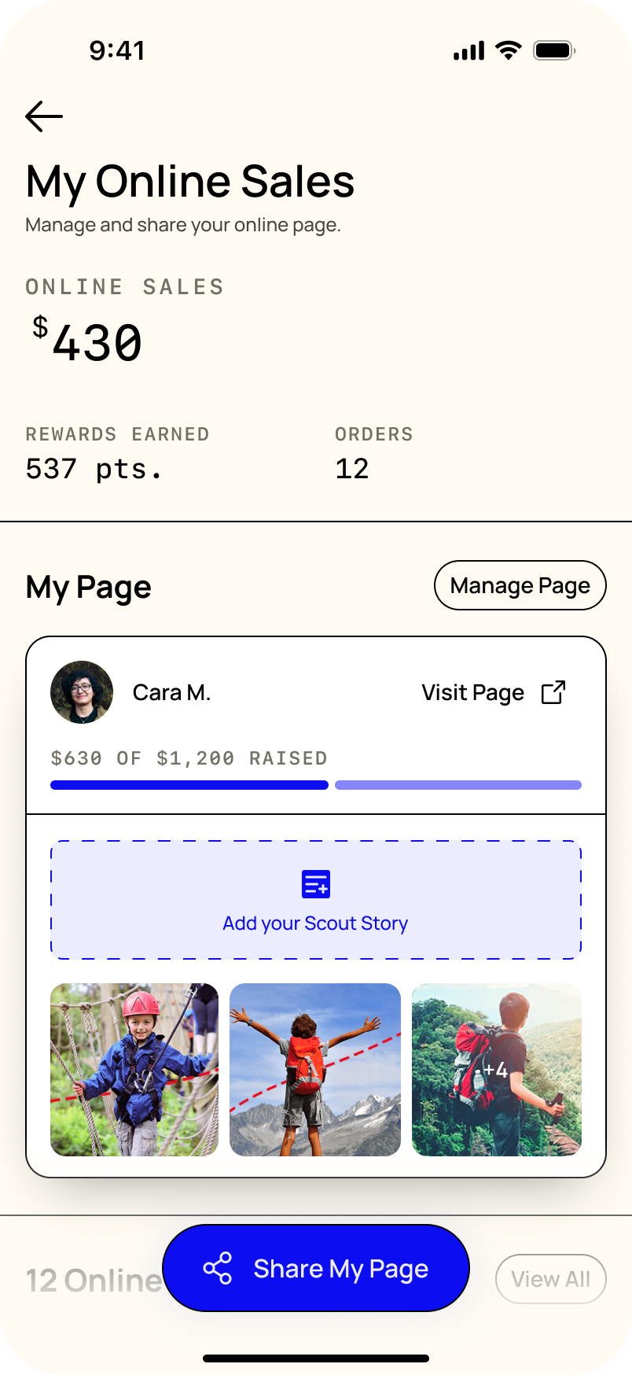

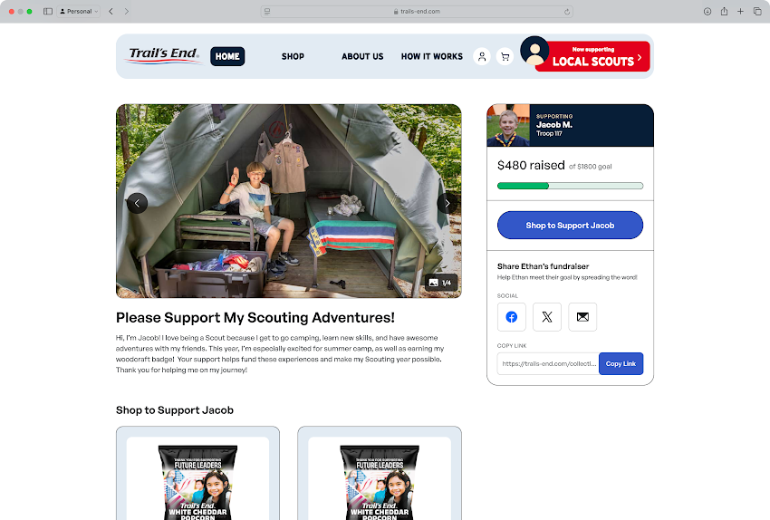
TRAIL’S END PROGRAM​ - ONLINE
Sharing is the primary action for Scouts
  Past customers
  Text
  Email
  Social
Scouts are guided to personalize their page with new empty states to help them get started
Redesigned Scout pages that:
  Emphasize the Scout and their story
  Allow consumers to share the Scout’s pages with their network
$7.49 flat rate shipping
Notes:
Becci to hand to Brian

Slide 19
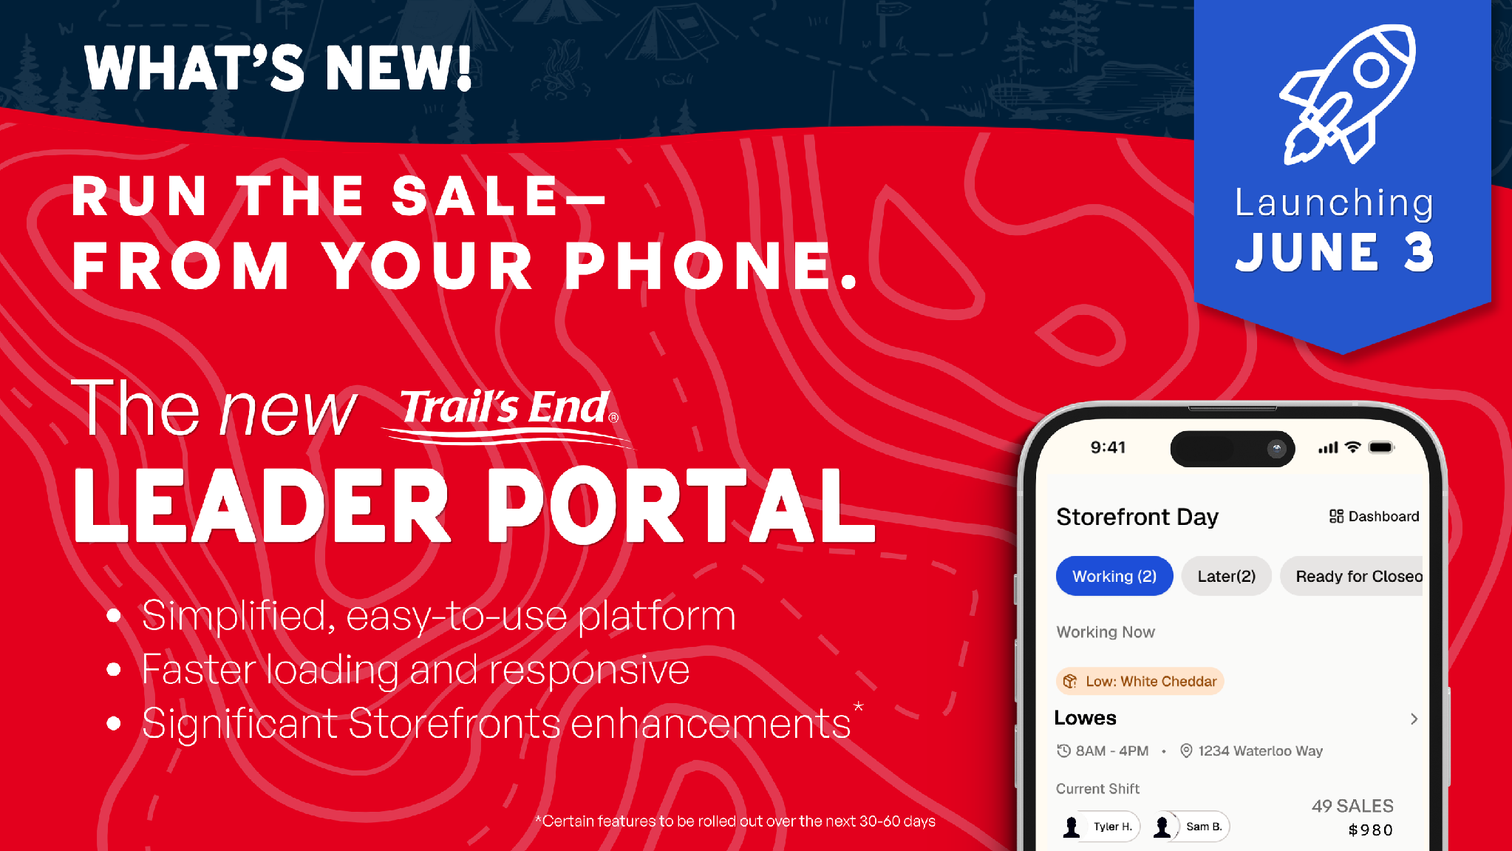

Slide 20
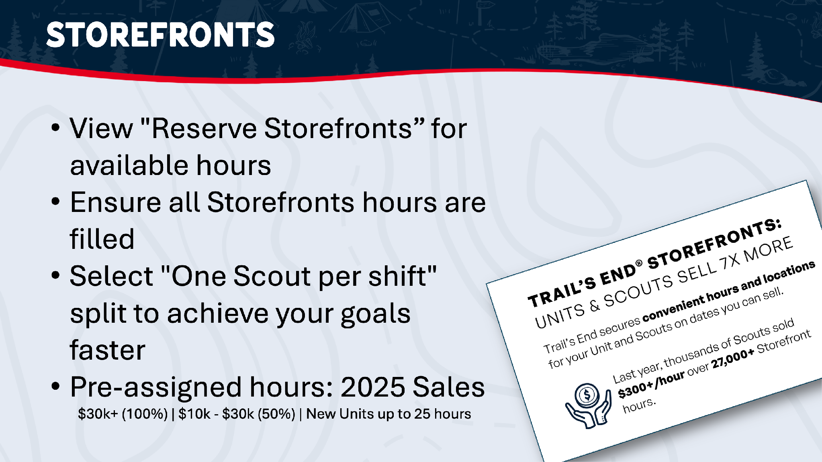

Slide 21
2026 VIP Program
Auto allocation will occur on 07.27
Manual picking begins 07.29
VIP Designation and hours are assigned based on PY Total Sales
VIP Gold -$60k+ Units
  All Hours Assigned- 1:1 Meeting with Storefront team - 50k Hours
VIP Silver -$30-60k Units
  ~100% of Hours
VIP Bronze -$10k to $30k Units
  ~50% of Hours* - 92k Hours
Notes:
Brian hand to Becci

Slide 22

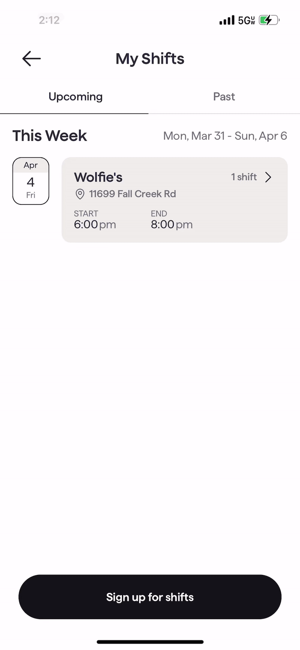

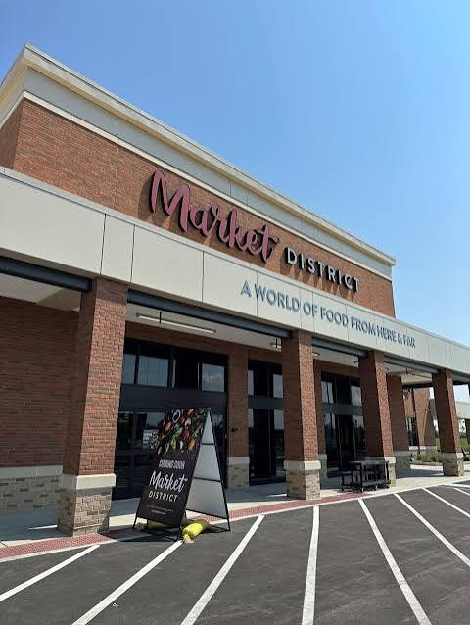

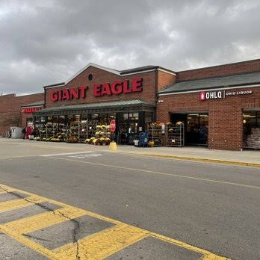


Trail’s End Storefront Sales®
Trail’s End books hours for Units
Leaders reserve in Leader Portal
Scouts sign up for shifts in App

Slide 23
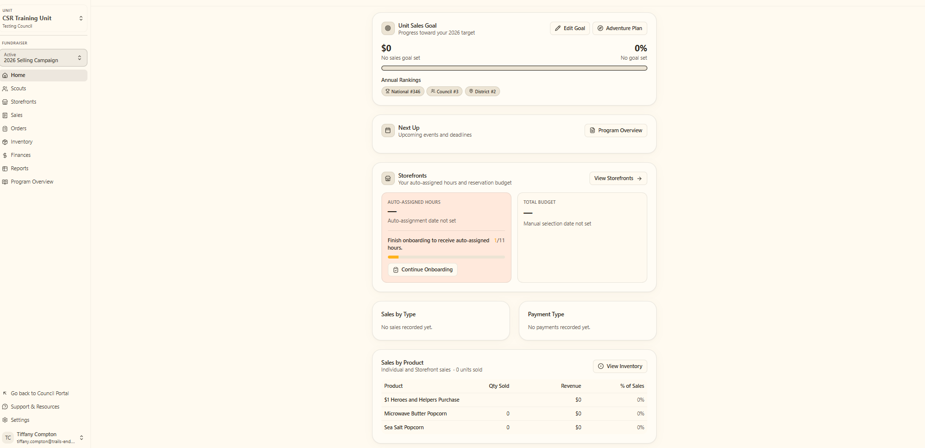
2026 Technology Update – Unit Leaders
Leaders manage entire sale in one place
Invite Scouts to register and manage Scout roster
​Easily set Unit and Scout goals
Order popcorn
Real time reporting of sales and inventory
Unit to Unit transfers; no Council assistance needed
Schedule and manage storefront sites and shifts
Overview screen with Timeline, Storefronts, Rewards, and Commissions info!

Slide 24
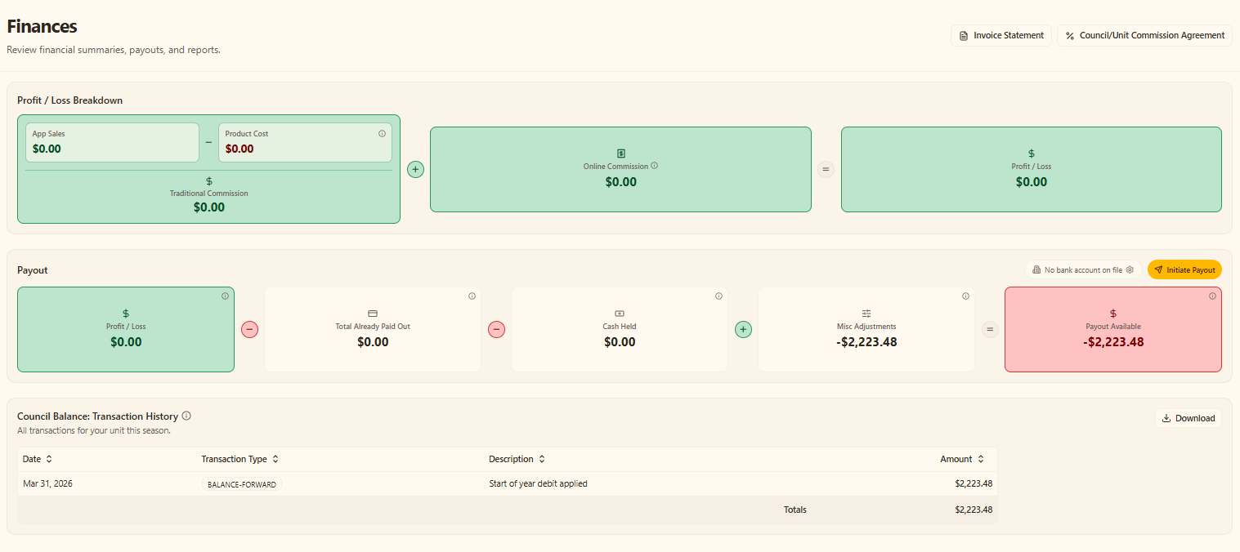
2026 Technology Update – Unit Portal
Notes:
TK – help with national data
Big Numbers with bullet points
Need to highlight – millions of Rewards ($3.3M), $ to Councils ($18.9M) and units ($11.1M)
Chance to set the direction (strategically)
Per Scout Avg.
sales per Scout hr
# of Scouts per Shift
Add payout dates for Councils and units
Unit AR as of Dec 1 or 15
Heroes & Helpers up 15% auto order
Unit ordered retail $70,611,526 + online retail $9,218,398
Product cost from Sage - $25,817,692

Slide 25
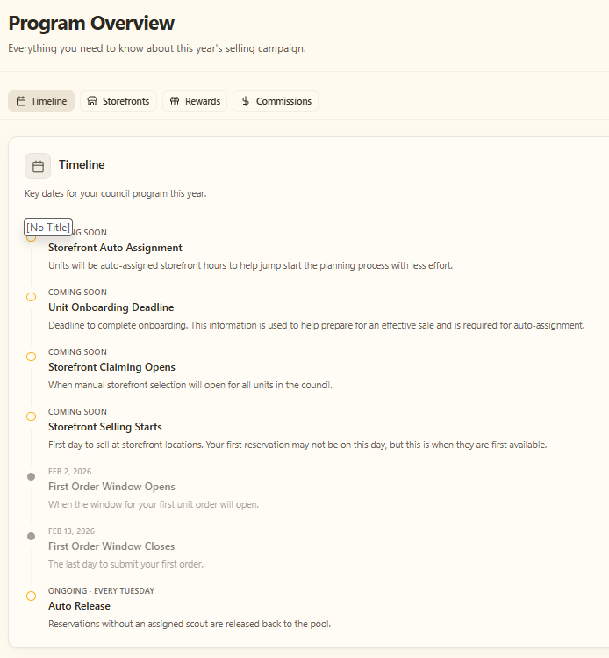
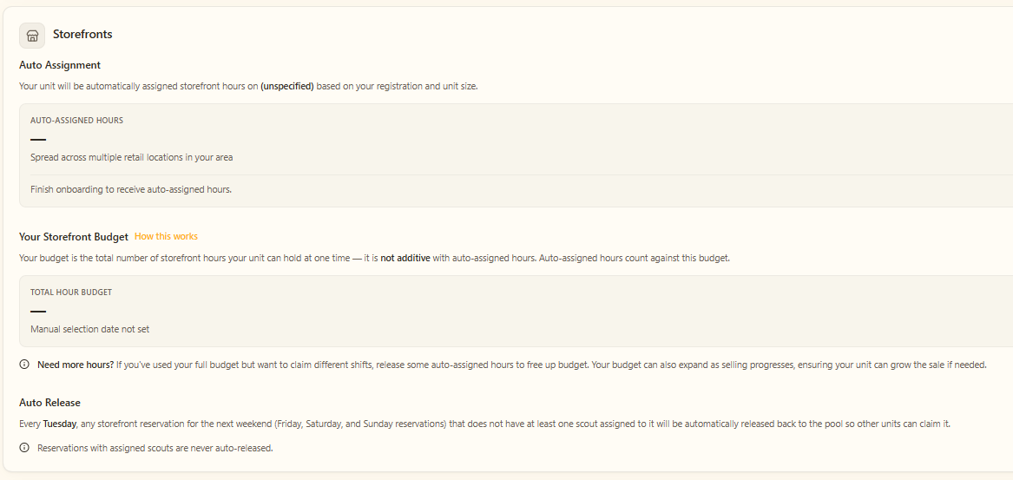
2026 Technology Update – Unit Portal
Notes:
TK – help with national data
Big Numbers with bullet points
Need to highlight – millions of Rewards ($3.3M), $ to Councils ($18.9M) and units ($11.1M)
Chance to set the direction (strategically)
Per Scout Avg.
sales per Scout hr
# of Scouts per Shift
Add payout dates for Councils and units
Unit AR as of Dec 1 or 15
Heroes & Helpers up 15% auto order
Unit ordered retail $70,611,526 + online retail $9,218,398
Product cost from Sage - $25,817,692

Slide 26
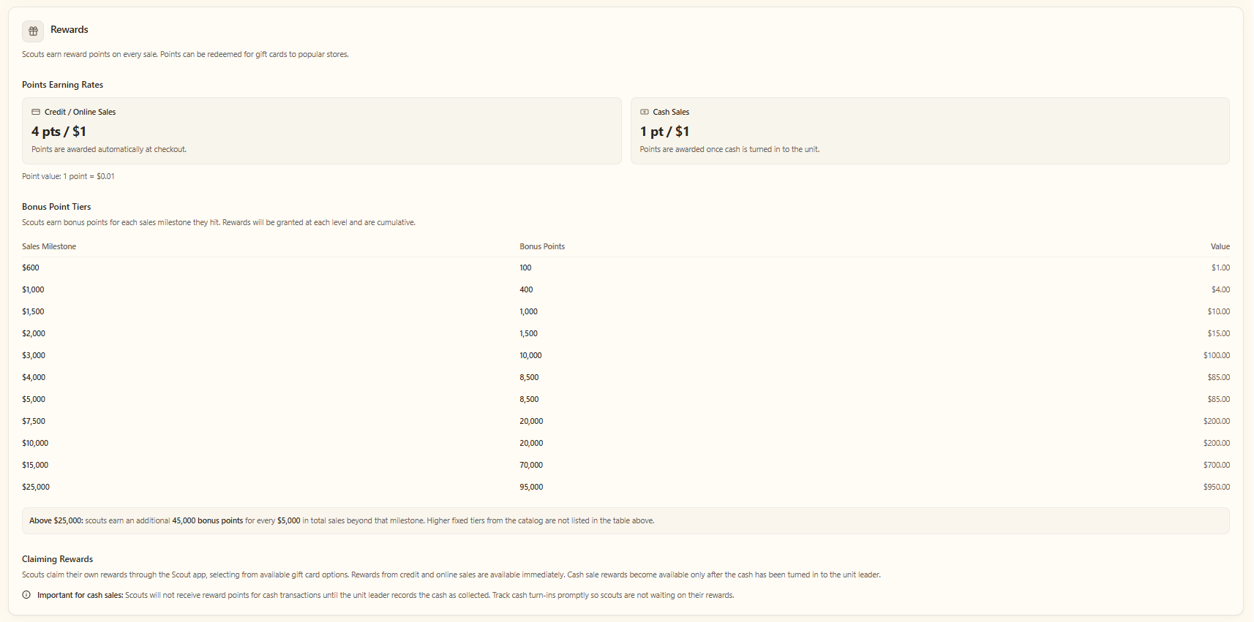
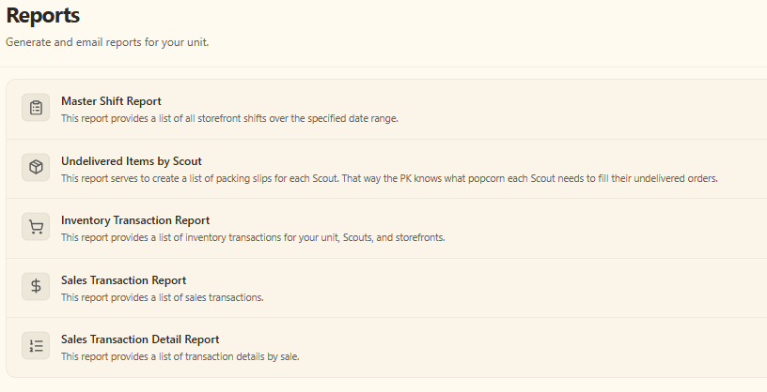
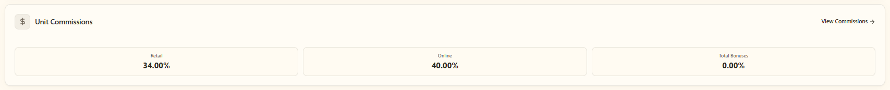
2026 Technology Update – Unit Portal
Notes:
TK – help with national data
Big Numbers with bullet points
Need to highlight – millions of Rewards ($3.3M), $ to Councils ($18.9M) and units ($11.1M)
Chance to set the direction (strategically)
Per Scout Avg.
sales per Scout hr
# of Scouts per Shift
Add payout dates for Councils and units
Unit AR as of Dec 1 or 15
Heroes & Helpers up 15% auto order
Unit ordered retail $70,611,526 + online retail $9,218,398
Product cost from Sage - $25,817,692

Slide 27



Products and Pricing
REMEMBER – YOU ARE NOT SELLING POPCORN. ANYONE CAN GO INTO A GROCERY STORE AND BUY A BAG!
Change your mindset to “$20 will be help me attend *insert adventure like Jamboree / specific summer camp!” and pick anything from the table!
Even if the customer says no, always say, “Thank you” and “Have a good day.”

Slide 28
Products and Pricing
One price – simplifies the fundraiser.
  Inventory management
  Mistakes with selling the wrong bag
Trail’s End tested this mix last year!
  $11 an hour increase
  8% more Yeses
  Scouts understand its not about the product its about ME and my Unit.
NEVER, NEVER, NEVER ask customers to buy popcorn.
It’s to support You!

Slide 29







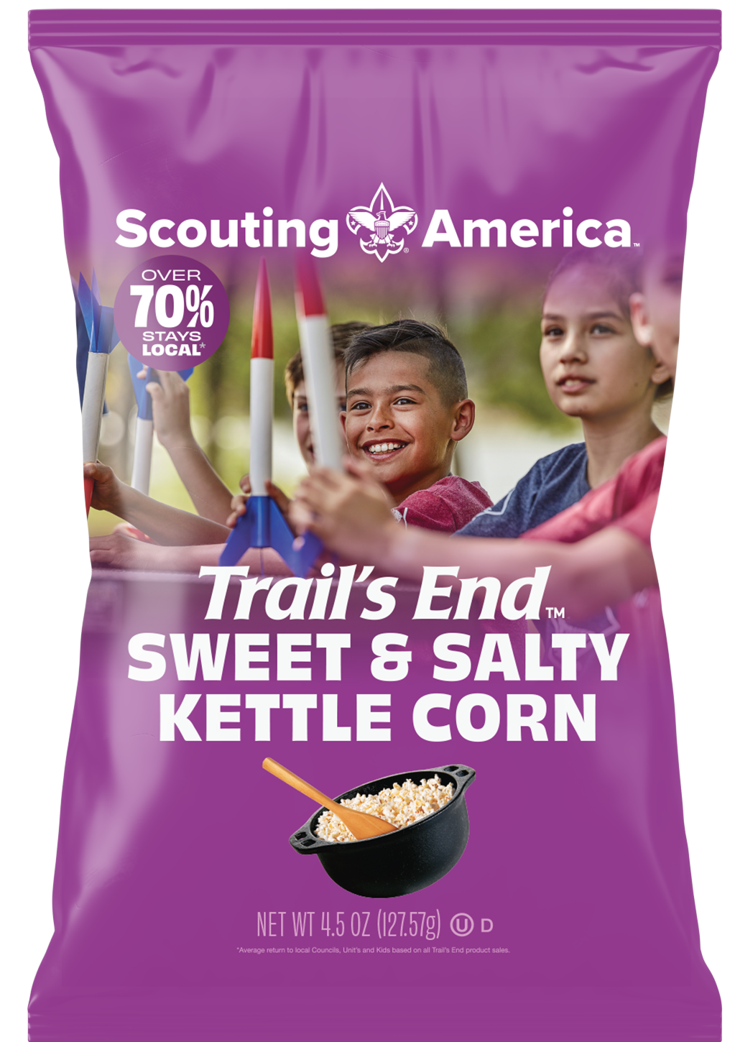





2026 Products
White Cheddar
National #1 seller
Savory and made with real cheese
16.5 cups | 6oz
Salted Carmel Corn
Rich caramel with just the right amount of salt
5 cups | 11oz
Kettle Corn
Light, crispy texture
Only 4 ingredients
7.5 cups | 4.5oz
Sea Salt
Just the right amount of salt
3 simple ingredients
12.5 cups | 5oz
Microwave Butter Popcorn
The right snack for movie night
12 microwave bags
Chocolatey Pretzels
Crisp airy pretzels in a creamy chocolatey coating
12oz

Slide 30
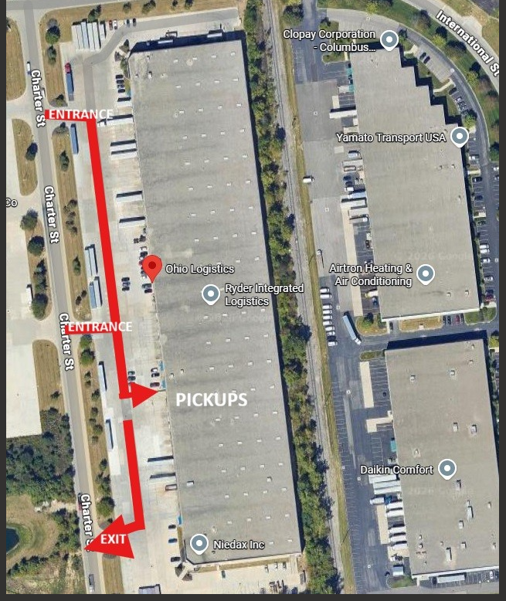
Hilliard, OH.
Hilliard
Weekly Pickups All Products READY TO GO !
Unit Order is in by Sunday Night
Sign up Genius for slots
Pickup ready Thursday from 1 to 6pm
Warehouse Location: Hillard @ Ohio Logistics

Slide 31
Popcorn Campaign Key Dates
Quick-reference schedule
Use this slide as the simple “what’s due and when” view for unit leaders.
Unit Onboarding Completed By
Auto Assignment of Show & Sell Sites
Manual Picking of Available Show & Sell Sites
Show & Sell Orders Due
Wednesday, July 23rd
Monday, July 27th
Wednesday, July 29th
Sunday, August 9 • 11:00 PM
Show & Sell Distribution
Final Orders Due
Take Order Distribution
Prize Orders Due / Final Invoices Paid
Thursday, August 20 • 1:00–6:00 PM
Sunday, November 15th
Thursday, Nov. 19 & Friday, Nov. 20
Tuesday, December 8th
Specifics vary by District. See weekly pick-up schedule.
Specifics vary by District.
Last day to place prize orders and pay final invoices in full.
Return Policy
Trails End Return Policy: 10% of app sales returned on 10/29, full cases only (cases can be re-packed and taped including same product only), no returns on chocolate product
Notes:
No external sources used. Schedule content supplied by user.

Slide 32
Weekly Pick-Up Schedule
Unit orders due → unit pick-up date
Read left to right: Unit orders must be submitted by the date in the first column for pick-up on the date in the second column.
Orders Due By
Pick Up
Notes
Orders Due By
Pick Up
Notes
August 23
August 27
October 11
October 15
August 30
September 3
October 18
October 22
September 6
September 10
October 25
October 29
Returns accepted. No chocolate.
September 13
September 17
November 1
November 5
Returns accepted. No chocolate.
September 20
September 24
November 8
November 12
September 27
October 1
First order with chocolate available
November 15
November 19
October 4
October 8
Reminder: Specific pick-up details may vary by District. Confirm local instructions before distribution day.
Notes:
No external sources used. Schedule content supplied by user.

Slide 33


Slide 34


Slide 35
Thank you!

